Slide 1
Publics/Counter Publics
Pub 101
Week Four: January 30, 2024

Slide 2
Check in
Top Social Media Stories on the Week
Questions and Comments
Activity
Lecture
Activity
Recap

Slide 3
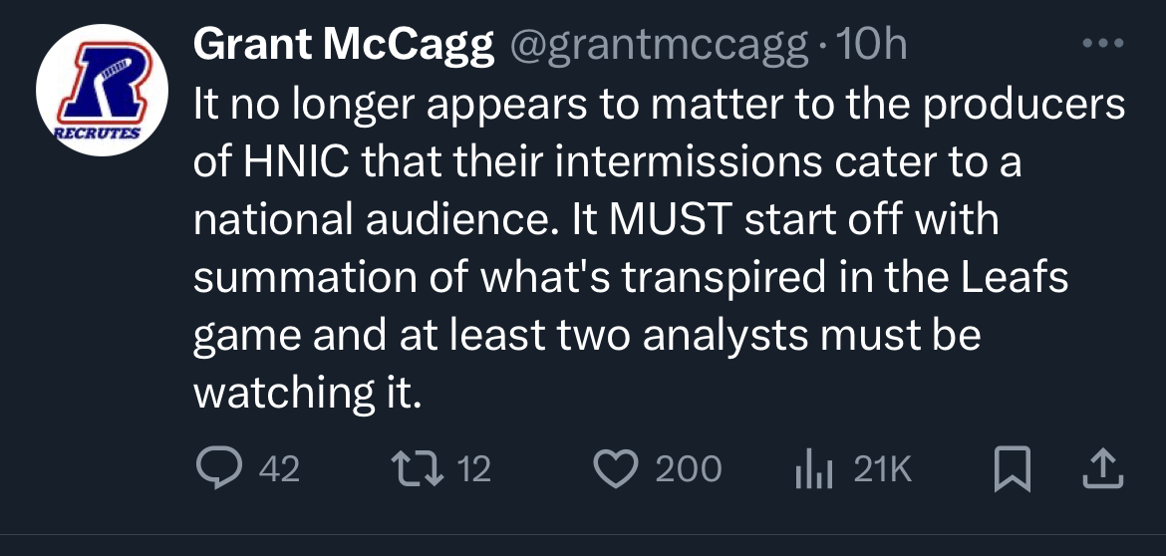
This Week in Socials

Slide 4
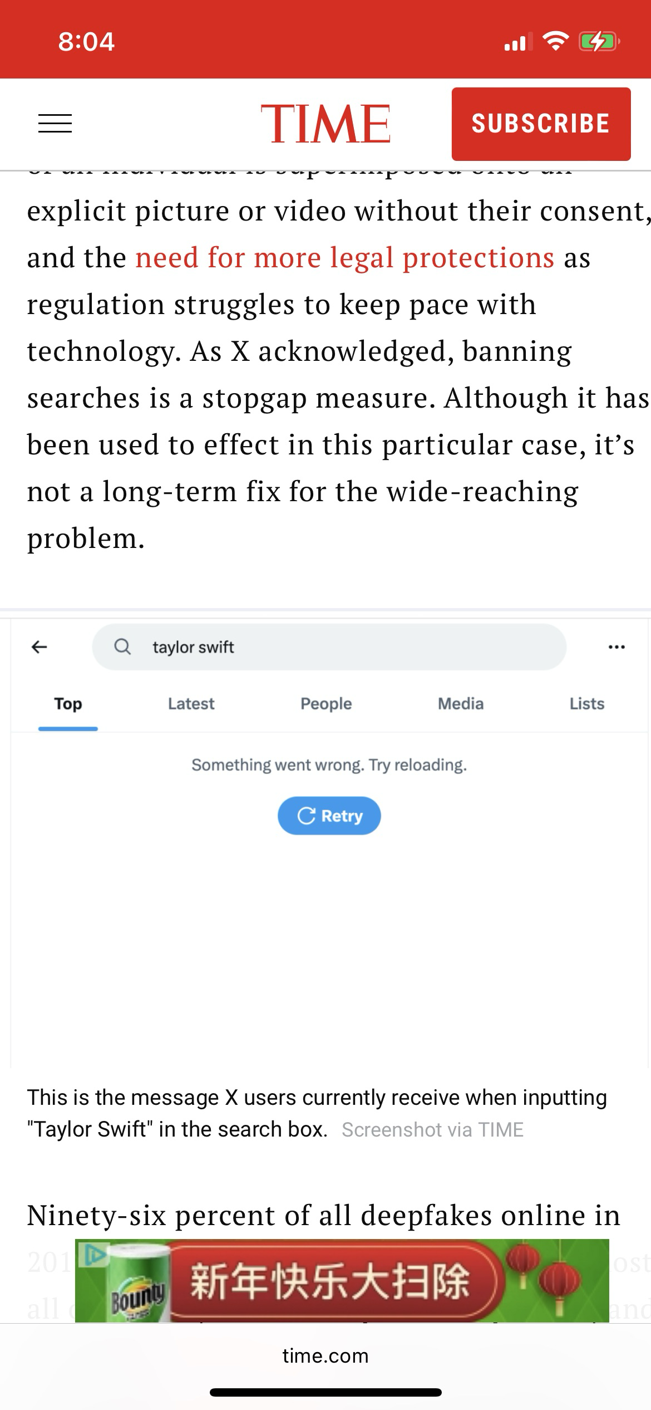
If X can create this stop-gap why is can we not stop other mis- and dis-information

Slide 5
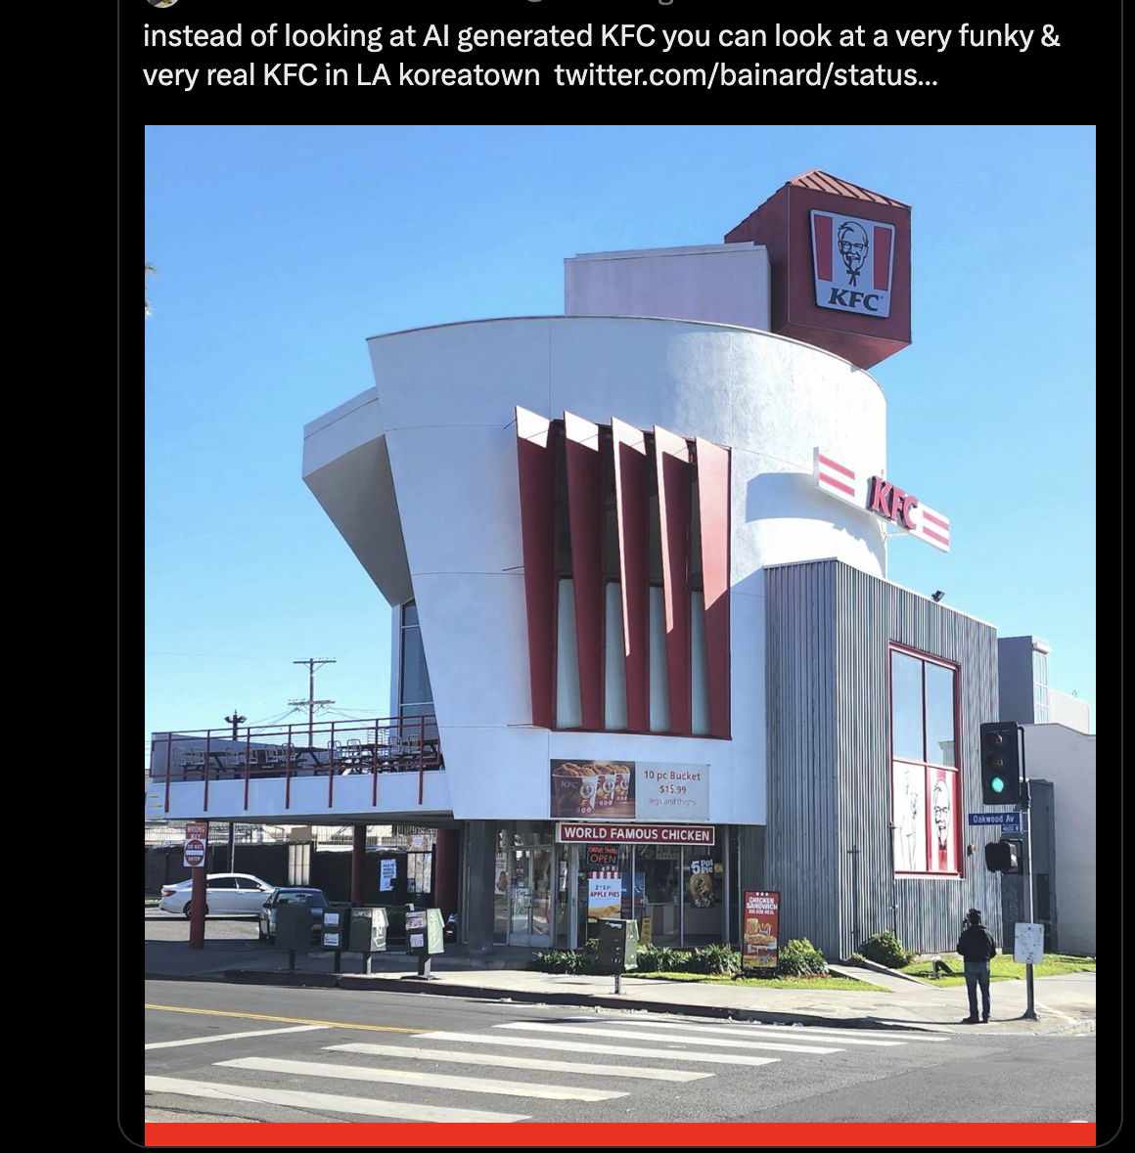
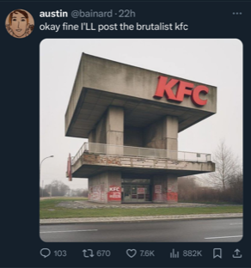
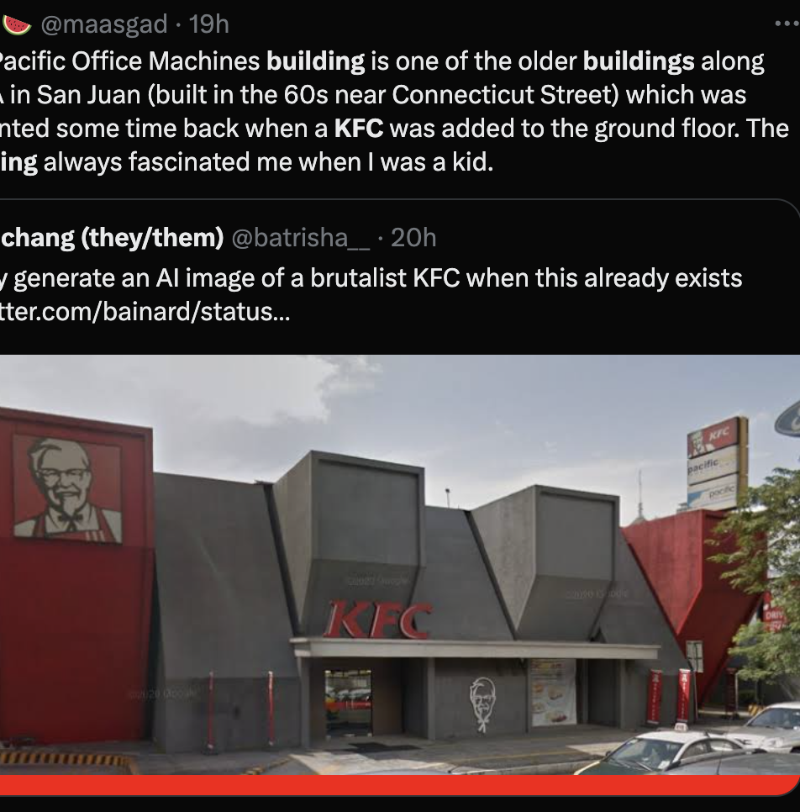
KFC Buildings

Slide 6
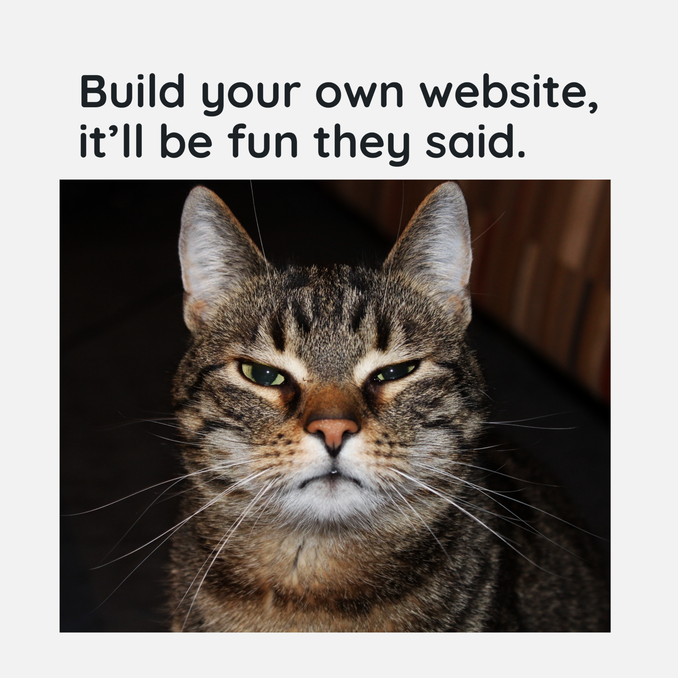

Slide 7
Student Examples
https://happyvibes.space/process-posts/process-post-3-mapping-out-my-site/
Erika
https://ashapannu.com/
Asha
https://joiemarin.com/process-post-3-mapping-it-all-out/
Joie
https://onebadmedia.com/onebadmedia/gaming/pal-world-pokemons-with-guns/
Allen
Notes:
Pal World - Talk on social that the characters are very similar to pokemon. But they are not. Since poke has 1000 + characters, why can’t they try.

Slide 8
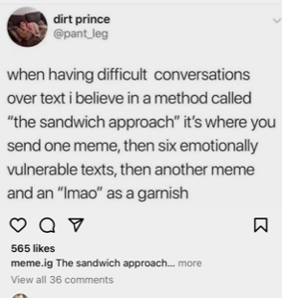
What would you call this – thinking of Suler’s traits?

Slide 9
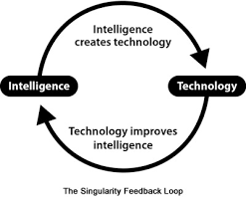
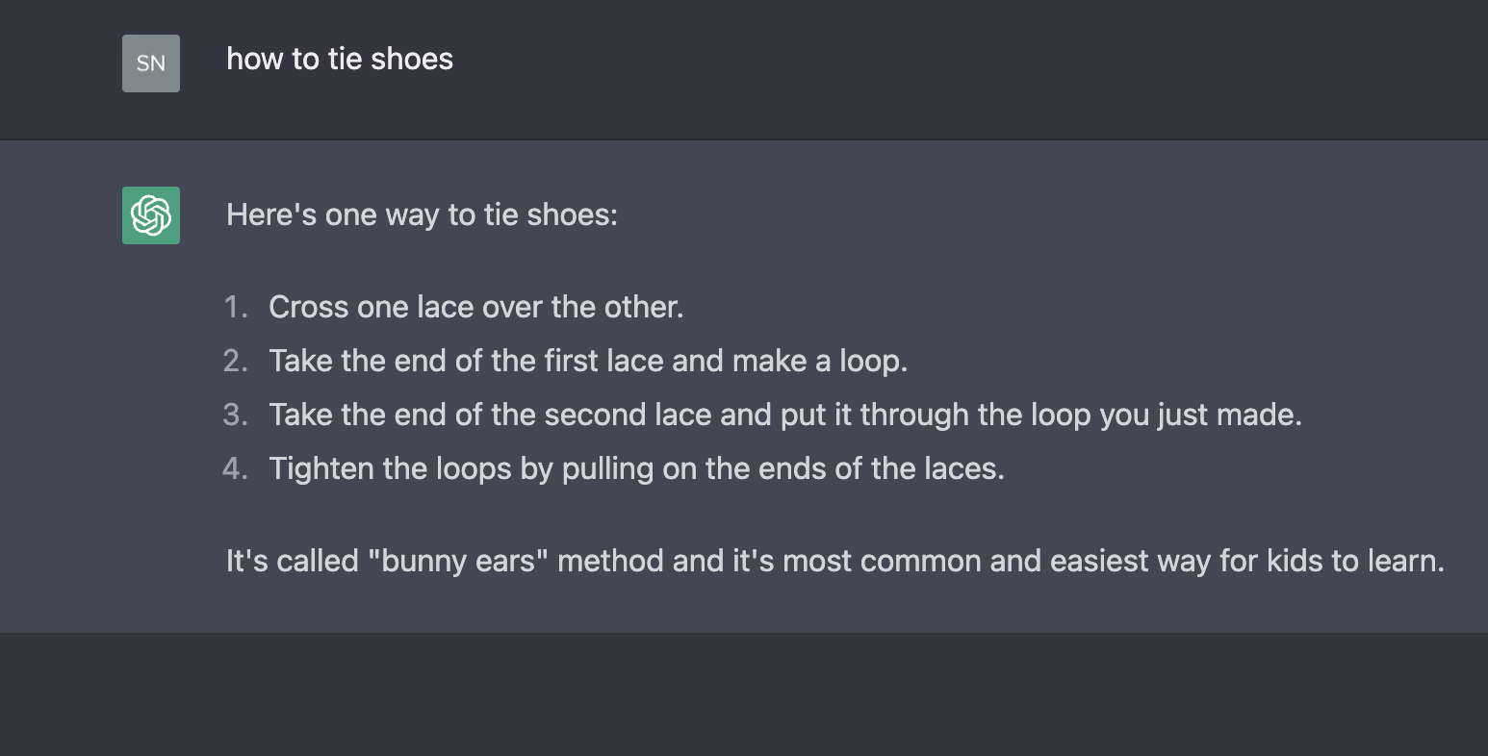
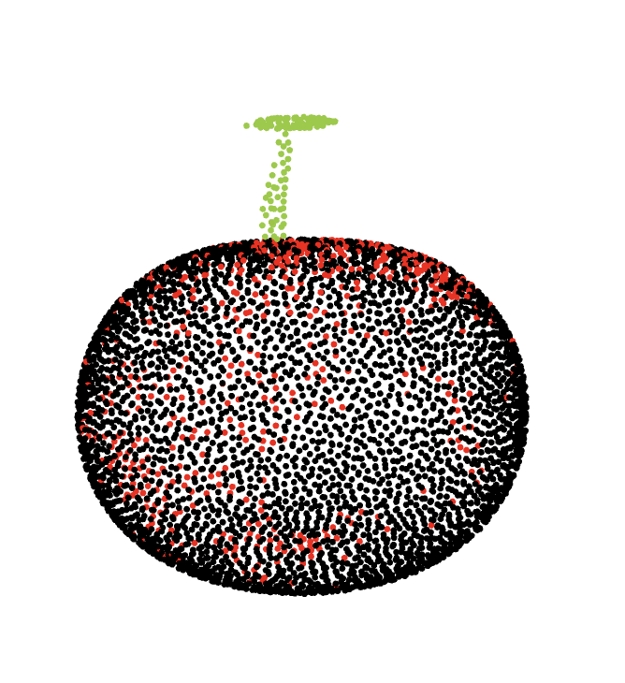
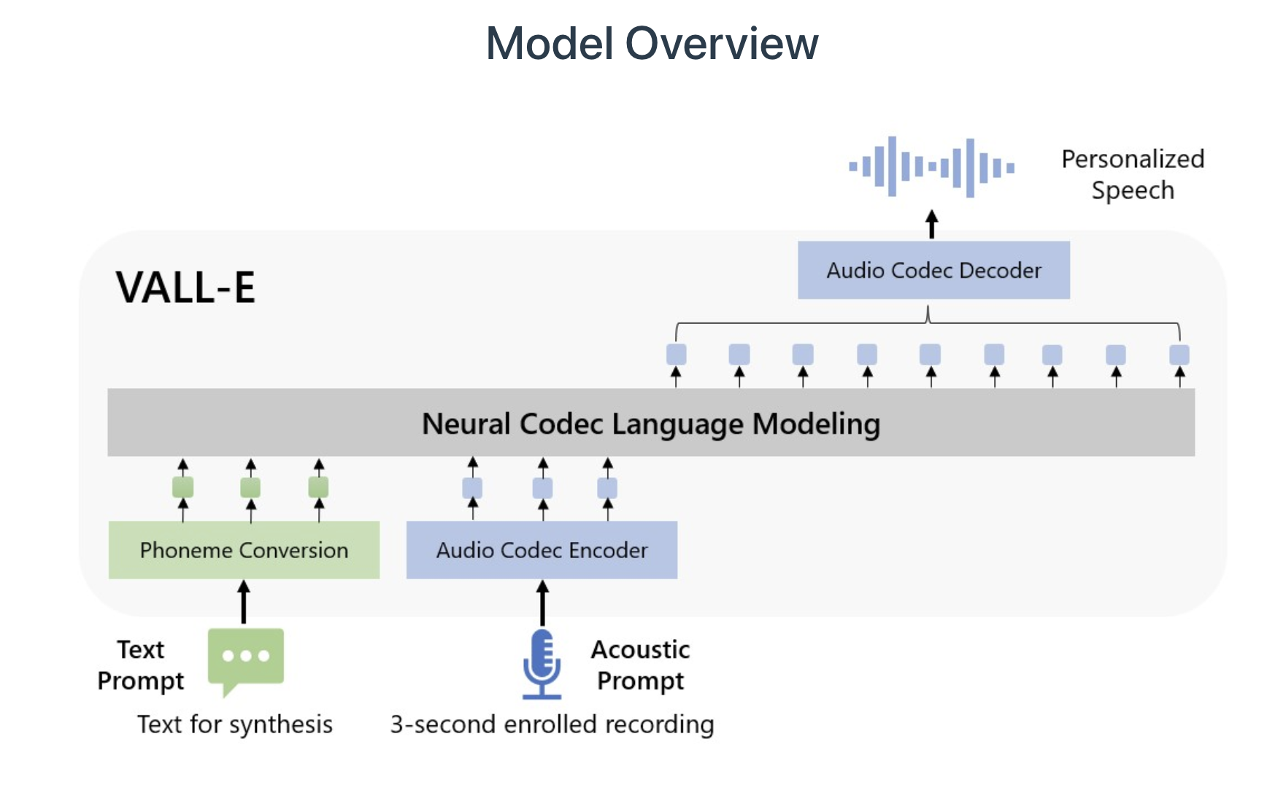
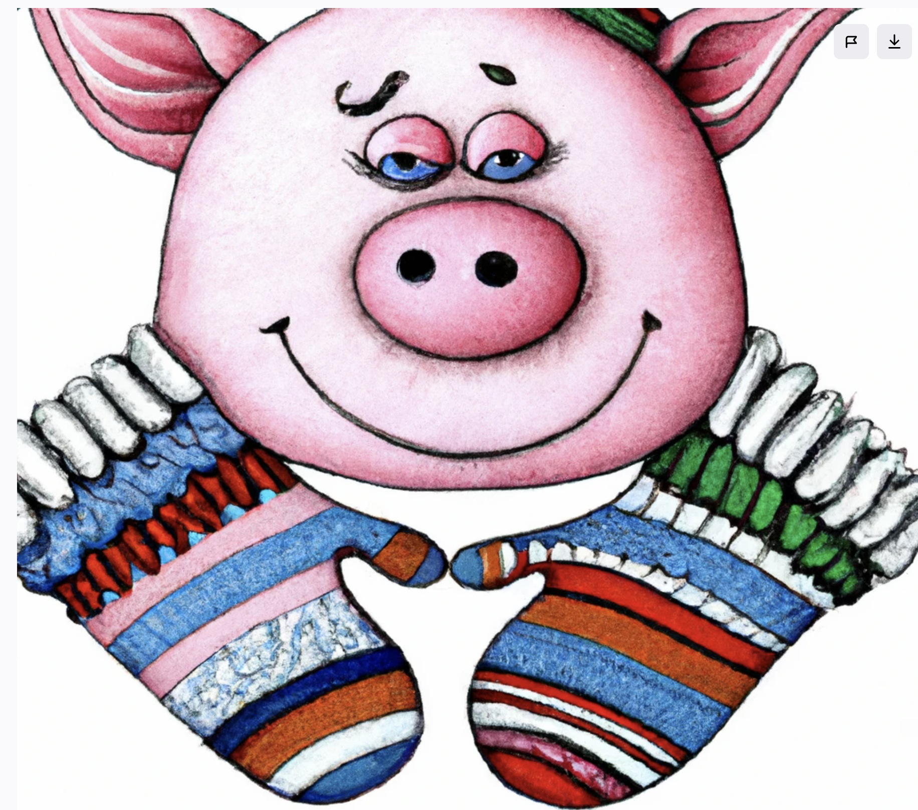
AI Recap from last week
Singularity?
ChatGPT4 + DALL-E = ??
ChatGPT?
Point-E?
VALL-E?
DALL-E?
Notes:
When is it in the public interest to draw attention to an issue?
it appears that YouTube plans to incorporate ads into Shorts, allowing creators to monetize their short-form content. This move also opens monetization opportunities to a wider group of YouTubers, including those with fewer than 1,000 subscribers and less than 4,000 hours of watch time (the current thresholds needed to qualify for monetization on normal YouTube videos).
This will allow creators to make money from ads that run between videos in the Shorts feed.
YouTube will add the revenue generated from ads in the Shorts feed and pay out a share to creators at the end of the month.
Singularity: Singularity is the notion that the exponential acceleration of technological development will lead to a situation where artificial intelligence supersedes human intelligence and will eventually escape our control.
NyQuil chicken appears to have originated on 4Chan in 2017 and earlier this year made the rounds in the news cycle.

Slide 10
Kahoot!
Notes:
A Public
The Public of Belgium
The public but also a public within genres or one podcast
A public, but also a public of NHL games in general
The public

Slide 11
Where do you belong?
Take 5 minutes and think about the groups or places you engage with.
Write down your top three.
In groups of three discuss: What is the key aspect that makes each your top three?
One person report back to the main group.
Notes:
What are three aspects that make them your top three?
How do you refer to your groups?
Are they friends?
What do you have in common?

Slide 12
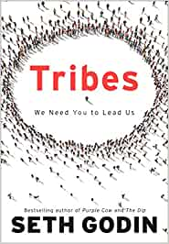
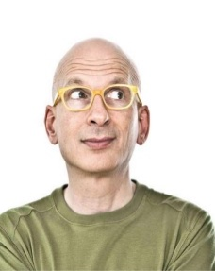
To belong
“We all have a basic need to connect with other human beings. Making friends, connecting with others, sharing experiences, keeping up with popular culture, and keeping up with current trends and developments in your community all are ways and reasons for connecting with other people.” ~Seth Godin
”…a group of people connected to one another, connected to a leader and connected to an idea”
Notes:
When you connect with others in a fashion that allows you to develop a relationship that is especially useful, these long-term connections can be very helpful in guiding you through your life, as well as aid you in feeling happy.
When you talked to a stranger some felt awkward. Some felt relief that it wasn’t as bad as they feared. Someone mentioned a “common world view” was a key part of making talking to a stranger worthwhile.
What is an Audience?
What is a Group?

Slide 13
Publics and Counterpublics

Slide 14
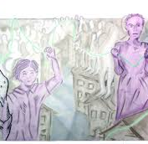
Jürgen Habermas
“The Structural Transformation of the Public Sphere”
From: “Representational” culture, where one party sought to "represent" itself on its audience by overwhelming its subjects, generally by the state, the king or the church.
To: Self-organizing and Self-determining.
Notes:
The Public Sphere is a domain of our lives in which public opinion is shaped.
A public is constituted through mere attention

Slide 15
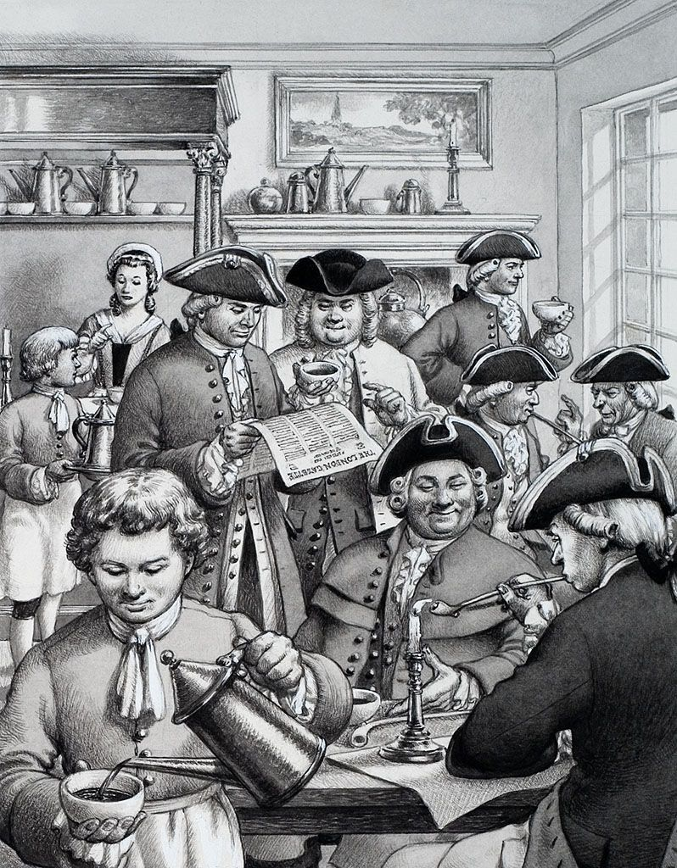
Who is missing from this happy little coffee shop conversation?
Notes:
during the renaissance (the 18th century) when European cities started to have a literate, educated middle ("bourgeois") class that actively discussed things.
Who is missing from this happy coffee shop conversation? While they may be self represented and self organizing this is still exclusionary

Slide 16
What is a Public?
Matthew Stadler defined it as the Production of a Public.
A definition which shifts the normal industrial emphasis on the manufacturing & distribution aspect to the idea of publication as a social and political act.
Publication as the creation of a public or social action
Notes:
Remember – by merely paying attention we are part of a public
Industrial period: Things were manufactured and and distributed to a public.
Once something is published it creates its own public or social action

Slide 17
The ‘public’ according to Warner, is
…self-organized,
a relation between strangers,
characterized by a mode of speech that is both personal and impersonal
constituted through mere attention
the social space created by the reflexive circulation of discourse
shaped by the temporality of the its circulation
This would suggest that any media that incites social interaction
between others could have its own public.
Notes:
If this is the case, what is the difference between a public of a medium and a community relating to said medium?
Facebook
/ Internet/Facebook groups

Slide 18
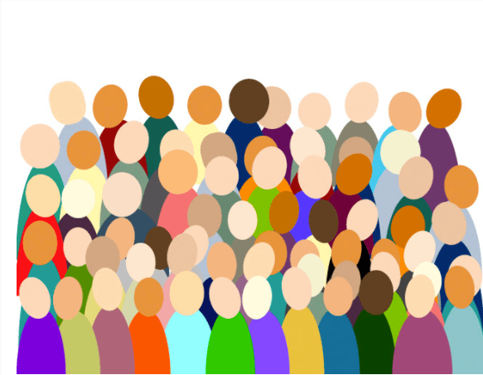
Publics
“…when a form of discourse is not addressing an institutional or subcultural audience, such as members of a profession, its audience can understand itself not just as a public but as the public.”
~ Hans Haacke
Notes:
Lawyer’s association speeches
I was at digital book world. Those in attendance would be a public of DBW but also the public
Pub 101 – the or a?
Warner: Without any institutional being, publics commence with the moment of attention. When attention is no longer being paid, the public ceases. They exist only by active participation rather than by ascriptive belonging.

Slide 19
Publics
“A public can also be … a concrete audience, a crowd witnessing itself in visible space, as with a theatrical public.”
Also has a sense of totality, bounded by the event or by the shared physical space. Ex. Performer on stage – knows where their public is, how big it is, where its boundaries are, and the time of its common existence.
~ Hans Haacke
Notes:
Warner: Public discourse isn’t necessarily argument and debate and deliberation, but circulation of discourse – whether or not it is successful is how how public arguments recreate that social world.

Slide 20
Publics
“Another form of public comes into being only in relation to texts and their circulation.
“Without the idea of texts that can be picked up at different times and in different places by otherwise unrelated people, we would not imagine a public as an entity that embraces all the users of that text, whoever they might be.”
~ Hans Haacke
Notes:
Think of The Handmaids Tale.
This doesn’t need to be books, it can be ads
And this extends to blogs or the public that finds a site independently of others.
A YouTuber – some of those influencers you named. There was a commonality that brought you all together.

Slide 21
A or The?
Pub 101?
People who live in Belgium
Listeners of podcasts?
Montreal Canadiens hockey game?
Kids getting treats from the ice cream truck?
Notes:
101 has its own public – A public of 101 but we are also part of THE public. Just for a while in a physical sense we are A public in a room. But all those who have taken the course are A public of 101.

Slide 22
A Modern Public Sphere then…
“…is a domain of our social life in which such a thing as public opinion can be formed.”
Source: Dajah Black
Notes:
Examples:
Classrooms
Forums
Council meetings

Slide 23
BREAK

Slide 24
One big public sphere?
Or many?
Overlapping
Competing
Power differentials
Alternate goals

Slide 25
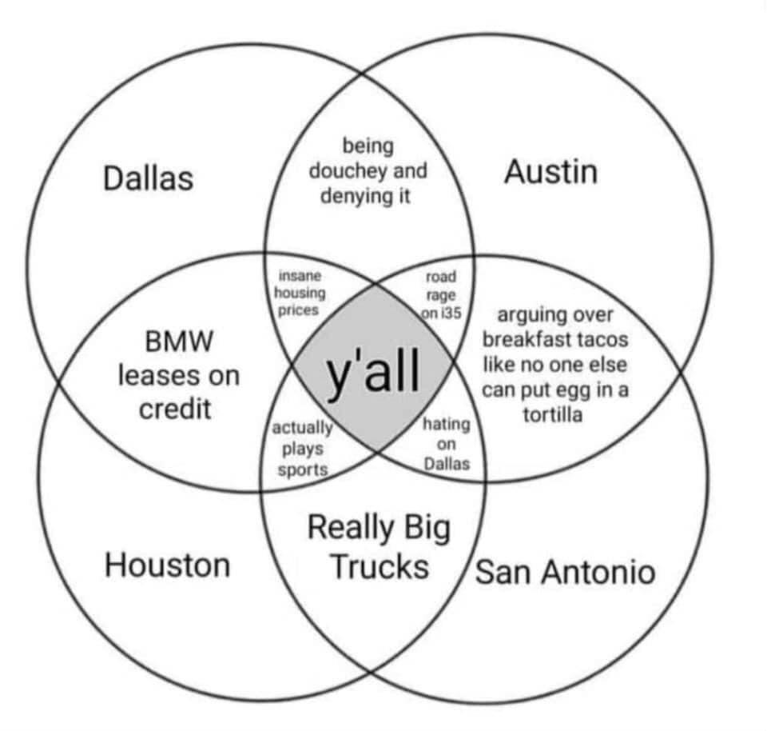
Nancy Fraser
There isn't ONE big comprehensive public, with a great lot of jolly chaps all intellectually sparring together.
Rather, the modern world is composed of a lot of (multiple) different public spheres. They overlap, like a big complicated Venn diagram.
Notes:
There isn't ONE big comprehensive public, rather, the modern world is composed of a lot of different public spheres. They overlap, like a big complicated Venn diagram.
https://prezi.com/bah_9nato_yu/publics-and-counterpublics/

Slide 26
Multiplicity…
Arenas that develop in parallel to or subordinate to public arenas and
“…where members of subordinated social groups invent and circulate counter discourses to formulate oppositional interpretations of their identities, interests, and needs.” (Fraser, 1990, p.67)
Notes:
These publics don’t just sit side by side – they are very intentionally organized and developed from a larger public from which possible members are excluded.
Exercise in determining counterpublics

Slide 27
Multiplicity Counterpublics
"As conceptual models of the public sphere have moved toward multiplicity, "counterpublic" has emerged as a critical term to signify that some publics develop not simply as one among a constellation of discursive entities, but as explicitly articulated alternatives to wider publics that exclude the interests of potential participants.”
~ Robert Asen, "Seeking the 'Counter' in Counterpublics".
Source: Dajah Black
Notes:
You may belong to a public but it is not everything you want or it ignores some of your main concerns. You splinter into what we can call counterpublics. You still hold the ideals of the public, but not entirely. The Y’all example
People in a counter-public may have originally been part of a public and rebelled against it. Creating a counter public through the act of rebelling.
What would be a good example from the #BLM movement?

Slide 28
As groups constitute themselves as counterpublics, they form an understanding of their identity, interests, and needs that symbolically rejects the dominant public’s description of them.
Some examples:
Feminist groups
Religious factions
Minority groups/institutions (Black churches)
English speakers in France
Sharing Common Understanding of Identity, Interests, and Needs
Notes:
A counterpublic maintains at some level, conscious or not, an awareness of its subordinate status.
Warner: Like general publics it is addressed to strangers, but not just any strangers – counterpublics are addressed to people marked by their participation in this kind of discourse; ordinary people are presumed to not want to be mistaken for the kind of person would participate in this kind of talk or be present in this kind of scene.

Slide 29
What do Counterpublics do?
Develop alternative norms for public argument
Engage in argument in political & political spheres
Enact identities through new styles
They can be Weak (conversations) or Strong (action-based)
Formulate oppositional interpretations (identities, interests, needs) by creating a new language
~Josie Madden
Notes:
Challenges to the common or dominant discourse
We are related to them as transient participants in common publics
“public opinion” in the United States could never easily be identified with the “public good,” but was always open to multiple sub- and non-public (private, corporate, technological, etc.) influences.
Publics can be classified as weak, strong, hybrid, networked etc.
Weak publics are those on which only public opinion is formed through discussion – no action is taken
Friends gathering, bookclubs, social events
Strong publics are those in which the conversation and discourse result in BOTH opinion formation and decision making
Advocacy Groups, Subcommittes of executive boards.

Slide 30
Notes:
https://prezi.com/bah_9nato_yu/publics-and-counterpublics/
Dajah Black

Slide 31
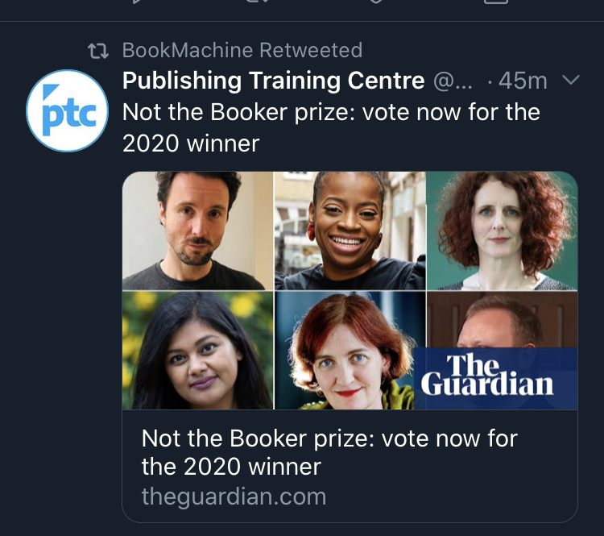
What is this all about?
Notes:
The Booker is a mainstream publishing award
What is this?

Slide 32
Exercise: Groups of 2/3
Name at least one counterpublic within the following publics:
Fashion
Cooking
Sports
Writing
Religion
Notes:
If time: Tell the class some of the counterpublics you’ve come up with

Slide 33
Leading a public could give us a strong sense of belonging and purpose.
However, how do we know where the line is between a rational movement and a destructive faction?
Is the social left one big public or are there counterpublics? What are they?
Is the political right one big public or are there counterpublics? What are they?

Slide 34
Publics or Counterpublics
“Tribes”
Notes:
And we circle back to the idea of Tribes.
Remember Godin’s definition? “A tribe is a group of people connected to one another and connected to a leader and connected to an idea”

Slide 35
Publics or Counterpublics Tribes
Leading a public could give us a strong sense of belonging and purpose.
“We all have a basic need to connect with other human beings. Making friends, connecting with others, sharing experiences, keeping up with popular culture, and keeping up with current trends and developments in your community all are ways and reasons for connecting with other people.”
~Seth Godin

Slide 36
Identifying Your Public/Tribe/ Audience/Community
What is a public you lead or participate in?
What unique value do you provide to this audience? Is this needed or wanted?
Does your community already exist?
What is the tribe you envision for your own public self?
Notes:
Think Back to the exercise earlier in lecture with your top three groups.
Activity (10 mins)
What are some of your counterpublics?
How have there developed? Are they active (weak or strong)
Discuss with a partner
Is there a tribe in there?

Slide 37
What are Publics and Counterpublics?
Head to menti.com

Slide 38
Counterpublics
"As conceptual models of the public sphere have moved toward multiplicity, "counterpublic" has emerged as a critical term to signify that some publics develop not simply as one among a constellation of discursive entities, but as explicitly articulated alternatives to wider publics that exclude the interests of potential participants.”
Source: Robert Asen, "Seeking the 'Counter' in Counterpublics"
To Recap:
Notes:
These publics don’t just sit side by side
Some publics are purposely separate and not a counterpublic but individual and explicit publics
New Publics – they are very intentionally organized and developed from a larger public from which possible members are excluded.
People in a counterpublic may have originally been part of a public and rebelled against it. Creating a counterpublic through the act of rebelling.
What would be a good example from the #BLM movement?

Slide 39
Thought Homework
What is your vision of your public?
What is it?
What are some of your counterpublics?
How have they developed? Are they active (weak or strong)
Notes:
Think back to the groups in which you have found commonalities and inclusion. What were some of the reasons you felt included. Can you apply some of those aspects to your own tribe?

