Slide 1

Copyright
PUB 101|Week Eight March 5, 2024

Slide 2

Today’s Agenda
Check-in
Today in Socials
Copyright lecture
Break
AI Activity
FEEDBACK
WEBSITE CRITIQUE
KATELYN PRESENTATION

Slide 3
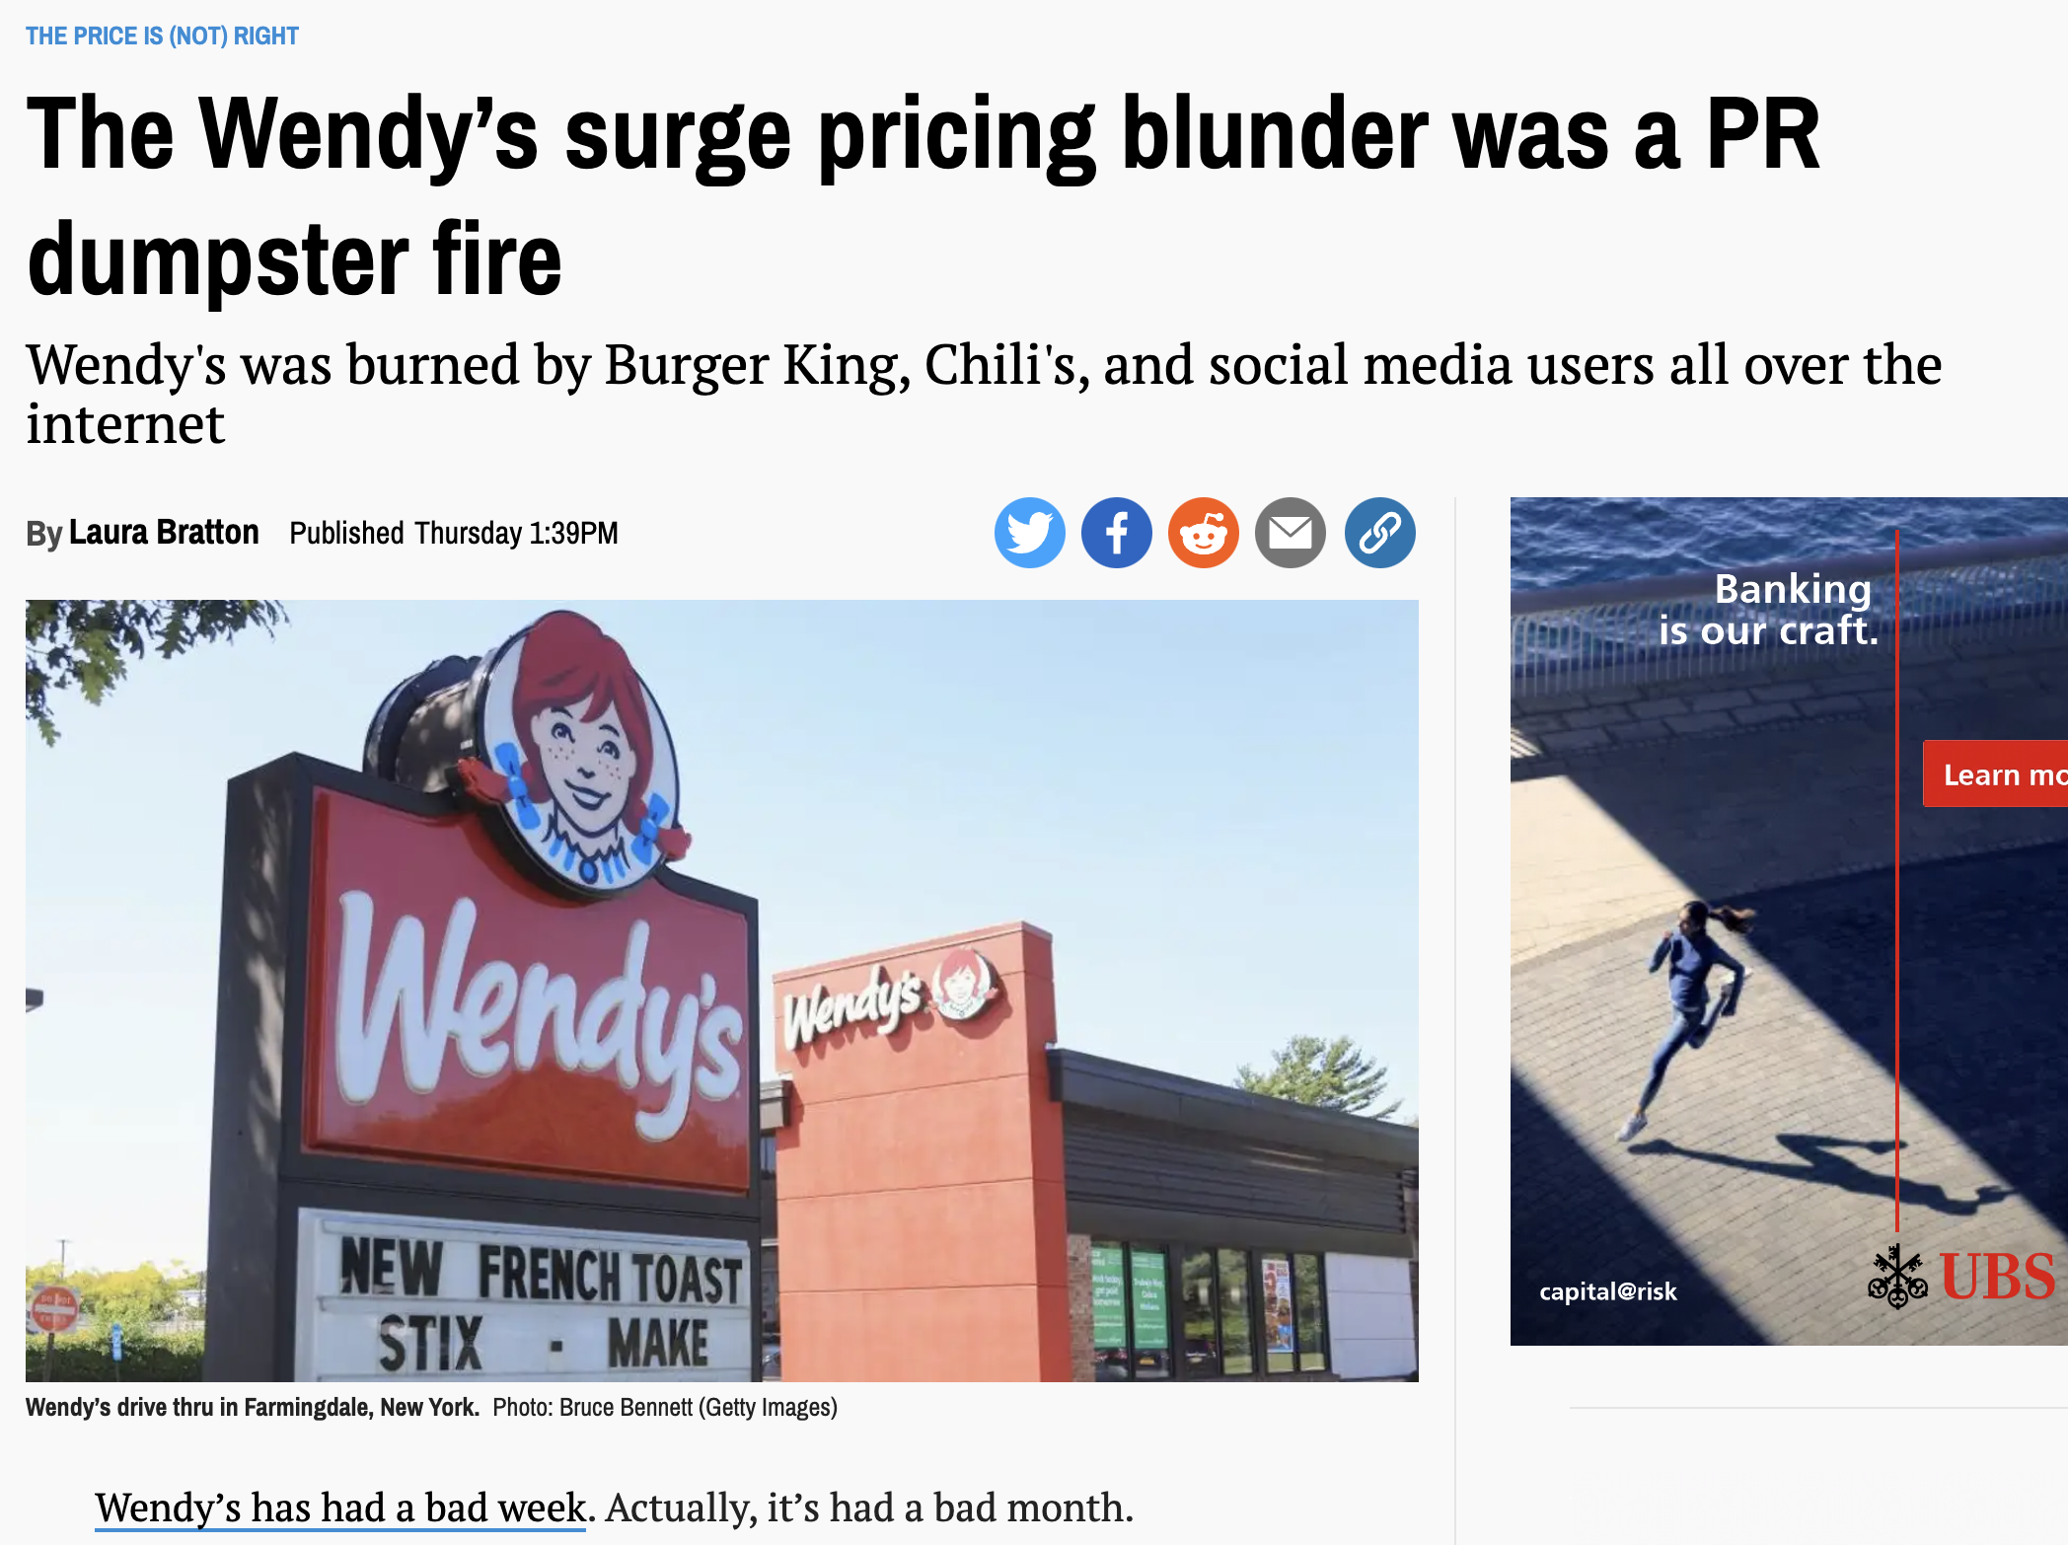
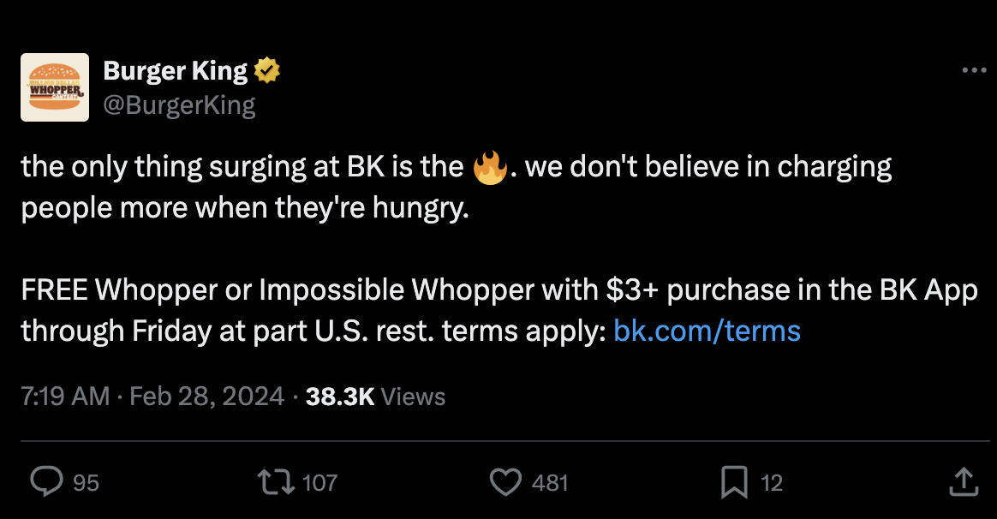
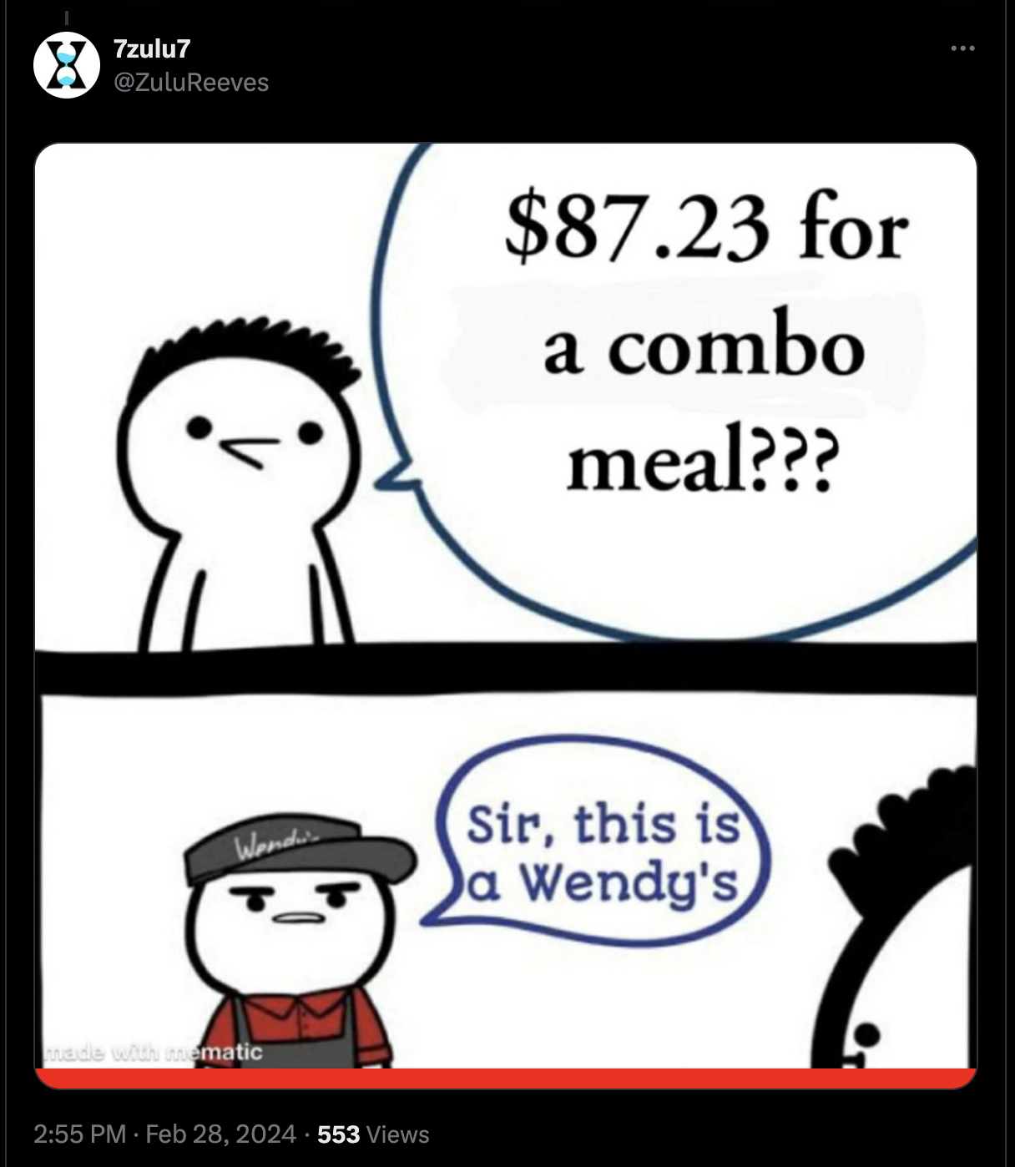
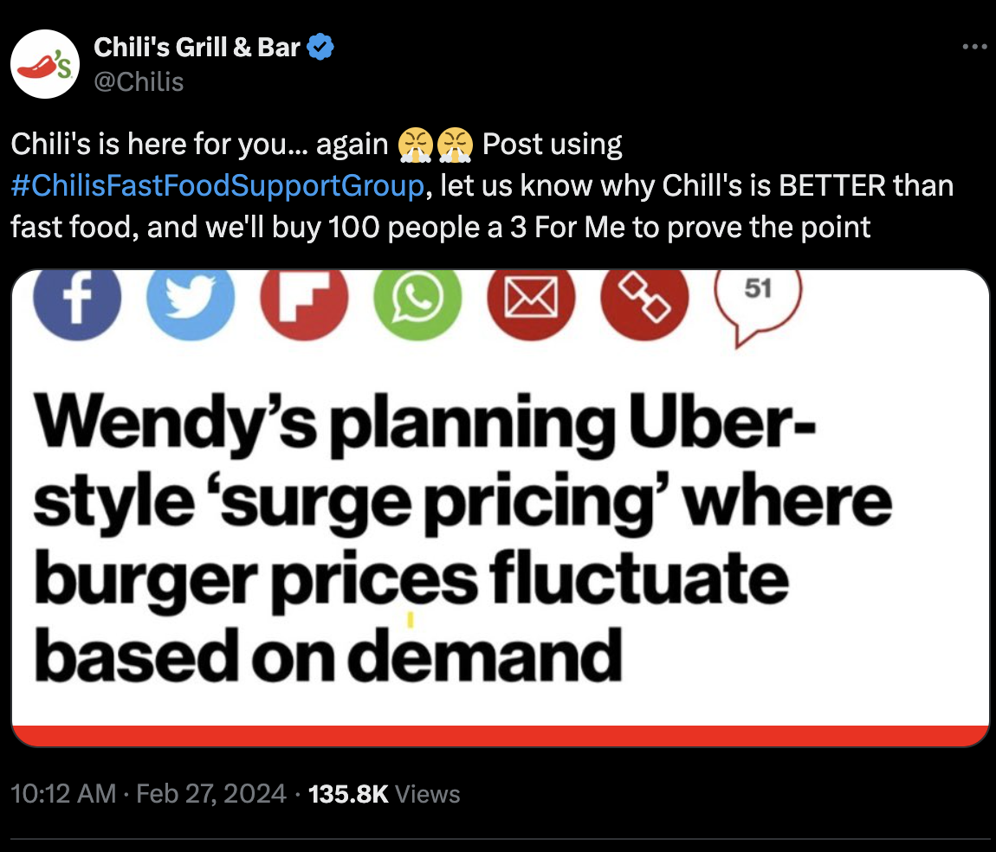
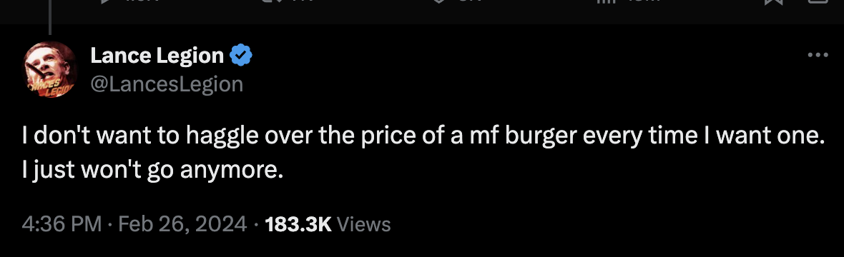
Notes:
Then came a flurry of media attention centered on a single comment made by CEO Kirk Tanner during Wendy’s earnings call with investors. “Beginning as early as 2025, we will begin testing more enhanced features like dynamic pricing and daypart offerings, along with AI-enabled menu changes and suggestive selling,” he said.
The key word was dynamic pricing — seemingly a euphemism for surge pricing, a tactic employed by companies such as Uber, in which prices rise during times of peak demand. Notably, the comment didn’t get picked up by many news outlets until two weeks after Tanner’s remarks.
Wendy’s quickly walked back Tanner’s comment. A Wendy’s spokesperson told NBC News that “dynamic pricing” is different from “surge pricing.”
“We didn’t use that phrase, nor do we plan to implement that practice,” the spokesperson said of “surge pricing.”
But it’s unclear how, then, dynamic pricing would work. For instance, how would prices shift (and by how much) if not based on consumer demand. Wendy’s did not immediately reply to that question from Quartz.
It was unclear whether or not the surge model would have a ceiling price point or if the surge could go in the opposite direction, below normal pricing.
A spokesperson for Wendy's didn't disclose what the fluctuating costs would be but stated:
“Dynamic pricing can allow Wendy’s to be competitive and flexible with pricing, motivate customers to visit and provide them with the food they love at a great value."

Slide 4
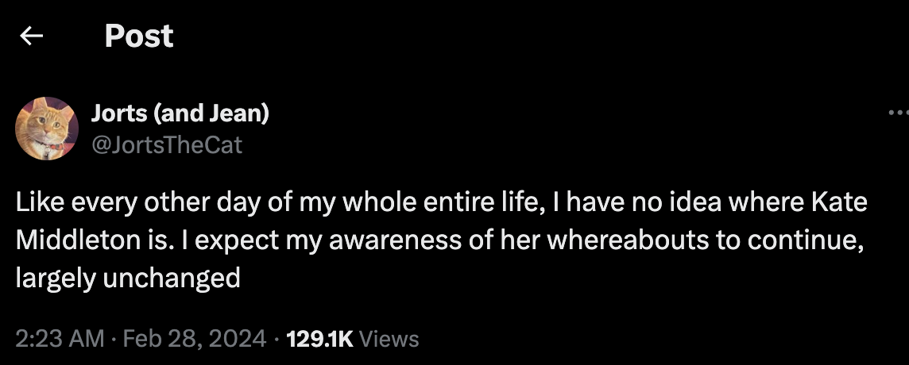
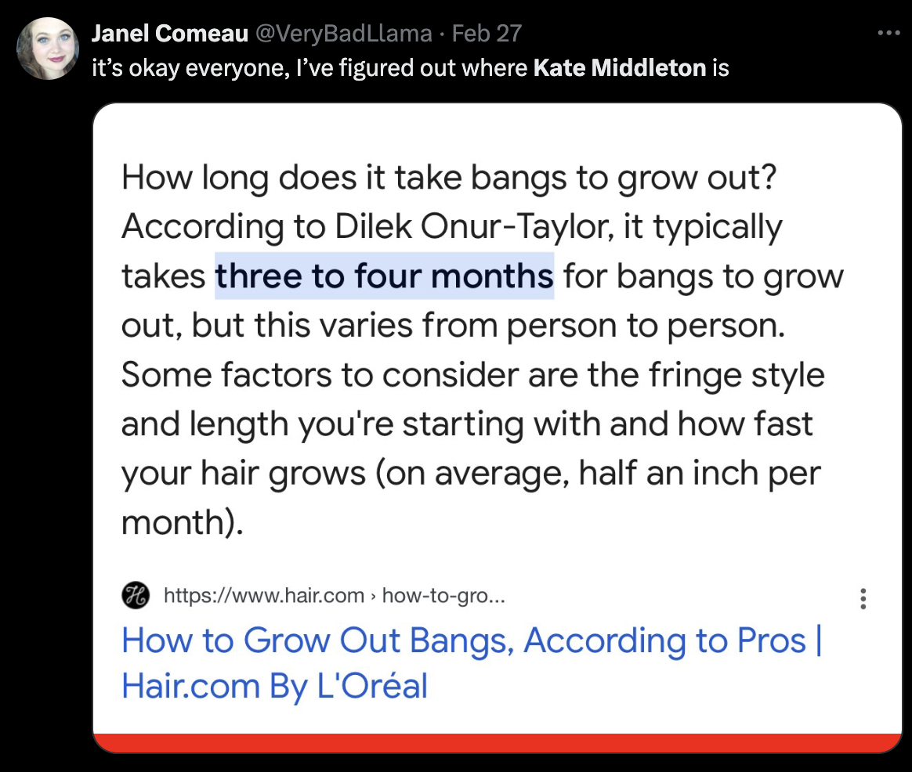
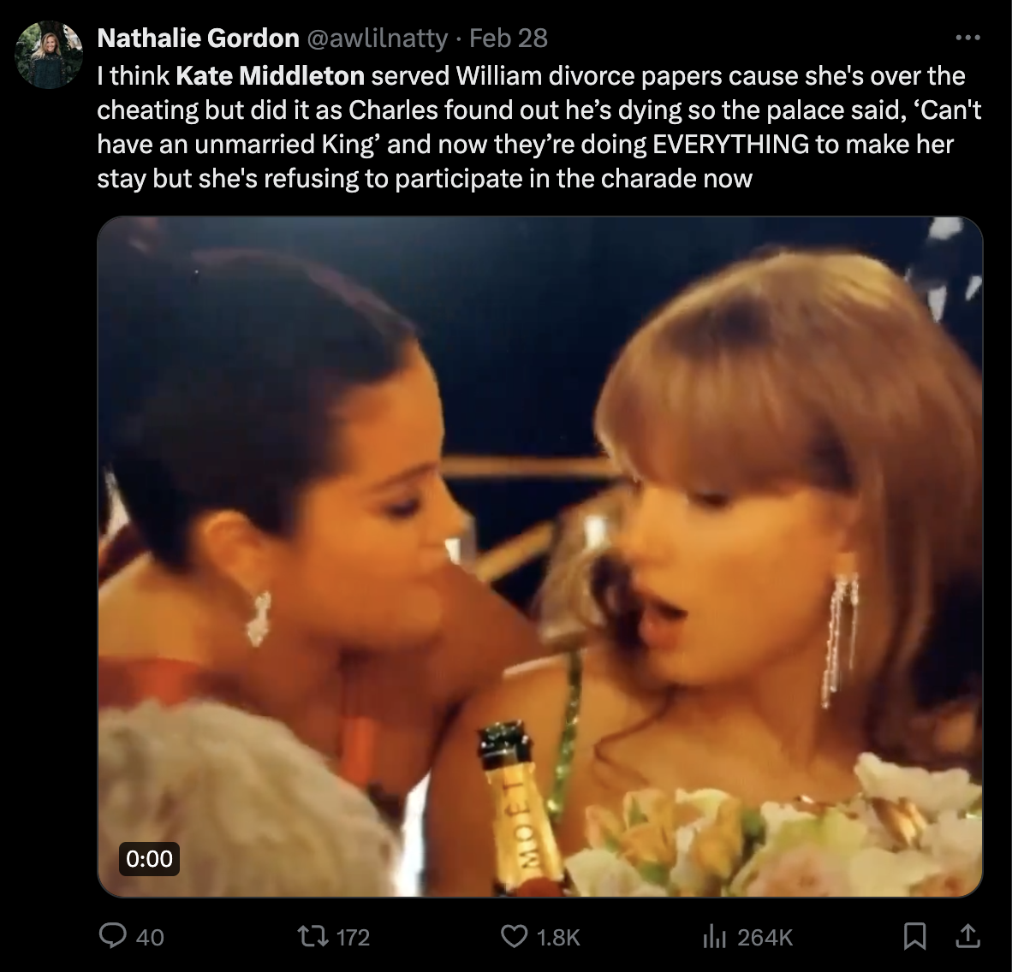
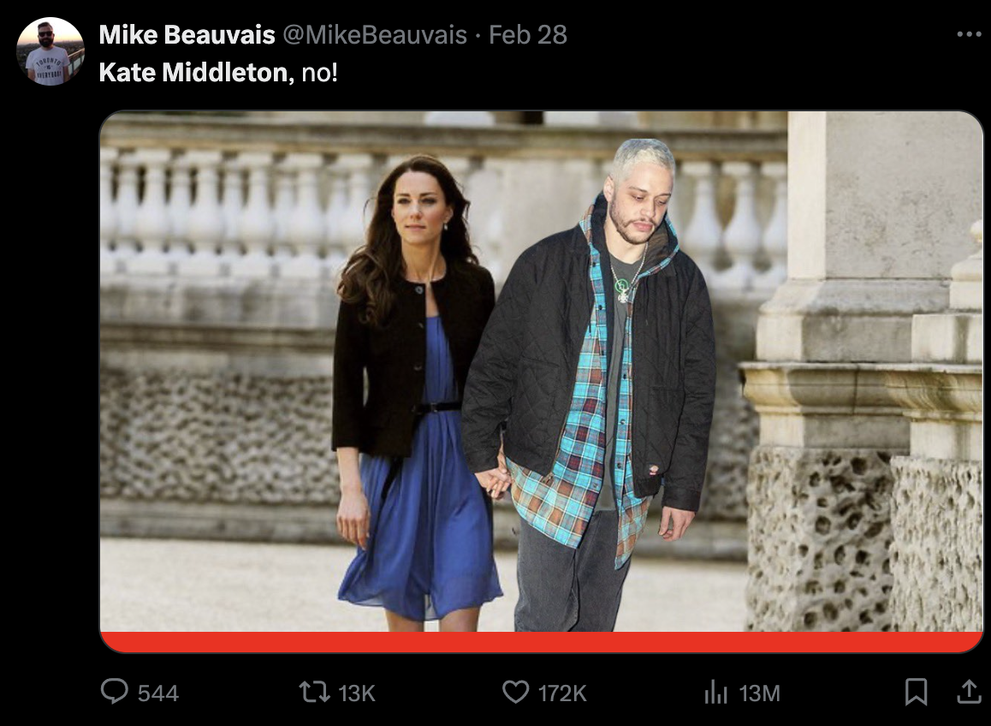

Slide 5
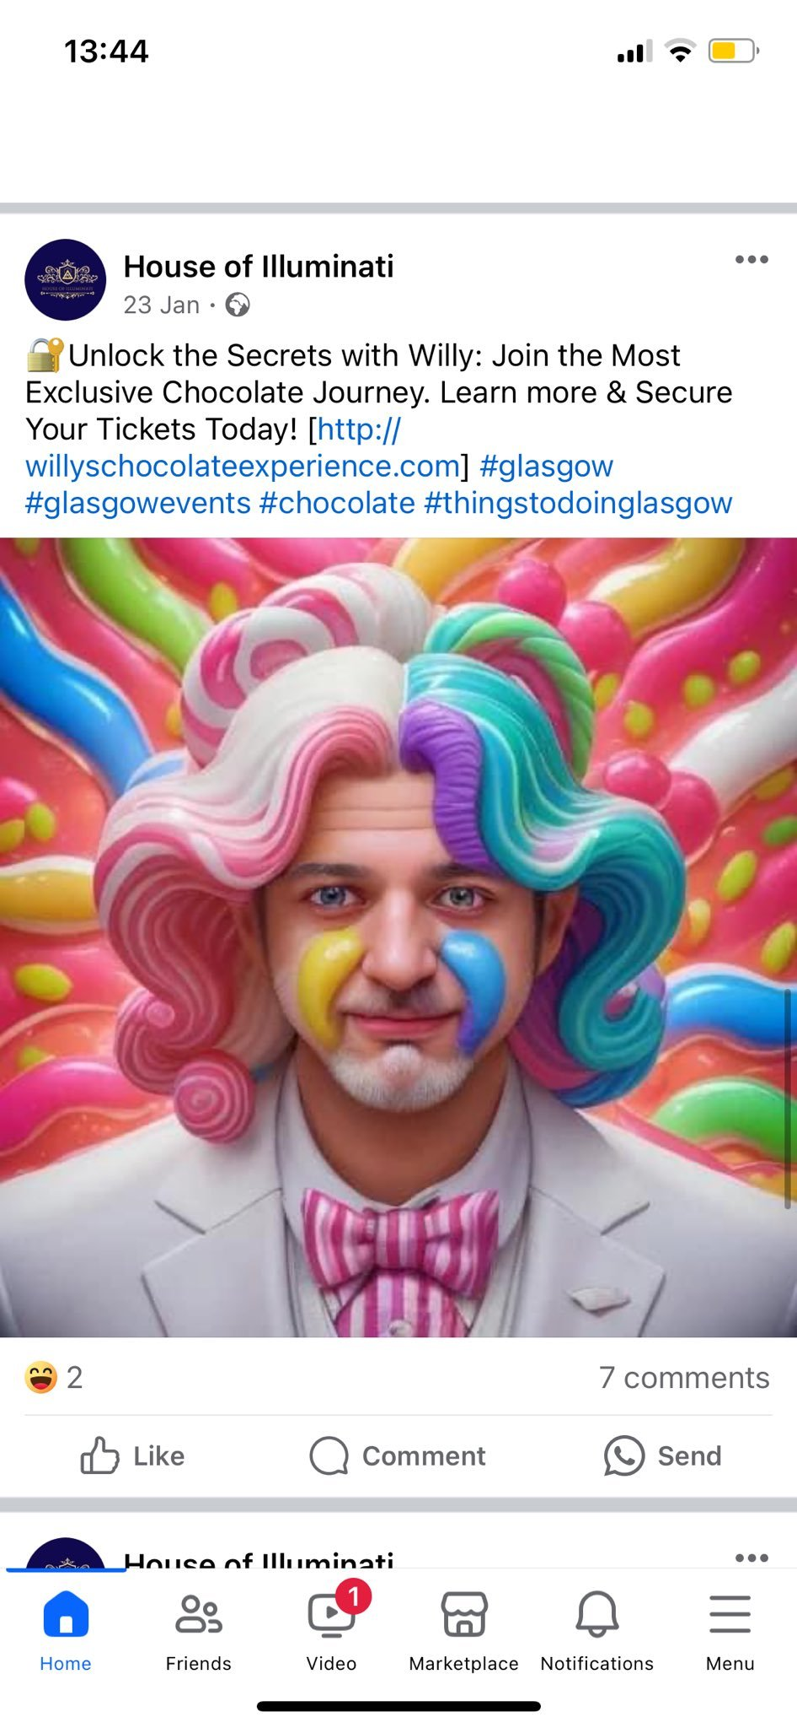
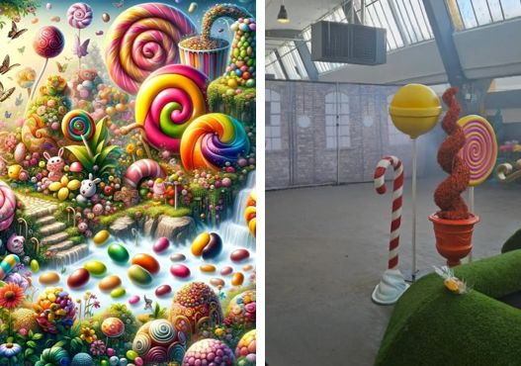

Slide 6
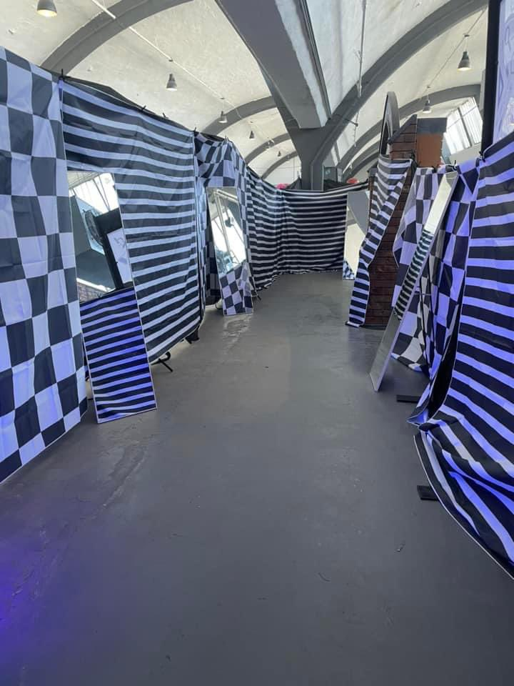
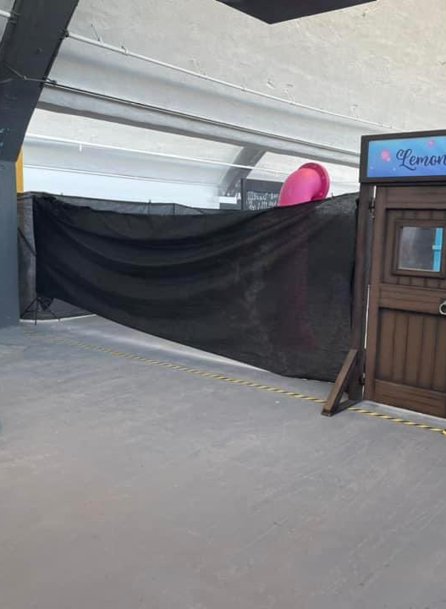
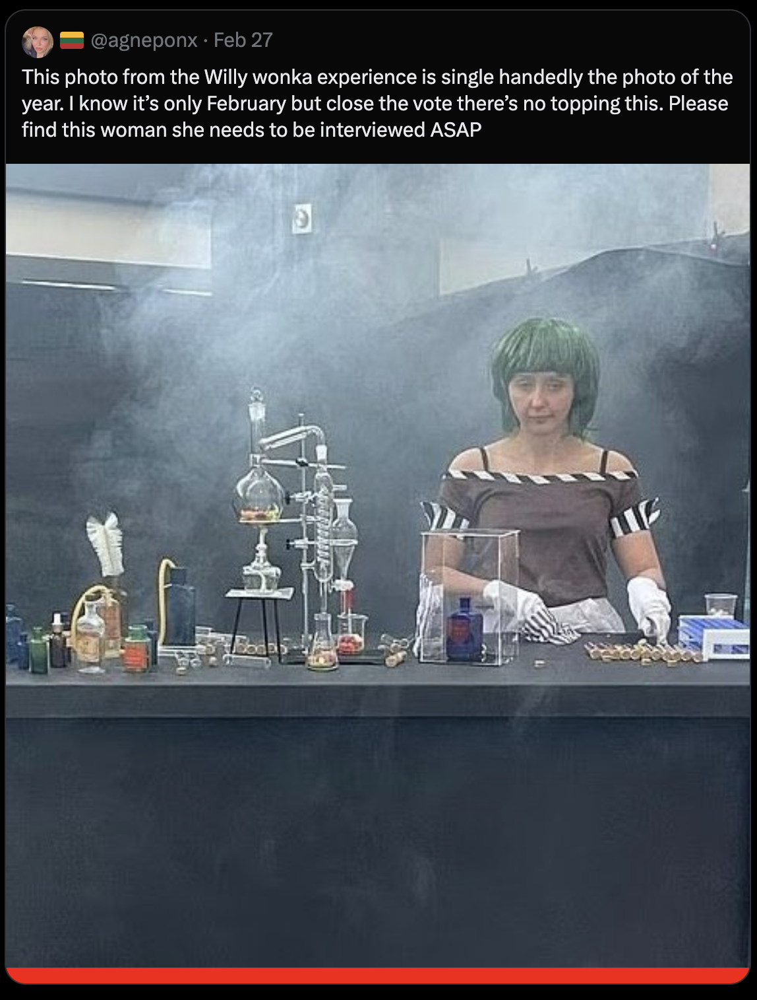
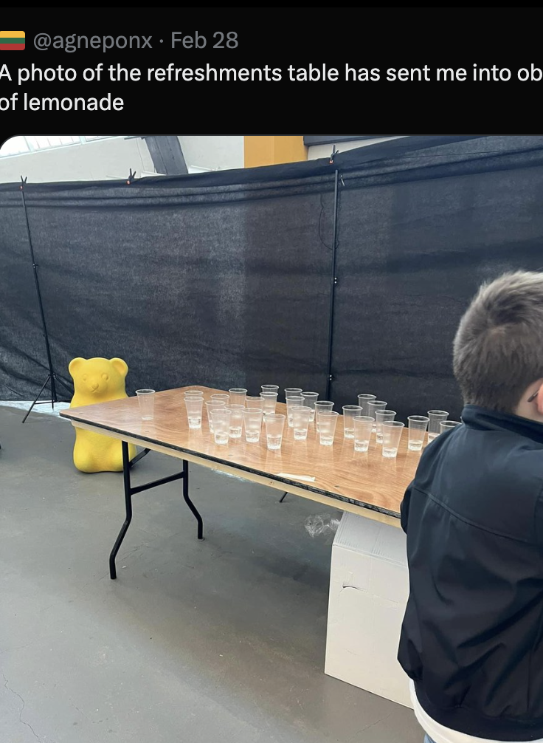
Willy Wonka in Glasgow –House of Illuminati
“I don’t know how else you can put sprinkles on shit, but we were trying to be the sprinkles on shit.”
Kristy Peterson – Oompa Loompa
Notes:
February 24’s disastrous Willy Wonka chocolate factory experience in Glasgow, Scotland, which instantly became a viral sensation when pictures emerged of the sad spectacle. Organized by House of Illuminati, whose AI-heavy website promotes the company as a place where “fantasy and reality converge,” the event was advertised as an immersive experience for families themed around the classic Roald Dahl novel and movie franchise (and with tickets that cost up to $44). But the end result was anything but magical.
As bewildered families wandered the space, they were greeted by actors dressed in shoddy costumes who read from scripts they later said they suspected were “AI-generated gibberish.” Rather than feasting on an array of sweets, children were given a few jellybeans and a quarter cup of lemonade. Soon, angry parents called the police as they demanded refunds from organizers, who canceled the event before the day was out.
While a subsequent photo shows there was at least one other Oompa Loompa at the table that day, it’s Paterson who has emerged as the viral star and defining image of the Wonka fiasco. X posts have proclaimed her as one of the standout memes of 2024 so far. People are comparing the image to works of art or making art of their own showing Paterson as the Mona Lisa. Others are wondering if she is really the missing Kate Middleton in disguise. Many are predicting, with good reason, that she’ll be among the Halloween costumes you see this year.

Slide 7
Best thing about the course
The content and discussions we have are particularly interesting. I do not always read the required readings, and even if I do, I don't usually read all of the articles posted. Although out of the required reading articles that I do read, I find them to be actually quite interesting
The class discussions. The gossiping during the first half of class:)
People can create whatever they like for their blog.
Talking about what is happening online during the beginning of class
I like … alternating between discussing social media and relevant events … also covering interesting theory.
How free form it is, we get to work on our own websites without much restriction. A lot of room for creativity.
It is very chill and a good way to incorporate creativity.

Slide 8
Worse thing about the course
The readings
Not really the worst, but how to apply the lectures to our websites.
Boring tutorials
Nothing really. Although sometimes the mini assignments seek out a greater amount of creativity than I have available.
Not everyone is on the same page with their blog, so it is hard to do the peer review.
Having to be consistent in order not to fall behind
Figuring out the website building is very tedious and difficult

Slide 9
What should we start doing?
Everything is pretty great as it is!
I don't want this class to be overly strict, but I find that for a class like this, actually showing up to class and having a decent pace of blog posts completed should be mandated. That's not to say that each student should always have 7 posts by the time week 7 arrives, but rather have at least 3 or 4 posts. I think that the fun of a class like this is to be able to see how other students' blogs are progressing. It's a little disheartening to visit a blog and see that it's empty.
Maybe in tutorials, we can have some more feedback and instruction on how to make a good website. I feel like Mauve's presentation was really engaging and interesting, and I would like to see more of that kind of teaching in tutorials!
Scoring, as half of the semester has passed so far, I have only received one assignment grade (peer review #1), which only accounts for 3% of the total grade.
Take the time in the first 1-2 tutorials to go through how to setup the website. this will save a lot of repeatedly asked questions to the TAs in the long run.

Slide 10

What should we stop doing?
Not using canvas. please Use canvas more for deadlines. Have fixed deadlines.

Slide 11
What should we continue doing?
I like hearing about the "What's up in socials" :)
Everything!
Continue doing anything that has been done!
Blog feedback.
what's new on socials
continue group discussions/ activities
The entire class is amazing!! love it! highlight of the week.

Slide 12
What should be added in the last weeks?
Maybe suggestions of how we can make our websites better/finalized?
More opportunity to discuss and see each other's websites?
No interests in particular.
Possibly talking to the peers beside us at the end of lecture about our websites for about 5 minutes for feedback and quick suggestions.
So far so good.
More in-class mini-group work or interactive material.

Slide 13
Other feedback
The way the class is managed is definitely a change of pace compared of all of the classes that I have taken so far at SFU. I pay attention in class not necessarily because I have to do so in order to pass, but rather because I am interested in the content.

Slide 14
Website Critique
1) Name three positives
Navigation
Design
Quality of content
2) Make three recommendations
Navigation
Design
Quality of content
http://shabusen.com/
Notes:
http://shabusen.com/

Slide 15

Break

Slide 16
Statute of Anne - 1709
Short title: Copyright Act 1709 8 Anne c.21
Long title: An Act for the Encouragement of Learning, by vesting the Copies of Printed Books in the Authors or purchasers of such Copies, during the Times therein mentioned
First copyright statute – and it was all about the publishers
Intended to encourage learning and public education
Granted publishers of books legal protection for 14 years (reinvested)
Granted 21 years of protection for any book already in print
After 14 years the copyright went to the author for 14 years
Notes:
Note who had held the copyright. Printers were de facto publishers and authors typically sold their books outright to pub/printer
Authors rights were incidental to the main goal of creating a better educated public. Interestingly eventually this statue came to protect the authors more than advancing the goal of reaching far and wide to better educate people.

Slide 17
Statute of Anne
Determined that the ‘copy’ was the 'sole liberty of printing and reprinting' a book.
It could be infringed by any person who printed, reprinted or imported the book without consent.
Infringements: ”fine of one penny for every sheet of the book, one moiety of which went to the author, the other to the Crown” and the copy destroyed
First to recognise the legal right of authorship
Confusing and unclear about authorship and author rights. Set the stage.
Notes:
Action could only be taken for books that had been registered at the Stationers’ Company.
Note who was paid
Any illegal copy was destroyed and the fine was huge.
The formal requirements of registration enabled users to locate the owners of copyrighted works.
The requirement for copies of published books to be deposited in university libraries ensured that there was public access to copyrighted works.
It is a copy - even for the author. The author owns the original work. It is the reproduction or copying of the work that is in question.

Slide 18
The Berne Convention - 1886
Collective agreement among many countries that provided the means for creators to control “how their works are used, by whom, and on what terms.”
Is the foundation of the modern copyright – 181 member states
Contains three principles
  Works of an author in one signateur state are automatically and independently given the same protections in all party states
  Protection must not be conditional. Protection is automatic
  Protection is separate from protection in the country of origin
Notes:
The Berne Convention, concluded in 1886, was revised at Paris in 1896 and at Berlin in 1908, completed at Berne in 1914, revised at Rome in 1928, at Brussels in 1948, at Stockholm in 1967 and at Paris in 1971, and was amended in 1979.
Protect every production in the literary, scientific and artistic domain, whatever the mode or form of its expression
the right to translate,
the right to make adaptations and arrangements of the work,
the right to perform in public
the right to recite literary works in public
the right to communicate to the public the performance of such works,
the right to broadcast (with the possibility that a Contracting State may provide for a mere right to equitable remuneration instead of a right of authorization),
the right to make reproductions in any manner or form (with the possibility that a Contracting State may permit, in certain special cases, reproduction without authorization, provided that the reproduction does not conflict with the normal exploitation of the work and does not unreasonably prejudice the legitimate interests of the author; and the possibility that a Contracting State may provide, in the case of sound recordings of musical works, for a right to equitable remuneration),
the right to use the work as a basis for an audiovisual work, and the right to reproduce, distribute, perform in public or communicate to the public that audiovisual work [4].
Duration: As to the duration of protection, the general rule is that protection must be granted until the expiration of the 50th year after the author's death.

Slide 19
What is copyright?
It is the right to copy; to reproduce a work
Applies to an author and anyone the author authorizes
It is the legal right of an author of their work
It protects the work for the life of the author plus 70 years after death
  It is then in the public domain and can be used by anyone
Notes:
Berne Convention and the USMCA : https://currentthoughtsontrade.com/wp-content/uploads/2019/11/USMCA-Side-by-Side-Chapter-20-Intellectual-Property-Rights.pdf
What is Copyright? (Canada)

Slide 20
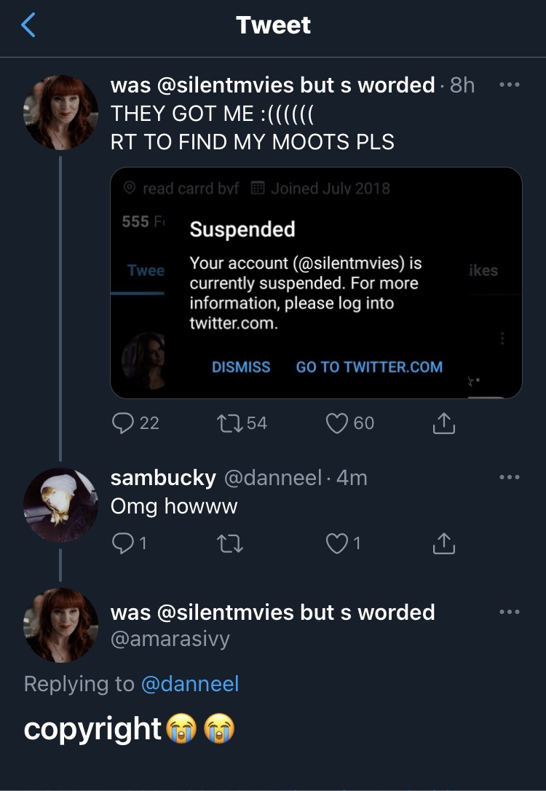
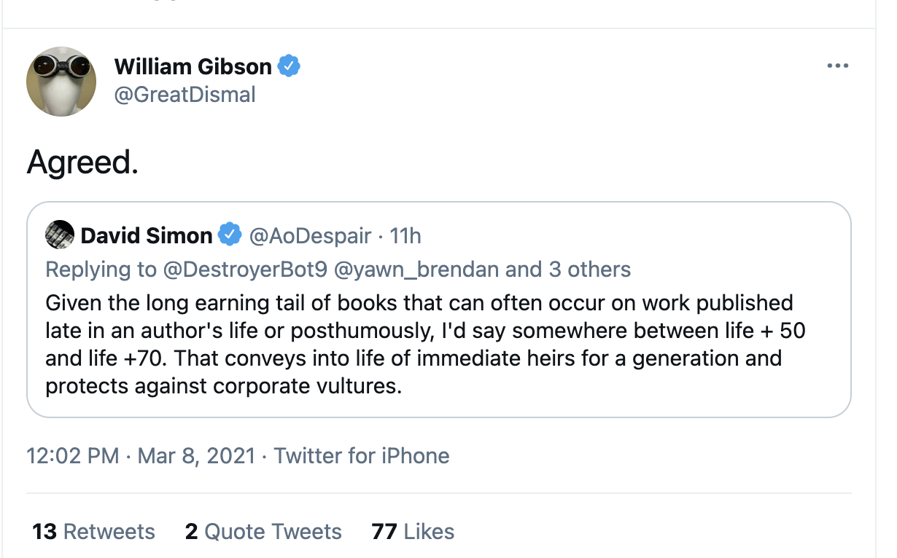
On the socials on Copyright…
Notes:
Tweets by William Gibson on copyright
https://twitter.com/GreatDismal/status/1369015598294781952

Slide 21
The Canada US Mexico Agreement
Required Canada to extend its copyright to 70 years at the end of 2022. This aligns with the US, UK and EU. Bill C-19.
Proponents said it provides copyright owners with more time to monetize their works and will encourage the creation of more Canadian works.
User groups opposed the extension because it means a longer period of restrictions and otherwise limits public access and use.
It will not revive copyright. The new Act came into force on January 1, 2023, and copyright that expired on December 31, 2022 (after the life of the author plus 50 years), will not be revived for another twenty years. 2043!
Notes:
the new Act came into force on January 1, 2023, and the copyright expired on December 31, 2022 (after the life of the author plus 50 years), such copyright expired and is not revived for another twenty years. On the other hand, if the copyright would have expired on December 31, 2023, such copyright continues for another twenty years.
Writers are not huge money makers. This allows their heirs to benefit
Walt Disney’s work came into the public domain in Canada in 2017
Martin Luther King’s speech came into the public domain in Canada
A guide for Fair Use and Fair Dealing in Social Media: https://www.legalzoom.com/articles/fair-use-and-fair-dealing-in-social-media

Slide 22
How does copyright work?
Copyright comes into effect as soon as the idea is expressed in a fixed format.
If the work is transformed and altered in a meaningful and substantial way new copyright and possible ownership can be applied.
  Works in the public domain that have been transformed can also be given copyright protection.
International copyright law principles guide us to the principle of national treatment.
The law of the country where the work is being copied applies.
  It is how Martin Luther King’s speeches came into the public domain in Canada but are still under copyright in the US.
But first, always determine whether copyright is even attached.
  It may be that there is no copyright attached to the work you want to use because it is in the public domain or falls under an exemption.
Notes:
Ideas are not copyrightable

Slide 23
Fair Dealing and Fair Use
There are exceptions to copyright protections.
  Canada: Fair Dealing
  United States: Fair Use
Exceptions of portions for specific purposes comprise:
  private study,
  research,
  criticism,
  education,
  news reporting,
  review,
  satire,
  and parody.
Notes:
fair dealing’ provides a statutory exception to copyright infringement. It applies to specific purposes under which a user may use portions of an original work without infringing upon copyright. Those purposes include: private study, research, criticism, education, news reporting, review, satire, and parody.

Slide 24
Personal Use Exemptions
Non-commercial user-generated content
  Mashups, remixes for non-commercial use
  Source/author must be cited
Copying a protected work from one device to another
  Purchase and playing of songs, books on multiple personal devices
Recording programs to consume in the future
  Must be legally obtained
  One copy
  Personal use only
  Not shared or given away
Notes:
Non-commercial user-generated content: This exception, sometimes called the mash-up, allows a consumer the right to use, for non-commercial purposes, a published work to create a new work, provided that the source and author are identified, that the original work or the copy was legally obtained, and that there is no substantial adverse effect on the exploitation of the original work. For example, someone could take parts of a video or movie and combine them together to create a new video.
2. Copy a protected work from one device to another: This allows a consumer, for private purposes, to copy any work if the source copy was legally obtained. For example, if someone buys a song from iTunes, they can download in onto their computer and then transfer it to their iPod without infringing copyright laws.
3. Record programs for later listening or viewing: Individuals are legally permitted to fix a communication signal, or reproduce a work, sound record or performance being broadcast in order to privately view the work at a later time. However, the signal must be obtained legally, only one recording must be made, the recording must be used for private use, and the recording must not be given away. This exception does not apply to works or sound recordings that are made available through an on-demand service, or to works protected by digital locks (a technological measure, such as encryption or digital signatures, used to restrict access to, or prevent the copying or playing of, CDs, DVDs, e-books, digital files and so on).

Slide 25
What isn’t protected under copyright
Ideas, Methods or Systems
Commonly known information
Choreographic Works
Names, Titles, Short Phrases, or Expressions
Fashion
Other
  The work is deemed to small “de minimus” or too minor
  Scènes à faire – scenes that are expected or customary in a genre (romance)
Notes:
1) Ideas, methods, and systems are not covered by copyright protection. According to the US Copyright Office, Circular 2, this covers quite a few things including making, or building things; scientific or technical methods or discoveries; business operations or procedures; mathematical principles; formulas, algorithms; or any other concept, process, or method of operation.
2) This category includes items that are considered common property and with no known authorship. Examples include standard calendars, height and weight charts, telephone directories, tape measures and rulers, and lists or tables taken from public documents. A phrase such as “The sky is blue” also falls under this category since there is no known authorship associated with it.
3) A choreographic work, whether original or not, is not subject to copyright protection unless it has been videotaped or notated. The same applies to speeches that have not been transcribed before or after they are given, as well as any other types of performances.
4) Also exempt: names, titles, short phrases, or expressions—such as that catchy slogan—product descriptions, pseudonyms, titles of works, and business names. The good news is that while they are not protected by copyright, if they pertain to your business (for example, goods and services) they can be protected with a trademark.
Recipes also fall under this category. Specifically the listing of ingredients (even if it's your own recipe ingredients) is not protected by copyright. This applies to formulas, compounds, and prescriptions as well. There are exceptions however, such as when recipes are compiled in a cookbook for instance or if the recipe is accompanied by “substantial literary expression,” a term that refers to text such as directions, or when there is a combination of recipes, there may be a basis for copyright protection.
5) Contrary to what you might think, fashion (that is, a shirt, dress, or other article of clothing) is not protected by copyright law. Despite the fact that copyright law protects such things as architectural design works (Circular 41) or works of the visual arts (Circular 40), fashion is all about clothing and accessories, which under copyright law are considered “useful articles." It is possible however, to copyright a specific fabric pattern (Burberry plaids for example), but not the actual dress. And, it should be noted that while designs can't be copyrighted, they can be patented.

Slide 26

The Marrakesh Treaty
The Marakesh Treaty administered by the World Intellectual Property Organization (WIPO)
Sets global standards on exceptions to copyright to allow print works to be adapted to accessible formats such as braille and audio without the copyright holder’s permission. It also allows for adapted works to be exported and imported without penalty.

Slide 27
What isn’t considered in Canadian Copyright?
There is no explicit provision for Indigenous works
It fails in “the protection, preservation, and dissemination of their cultural expressions.”*
Ownership of IP can contrast with Indigenous meanings of ownership of Indigenous knowledge and cultural expressions
Oral cultures do not meet the western requirement of “fixed”
The limited term of copyright requires a date of creation – often unknown
Currently the gaps create exploitation. The TRC recommends remedies
*2019 Standing Committee on Industry, Science and Technology.

Slide 28
Public Domain Works Outside Canada
  If the work would have been in the public domain if published in Canada, it is in the public domain in Canada.
  If the work would not be in the public domain if it were published in Canada, check to see whether the work is in the public domain in the country where it was published.
  If the work is in the public domain in the country where it was published, then it is in the public domain in Canada. If the work is not in the public domain in Canada nor in the country where it is published, then the work is not in the public domain.
  Therefore, if a U.K. author passed away 60 years ago, his work is in the public domain in Canada, but not in the U.K., where works do not enter into the public domain until 70 years after the death of the author.
  If a country has a copyright term that is less than 50 years, say 30 years, then the work will be in the public domain in Canada after 30 years.
  If you wish to use a work that originated in a country that has not signed the Berne Convention, then you should seek permission from the copyright holder.
                Taken from https://copyright.ubc.ca/public-domain/
Notes:
https://copyright.ubc.ca/public-domain/

Slide 29
Copyright Infringement
Copying or altering a work that is under copyright protection and without the permission of the owner
Disabling digital locks (DRM); selling devices to disable digital locks
The person infringing the copyright is liable
The person enabling or authorizing infringement may be liable as well as the infringer
Companies may be liable for employee infringement
Online providers who knowingly allows infringement or hosts copyrighted works
Penalties include fines ($25,000/$1,000,000) jail time (6 months/5 years), sanctions, cease and desist, and possible criminal charges

Slide 30
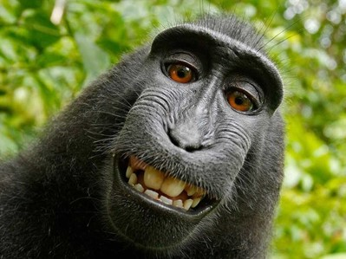
Naruto v. David Slater

Slide 31
Notes:
Monkey selfie.
Naruto picked up a camera left by photographer David Slater and snapped a bunch of photos including a few selfies. Slater published a book with the photos noting that Naruto took some pics but maintaining he owned the copyright and hence the royalties. Peta acted as the next friend or representative of the monkey and sued for copyright ownership and royalties. Basically, the case was thrown out because PETA could not substantiate that it had a special and unique relationship Naruto.

Slide 32
Artificial Intelligence (AI)
Refers to machines and systems that can carry out tasks generally thought to require human intelligence and do so with limited or no human intervention.
Two main concerns:
  Source data and possible copyrighted material used to create the AI
  Generated works
Bill C-27 The Digital Charter Implementation Act, 2022 introduced in June 2022
Contains the Artificial Intelligence and Data Act (AIDA)
Seeks to regulate the development and use of AI in Canada
Mainly deals with the use of personal data and transparency of companies using AI
There are no regulations about AI generated-content

Slide 33
What we need to think about with AI
Fair dealing/use for model training
Output infringement
Ownership of AI-generated works
How open is the training data?
How do we know if the training data is already infringing?

Slide 34
What we need to think about with AI
Secondary liability for those providing AI tools and the users/prompters who are involved with
  Generating infringing materials – outputs
  Compromised training material – inputs
  Bad actors supplying protected content
  Poor training in scraping data
  AI cannot be held liable, so who should be liable
How much of one artist’s work is involved in output? Can it be proven?

Slide 35
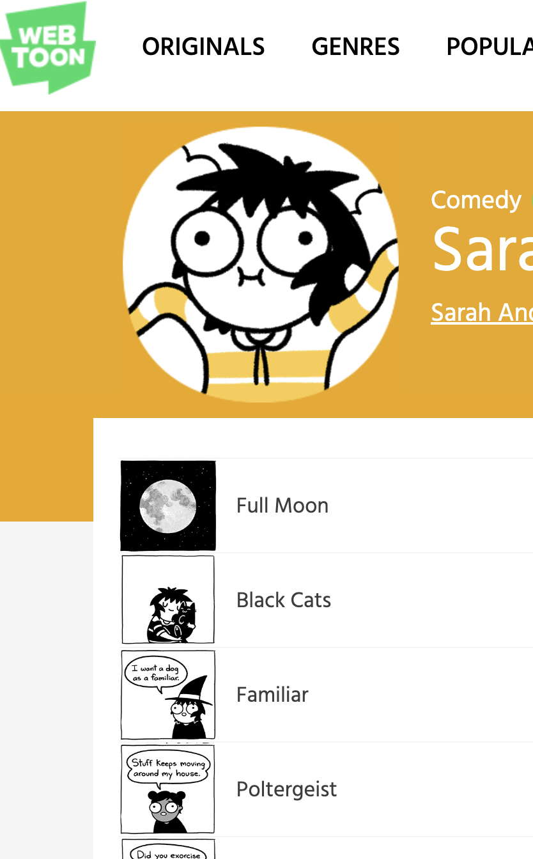
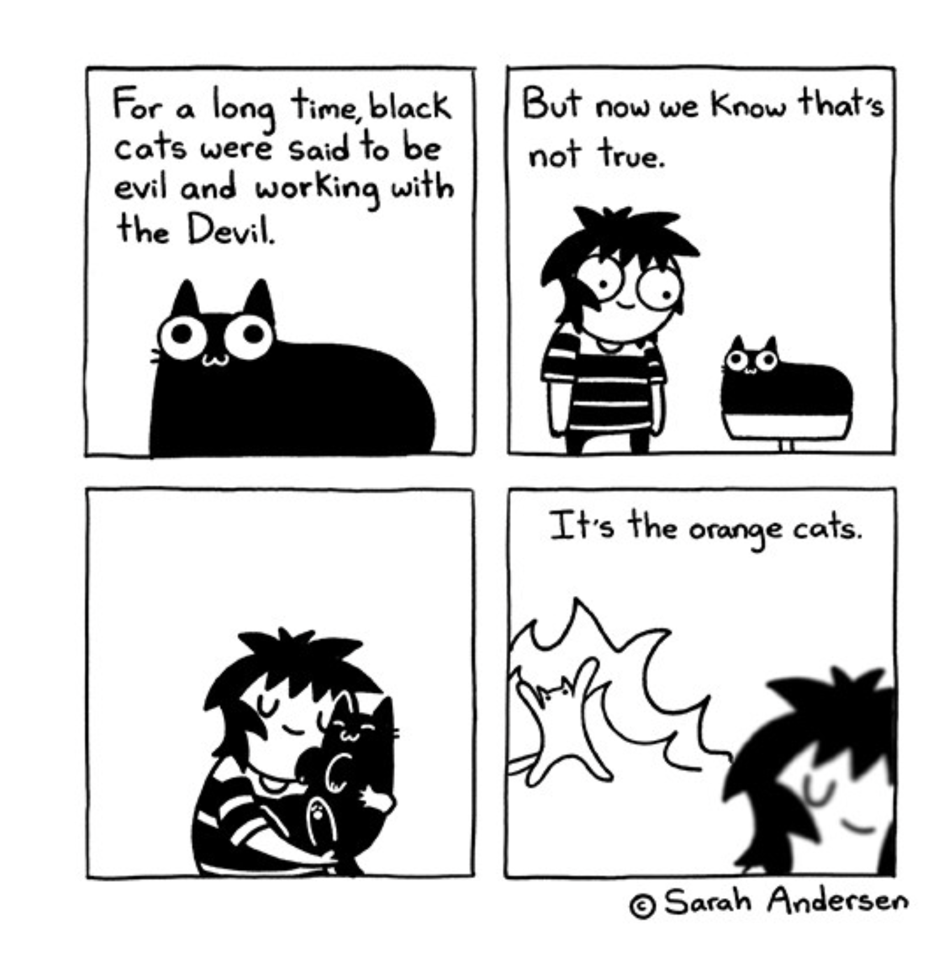
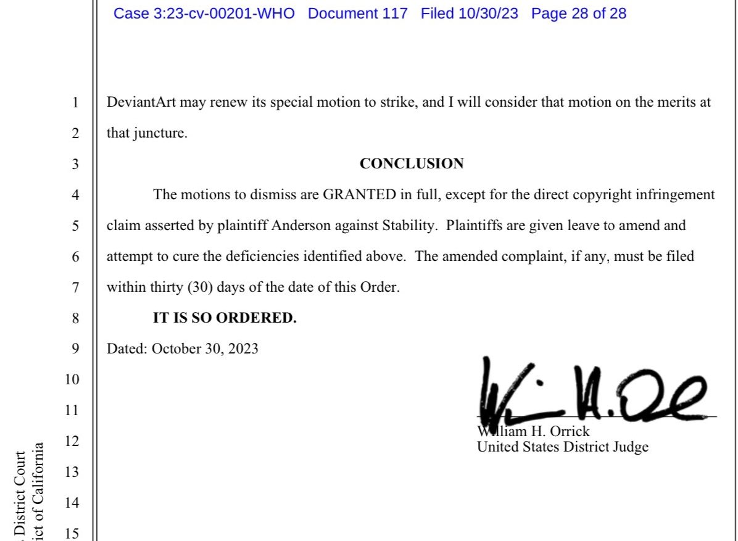
Anderson et al. vs Stability AI Ltd., et al.
Notes:
A group of artists is taking on AI generators Stability AI Ltd., Midjourney Inc., and DeviantArt Inc. in what would be a first-of-its-kind copyright infringement class action over using copyrighted images to train AI tools.
They alleged that Stability AI created and released (2022) stable diffusion under open source and is alleged to have downloaded and used for training billions of images wothnout permission
Sarah Andersen, author of the web comic “Sarah Scribbles,” along with fellow artists Kelly McKernan and Karla Ortiz, sued the AI companies in a purported class action that claims they downloaded and used billions of copyrighted images without obtaining the consent of or compensating any of the artists.
The rise of artificial intelligence applications has left a murky legal landscape in its wake, raising new copyright questions, including whether AI creators can be held accountable for their use of existing copyrighted works to train their AI generators.
claiming that the new images it generates are derivative works of the images it draws from, and the resulting works compete in the marketplace with originals
Stable Diffusion has been incorporated into several software programs as an image-generating engine—including DreamStudio by Stability AI, Midjourney, and Dreamup by DeviantArt—the complaint said.
The artists say that AI tools permit users to create works “in the style of” a given artist instead of commissioning or licensing an original, violating the rights of millions of artists and taking away from their income.
Cause of Action: Copyright infringement, violation of Digital Millennium Copyright Act, violation of right to publicity, unfair competition, breach of contract.
Relief: Permanent injunction; statutory and punitive damages; attorney’s fees; pre-and-post judgment interest.
Ruling:
Direct infringement and
Vicarious infringement was dismissed.
Right of publicity claims dismissed for lack of evidence that the artists’ names were used to market the AI tools
DMCA removal of CMI claims are dismissed for lack of evidence, plus DeviantArt and Midjourney weren’t involved in LAION data training phase.
DMCA – Digital Millennium Copyright relates ti “a defined process un remiving content from the internet”
Addresses the rights and cbliagtions of owners of copyruighted material as well as the rights and obligations of Internet Service Providers on whose servers or networks the infringing material may be found

Slide 36
Activity
https://chat.openai.com/
You are an XX doing XX
Design/Create a quiz/recipe/story/ that tests/measures/ understanding of the following: type of XX and XX.
Write it in the style of XX
Notes:
You are an instructor teaching a second year political science course called Introduction to Comparative Politics. Design a 10 question multiple choice quiz that tests the students' understanding of the following topics: type of constitution (presidential and parliamentary) and states and political regimes (democratic and authoritarian). The multiple choice questions should follow the suggestions offered by Kar, S.S., Lakshminarayanan, S., & Mahalakshmy, T

Slide 37
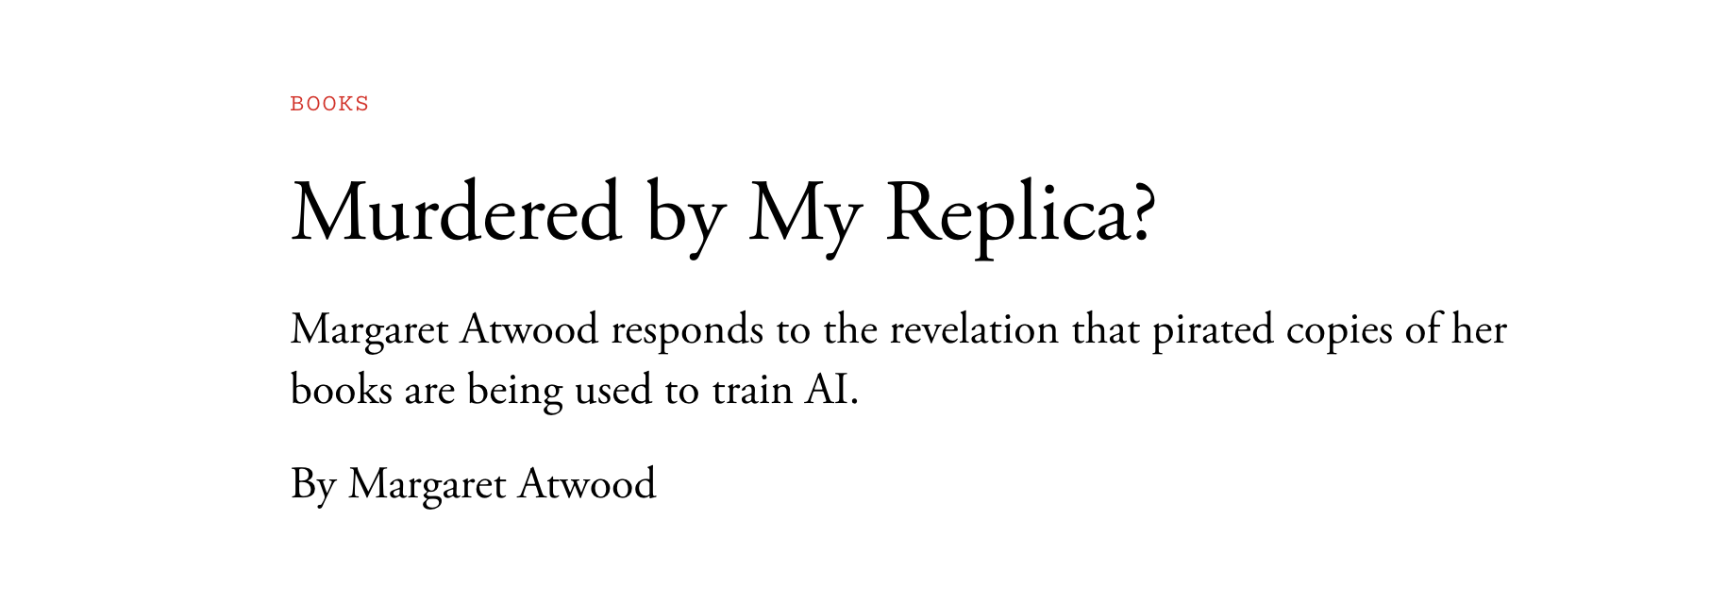
Books3
Data set of 191,000 + books used without permission to train Gen AI systems.
  Suits against Meta for copyright infringement
Notes:
out permission to train generative-AI systems by Meta, Bloomberg, and others.
was based on a collection of pirated ebooks, most of them published in the past 20 years.

Slide 38

Should AI systems that create “works” without human involvement be granted copyright protection?
What would it look like?

Slide 39
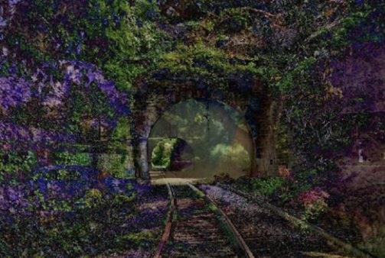
A Recent Entrance to Paradise
Notes:
In the US an AI system called DABUS (Device for Autonomous Bootstrapping of Unified Sentience) created an image called A Recent Entrance to Paradise – a simulation of a dying brain. DABUS also generated other inventions that fell under patents. In 2018 Stephen Thaler, president and CEO of Imagination Engines filed for copyright under the Work for Hire provision that says ownership of a work that is commissioned goes to the commissioner. Thaler argued that DABUS’s artwork generated by the Creativity Machine which is the author. He argued that the copyright act protects “original works of authorship.” The US Copyright office denied the application saying the work had to be created by a human. On February 14, 2022, the Review Board reaffirmed that human authorship is a prerequisite to copyright protection in the United States. 1) the doctrine only addresses who the owner of the work is, not whether the work is eligible for copyright protection; and 2) it requires binding legal contracts, which DABUS cannot enter into.

Slide 40
DABUS and the courts
2018 – Dr Stephen Thaler applied for copyright of the work naming The Creativity Machine as the author in a ”work for hire” arrangement. Argued that copyright protects “original works of authorship”.
2019 – the copyright office denied the application noting that the creator had to be human.
2022 – a review board reaffirmed that human authorship is a prerequisite to copyright protection and that:
  the doctrine only addresses who the owner of the work is, not whether the work is eligible for copyright protection; and
  it requires binding legal contracts, which (AI) cannot enter into.
Notes:
DABUS (Device for Autonomous Bootstrapping of Unified Sentience) created an image called A Recent Entrance to Paradise – a simulation of a dying brain.

Slide 41
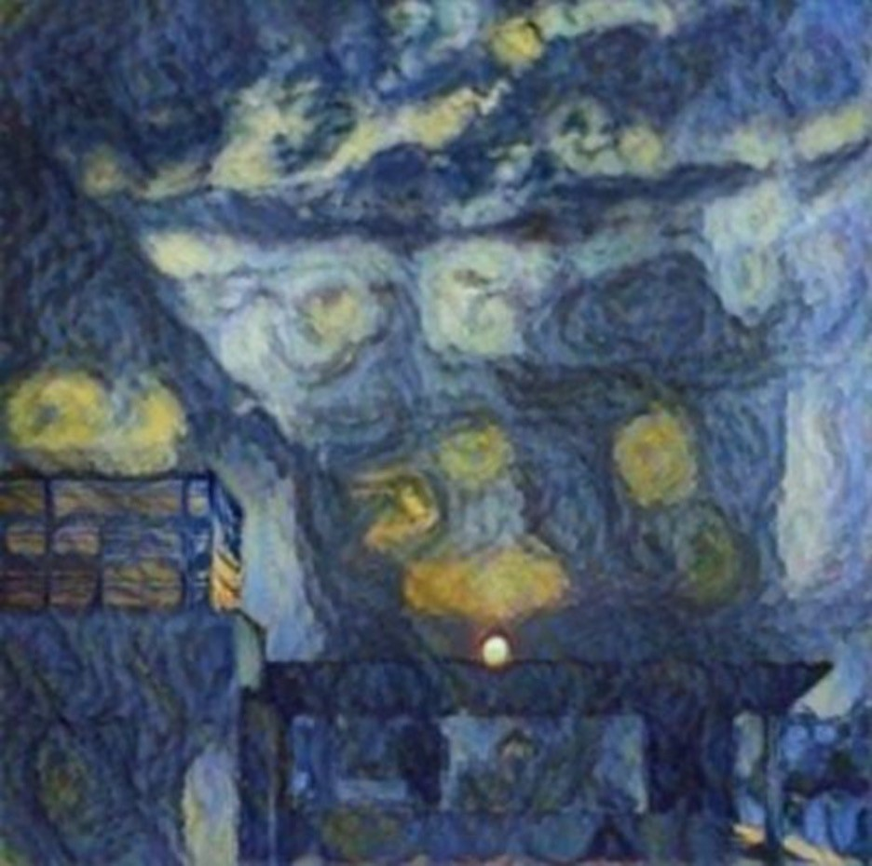
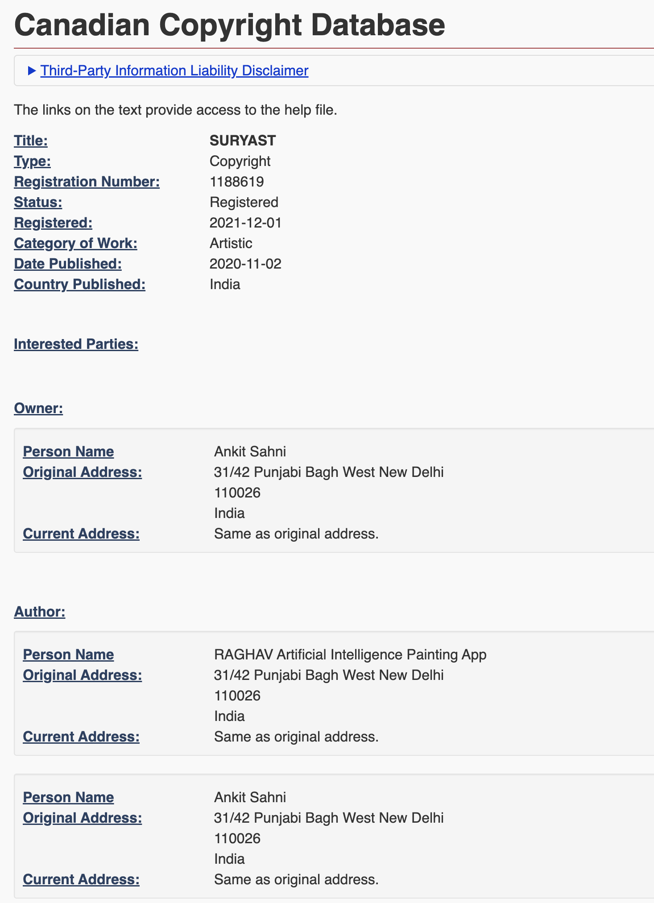
AI and human copyright
Notes:
In December 2021, CIPO registered a copyright for a Starry Night-inspired painting titled Suryast. The copyright registration lists two co-authors – Mr. Ankit Sahni and RAGHAV Artificial Intelligence Painting App (RAGHAV), making Suryast the first-ever Canadian copyright registration with an AI author.

Slide 42
Copyright, Patents, and Trademarks
Copyright protects (typically) creative Intellectual Property (IP) at the creation of the property and are limited in duration
Patents protect (typically) scientific inventions that comprise a unique product, equipment or “manufacturing process”. Patents have to be applied for and granted
Trademarks protects (typically) a mark. May be registered or not. Will. Not expire as long as the mark is in use
Notes:
Copyright: Copyrights were created to protect ownership of artistic works, including artsy, literary, musical and theatrical creations. Intellectual goods protected by copyrights include poetry, music, songs, motion pictures, novels, architecture, paintings and even computer software and digital creations.
Ideas cannot be copyrighted, however, a tangible form of the idea can be.
Patents: Patents are intellectual property rights granted to inventions. Materials which are patentable include industrial processes, machines, chemical compositions, and manufactured commodities and artifacts.
Patents can be categorized as design patents, and utility and plant patents. Design patents protection lasts 15 years starting from application issuance. Conversely, utility and plant patents last maximum 20 years following a filing of the patent application. There is a possibility of extending or adjusting patent terms.
Furthermore, in order to be patentable, the invention must be usable by any kind of industry. Therefore, the invention must be a product, an apparatus or a manufacturing process, rather than a scientific theory, a work of art, or a mathematical design.
Trademarks: Businesses make use of certain names, symbols, words, and designs when trading goods or services to distinguish themselves as the source of certain goods, products and services. The term “trademark” is frequently used to refer to service marks as well as trademarks.
Some examples of intellectual property requiring a trademark are brand names, brand logos, and their slogans. These examples can all be categorized under the term “mark”. However, these rights do not prevent others from creating and selling the same services and goods under a different name, symbol etc.
Trademarks are not subject to expire after a set period of time. Trademarks can last indefinitely so long as the mark is being used in commerce because the rights apply to actual “use”. Trademark registrations also last forever once you have paid the due fees and filed the necessary documents.

Slide 43
EU Copyright Directive

Slide 44
The Modernization of EU Copyright
The measures aim at creating a fairer market place for online content especially for press publications, online platforms and remuneration of authors and performers.

Slide 45
What is it?
The Copyright Directive is meant to protect content creators and has received strong support from some in the artistic and media communities.
But its critics—including internet pioneers as well as tech giants like Google, Facebook, and Apple—argue that the reforms would hamper the free flow of information, turn tech companies into content police, and lead to the web’s ossification.

Slide 46
Two BIG Issues
Article 15 (11) calls for news aggregators like Google to pay media companies a so-called “link tax” when sharing their content.
Article 17 (13) demands that platforms police the content uploaded (“upload filter”) to posts ahead of their publication by using automated software that would detect and filter out intellectual property violations.

Slide 47
Article 15 (formerly 11)
The Link Tax

Slide 48
Article 15 …is intended to give original content publishers a way to make money when companies such as Google link to their stories, allowing them to demand paid licenses.
Critics say regulating Google has consistently failed and “…the system would be ripe to abuse by copyright trolls.” Source
Supporters say it benefits papers and journalists who deserve to be fairly compensated. And exemptions “… allow for the sharing of mere hyperlinks and “individual words” describing articles without constraint.” Source
Notes:
News companies can now levy fines or taxes against original content sites for potentially missed clicks.

Slide 49
Article 17 (formerly 13)
The Upload Filter

Slide 50
Article 17 requires that certain platforms like YouTube and Facebook stop users from sharing unlicensed copyrighted material. The legislation requires that platforms proactively work with rightsholders to stop users uploading copyrighted content. Source
Supporters say creators’ “professional existence depends upon being paid for the sharable content they create, such as musicians, authors, filmmakers and so on. …their hard work is being ripped off because they are not being fairly recompensed for it. …big US tech companies, [are] eager to keep control of the web’s biggest platforms.” Source
Critics say the process is onerous and “… could be used as a mechanism for widespread censorship.” Source Additionally, algorithms could block legitimate content.
Notes:
The only way to do so would be to scan all data being uploaded to sites like YouTube and Facebook. This would create an incredible burden for small platforms, and could be used as a mechanism for widespread censorship. This is why figures like Wikipedia founder Jimmy Wales and World Wide Web inventor Tim Berners-Lee came out so strongly against the directive.

Slide 51
Resources and Further Reading
Canada’s Copyright Act failing Indigenous people, committee finds
Welcome, Mr. Disney, to the Canadian Public Domain
Disney could soon lose exclusive rights to Micky Mouse
Are Disney's Live Action Remakes Extending The Copyright Of Their Animated Movies?
Fair Use and Fair Dealing in Social Media
Canadian Copyright Term and Public Domain Flowchart - Types of Content
Public Domain Day 2022
Creative Commons
Internet Archive

