Slide 1
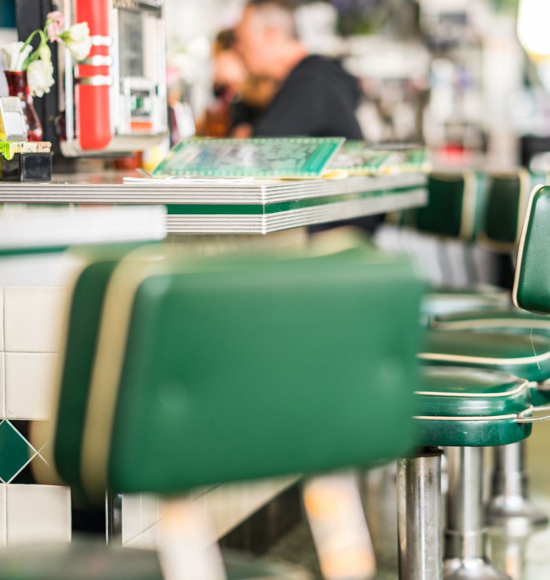
PUB 101 – The Publication of Self in Everyday life
Week One –January 9, 2024

Slide 2
Who we are
Suzanne Norman, Instructor
snorman@sfu.ca
Office Hours:
Wednesday 12:30 to 1:30 pm via Zoom.
Or by appointment – Zoom or In-person
TA: Christina Paul: Christina_Paul@sfu.ca
Office Hours: TBD

Slide 3
Do any of you remember this?
Notes:
2015 – 8 years ago. Before Trump, before hardlines in the sand on social

Slide 4
Expectations
1) TELL US TWO GOALS YOU HAVE FOR THIS CLASS
GO TO MENTI.COM
2) NAME SOME SKILLS YOU HAVE (AND ARE PROUD OF)
GO TO MENTI.COM

Slide 5
So, What is PUB 101?
It is based on Erving Goffman’s The Presentation of Self in Everyday Life.
Dramaturgical theory: on stage and off stage
Who can/should be considered a publisher?
Bloggers? YouTubers? Instagrammers? Podcasters? Gamers? Who?
Explores the concept and practice of “publishing” through the development of your own personal cyberinfrastruture. Your own digital locker.
Student-centered and driven.
You are the the creator and manager. The Master of Your Domain.
Notes:
http://posiel.com

Slide 6
I shall consider the way in which the individual in ordinary work situations PRESENTS himself and his activity to others, the ways in which he GUIDES and CONTROLS the impression they have of him, and the kinds of things he may and may not do while sustaining his PERFORMANCE before them.
Notes:
The Presentation of Self in Everyday Life is a 1956 sociological book by Erving Goffman, in which the author uses the imagery of theatre in order to portray the importance of human social interaction; this approach would become known as Goffman's dramaturgical analysis.

Slide 7
Assessment
One short (~750-wds) essay: 15%
Online development & Process posts (weekly): 35%
Website Accessibility: 10%
Mini assignments: 10%
Peer-review activities: 15%
Participation: 10%
Flexible Five: 5%

Slide 8
Website Accessibility – Born accessible
Accessibility Basics
Use the POUR method of thinking about everything you place on your site.
Perceivable
Operable
Understandable
Robust
The Four Principles of Website Accessibility
Notes:
There are a whole bunch of reasons to ensure your website is accessible and pretty soon it will be law around the globe. So on this fresh start let’s make every site in this class accessible. And let’s celebrate it.

Slide 9
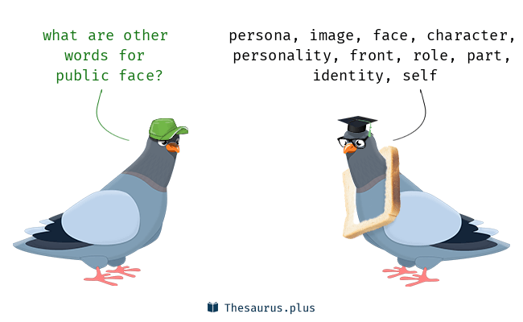
What assignments will you be doing each week?
PUBLIC
ONE POST TO YOUR PUBLIC – COULD BE A BLOG POST, A VIDEO POST, A PODCAST OR ?
BEHIND THE SCENES
ONE PROCESS POST REFLECTING ON THE CLASS MATERIAL/LECTURES/GUESTS
SOMETIMES A MINI ASSIGNMENT
SOMETIMES AN ESSAY
SOMETIMES A PEER REVIEW
ALWAYS LOOKING FOR CONTENT AND BUILDING YOUR SITE
LEADING ONE DISCUSSION ( FOR THE VERY BRAVE )

Slide 10
A typical class
Check-in
What’s up online
Student presentation
Lecture
Activity
Recap

Slide 11
BREAK – 10 mins

Slide 12
WHAT ANNOYS YOU ABOUT THE ONLINE SPACE?
GO TO MENTI.COM
ENTER CODE

Slide 13
What do you like most about the online space?
GO TO MENTI.COM
ENTER CODE

Slide 14
Rank these social platforms?
Go to Menti.com
Enter code

Slide 15
WHO/WHAT IS YOUR FAVOURITE ONLINE – YOUTUBER, PODCASTER, BLOGGER…
GO TO MENTI.COM
ENTER CODE

Slide 17
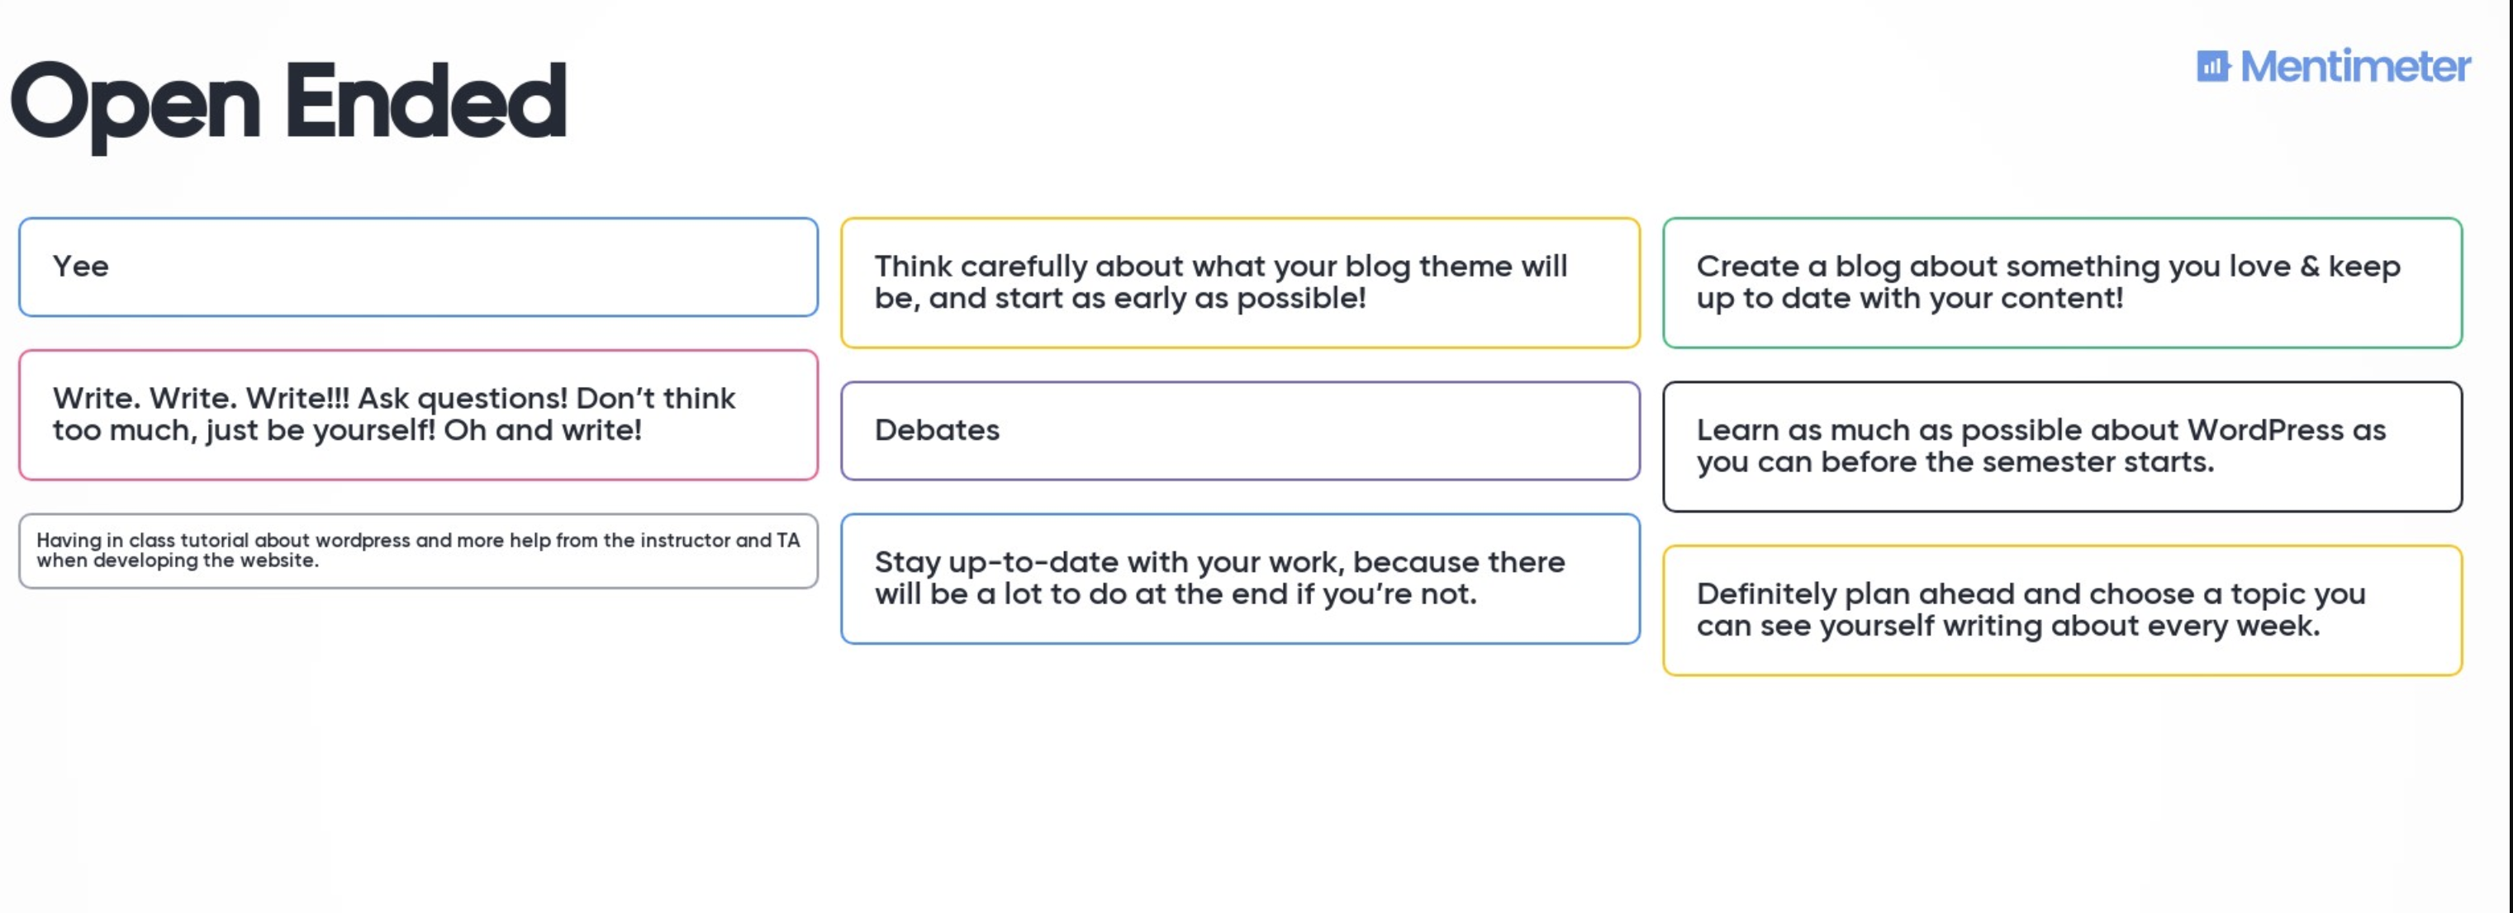

Slide 18
Who Are You Online – 15 mins
With your assigned partner exchange names and spend five minutes getting to know each other.
Now, each of you go online and look for your partner.
Google them. Check their social platforms.
Think about your first impressions of them online.
Compare that to you more intimate class conversation.

Slide 19
For next week: Getting Online
Go
Go to ReclaimHosting.com and set up your own domain and blog (WordPress). Instructions: Hosting Setup
Submit
Submit your URL.
Begin
Begin to familiarize yourself with WordPress terms such as “categories”, “posts”, “pages”, “tags” etc. A useful article is at https://codex.wordpress.org/WordPress_Semantics
Notes:
Go to Google Sheets

Slide 20
For next week: talk to a stranger
Some time this week, strike up a conversation with a stranger. Consider the readings for Week One, particularly Hamblin’s, and reflect on the experience.
When do you consider a person known? How does your behaviour change? IRL? Face to face? What constitutes a stranger? Reflect on any aspect of this experience that interests you.
Is “talking to strangers … good for you”?
NOTE: A safe in-person encounter may not be possible this semester. If so, you can skip this exercise or find an alternate.

Slide 21
Mood/Vision/Word Board
Next week we will work on our vision boards. Creating a firm foundation for your online presence can take some time to let’s take make that time now.
Create a “vision board” for your personal cyberinfrastructure (!) What do you imagine it will look like? Think about this broadly, in terms of themes, platforms, aesthetics, “feel,” etc.
Examples
Bring some materials to class – I will also bring some bits and pieces to play around with.
Notes:
Vision Board:
What is your catnip?
What do you think about at least once a week?
What makes you passionate? What pisses you off? What BRINGS you contentment?
While it is a vision board, use words as well.
Take the next few days and notice the things around you. What inspires you? What annoys you?
What websites are you drawn to? What colours bring your contentment?
What fires you up?
Print it out and keep in view throughout the semester.
What do you first look at in the morning?
Where do you shop online?
How do you think you are perceived online? In person?

