Slide 1
Personal Cyberinfrastructures
Week Two – PUB 101
January 16, 2024

Slide 2
Check in
PSA: Greg Younging Publishing Award
URLs in place?
Process Prompts
What’s up in Socials?
Strangers?
Who are you?
Vision Boards?
Break
Lecture: Personal Cyberinfrastructures
Breakout Discussion
For Next Week
Notes:
TikTok
https://www.technologydecisions.com.au/content/security/news/tiktok-s-privacy-impact-analysed-1330950520
https://techcrunch.com/2020/01/03/tiktok-deepfakes-face-swap/
https://www.vox.com/open-sourced/2019/12/16/21013048/tiktok-china-national-security-investigation

Slide 3
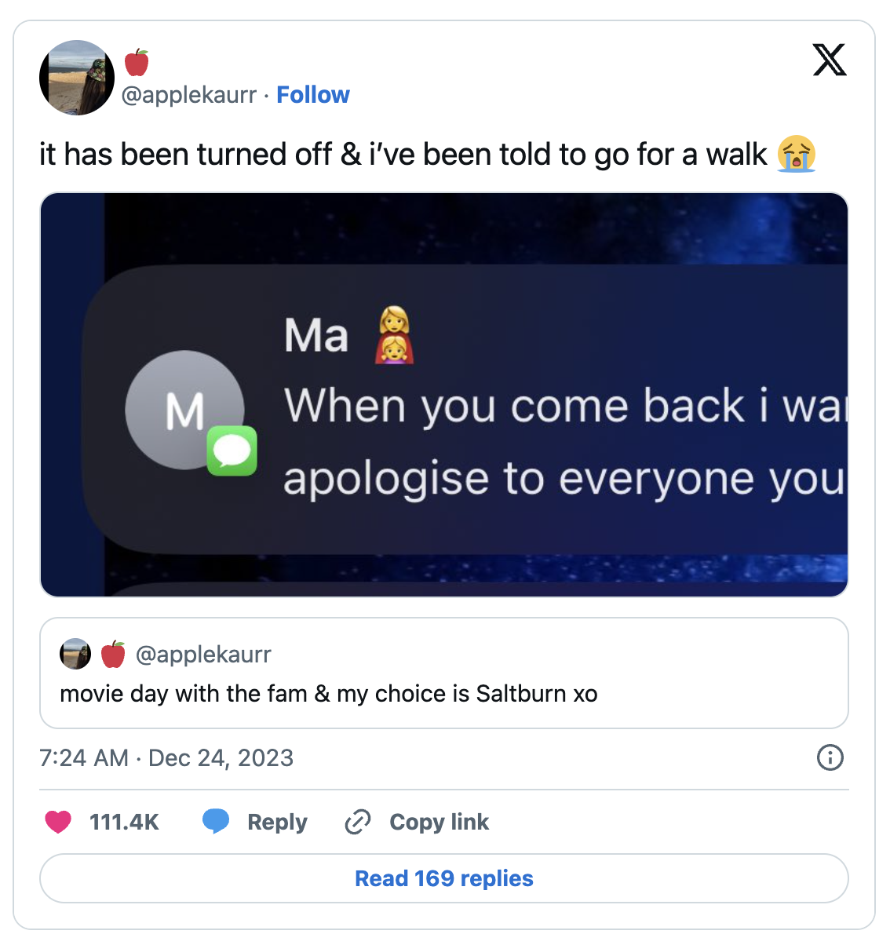
This week in socials
Notes:
https://www.tiktok.com/search?q=cat%20driving&t=1695101262299

Slide 4
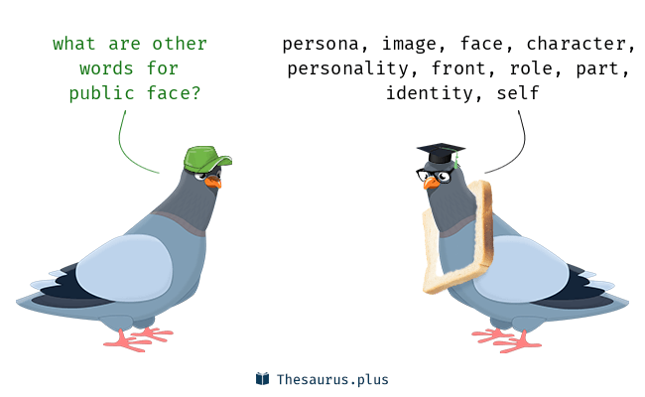
What will you be doing each week (recap)?
Public
Behind the Scenes
ONE POST TO YOUR PUBLIC – COULD BE A BLOG POST, A VIDEO POST, A PODCAST OR ?
ONE PROCESS POST REFLECTING ON THE CLASS MATERIAL/LECTURES/GUESTS
SOMETIMES A MINI ASSIGNMENT
SOMETIMES AN ESSAY
SOMETIMES A PEER REVIEW
ALWAYS LOOKING FOR CONTENT AND BUILDING YOUR SITE
LEADING ONE DISCUSSION ( FOR THE VERY BRAVE )

Slide 5
Notes:
Used with permission
https://www.instagram.com/rodney_mercer_artist/
What is happening here?
What title would you give this image?
Is there one online self and one in person self?

Slide 6
Blogs aren’t dead

Slide 7
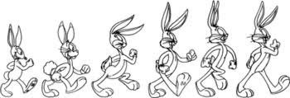
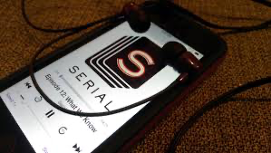
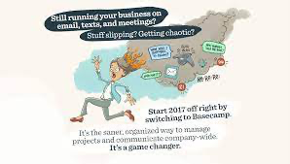
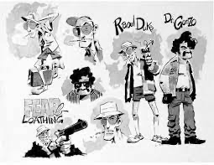
And there is so much more
Podcasts
Vlogs
TikToks
Imagery
Music
Animation
Graphic stories
What else?

Slide 8
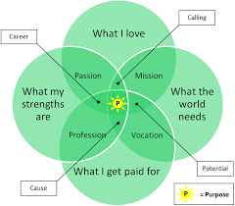
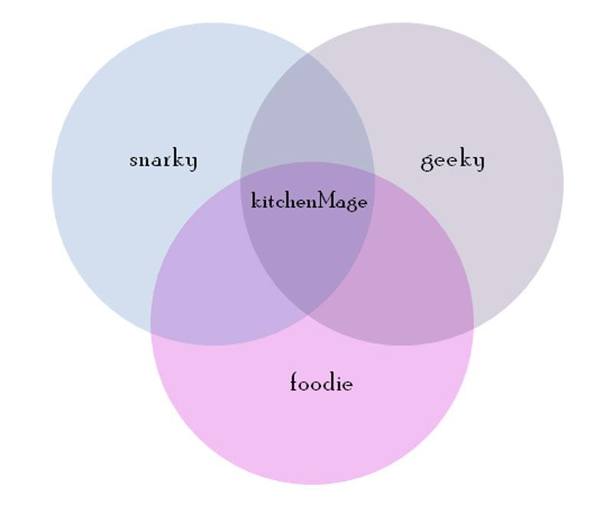
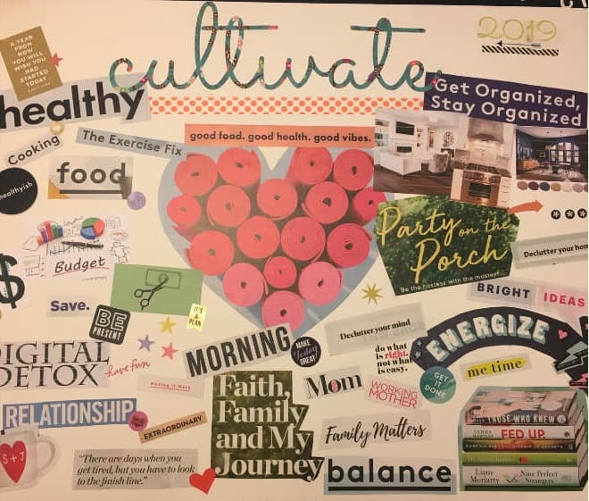
Mood/Vision/Word Board
Continue refining your personal cyberinfrastructure “vision board”.
How is it shaping up? Think about this broadly, in terms of themes, platforms, aesthetics, “feel,” etc.
Notes:
Vision Board:
What is your catnip?
What do you think about at least once a week?
What makes you passionate? What pisses you off? What BRINGS you contentment?
While it is a vision board, use words as well.
Take the next few days and notice the things around you. What inspires you? What annoys you?
What websites are you drawn to? What colours bring your contentment?
What fires you up?
Print it out and keep in view throughout the semester.
What do you first look at in the morning?
Where do you shop online?
How do you think you are perceived online? In person?

Slide 9
Gardner Campbell
Print is not advanced calligraphy
The web is not a more sophisticated telegraph
The medium is the message
New modes of communication change what can be imagined and expressed
[Students] would become, in myriad small but important ways, system administrators for their own digital lives.
Notes:
New modes of technology change what can be imagined and expressed. Think about how you receive the content from Tik Tok versus a blog post. You tube vs a podcast. What senses are involved? Audio books vs a print book vs podcast
Students must be effective architects, narrators, curators, and archivists, inhabitants of their own digital lives

Slide 10
Audrey Watters
“…almost all arguments about student privacy, whether those calling for more restrictions or fewer, fail to give students themselves a voice, let alone some assistance in deciding what to share online. Students have little agency when it comes to education technology — much like they have little agency in education itself.”
Notes:
You have control over your own scholarship, data and digital identity. This course provides a space for you to create your own digital face.
A Domain of One’s Own – a room of one’s own, gives the needed space to write
students need a proprietary online space in order to be intellectually productive.
it is important to have one’s own space in order to develop one’s ideas and one’s craft.
students have already developed rich social lives online and could use help, not punishment or paternalism, in understanding how to think through the data trails they’re leaving behind.
It is important for creativity to have control over your own work,
It is also important to understand the control and data you are giving up when your primary source of publication is Instagram or other social media.
While not intentional on your part, SM platforms shape your online identity – filter bubbles
You should have the opportunity to decide what and when and how that public, online display should look like. You will be in control, responsible as well.

Slide 11
Erin Glass
We know what you ate for dinner, but what did you struggle to reflect on, what were you trying to express?
Let us build a stable space for student writing to accrue dignity and circulate over time across disciplines, institutions, communities, and nations.
Notes:
Every year, enough papers are written by American students to almost reach the moon. Who is reading this writing?
Where are the platforms to allow for public discourse?
[I]t (student writing) occupies a vast portion of the energies and aspirations of students as well as the labour of those who are employed evaluate it. Yet it is also hidden, [it] never has a chance to shine, or rather, to attract an authentic public.
I will be collecting essays this semester.
we have come to feel the great promise that the collaborative, the social and the public hold for our intellectual engagements.
The tools that we use swallow up, lock away, and obscure student writing in the great continuous shuffle of the web.

Slide 12
Personal Cyberinfrastructures
Something more specific than the network itself
More general than a tool
Experiment, play, innovate
“thoughtfully, rigorously, and expressively composed as an excellent essay or an ingenious experiment”
Digital lives - of which you are the system administrator
Notes:
More specific than the network or space you occupy online. But broader than a simple tool such as Instagram. It is your space not inside fences owned, controlled and aggregated by corporations, millionaires etc.

Slide 13
”To build a cyberinfrastructure that scales without stifling innovation, that is self-supporting without being isolated or fatally idiosyncratic, we must start with the individual learners.
Those of us who work with students must guide them to build their own personal cyberinfrastructures, to embark on their own web odysseys. And yes, we must be ready to receive their guidance as well.”
Gardner Campbell
Notes:
Scales – can grow
Can have readers and audience

Slide 14
Break

Slide 15
Case study –
Founded by Maria Popova in 2006 for a few friends
Curated content – an emporium of narrative, images, letters
Renamed The Marginalian on its 15 birthday in 2021
> 5 mill pageviews
946.6 k twitter followers
Direct Newsletter
No ads; subscription and patron
“ I don’t hold knowledge in all the domains and disciplines I tweet about, I hold curiosity about them.”
Notes:
https://www.copyblogger.com/how-maria-popova-writes/
“Over the years, I grew up and grew on these pages — more than six million of them, if one were to paginate and print everything I have published on the site over the years, dwarfing the 600 pages of Figuring and microscopizing The Snail with the Right Heart. I filled this infinite scroll with my reflections on what I was reckoning with — my marginalia on life and the most important things I was learning about it along the way, often through reading, often from people and ideas marginalized by culture, erased by the collective selective memory we call history, because they were in some way too other, too ahead of their time or apart from its mores, saw too clearly through the willful blindnesses of their era or bent their vision too far past its horizons of possibility.
In the margins of books, in the margins of life, as commonly conceived by our culture’s inherited parameters of permission and possibility, I have worked out and continue working out who I am and whom I wish to be — a private inquiry irradiated by the ultimate question, the great quickening of thought, feeling, and wonder that binds us all: What is all this?”

Slide 16
What it is…
”Brain Pickings is your LEGO treasure chest, full of pieces across art, design, science, technology, philosophy, history, politics, psychology, sociology, ecology, anthropology, you-name-itology. Pieces that enrich your mental pool of resources and empower you to combine them into original concepts that are stronger, smarter, richer, deeper and more impactful — a modest, curiosity-driven exercise in vision- and mind-expansion.”

Slide 17
“I ask myself three things”
Is it interesting enough to leave the reader with something – a thought, an idea, a question – after the immediate fulfillment of the self-contained reading or viewing experience;
Is it evergreen in a way that makes it just as interesting in a month or a year;
Am I able to provide enough additional context – historical background, related past articles, complementary reading or viewing material – or build a pattern around it to make it worth for the reader to share, link to and engage with the [site’s] article rather than the thing – book, TED talk, site – being featured directly.
Notes:
With every piece of content I choose for [the site] (as opposed to for Twitter or Google+),

Slide 18
On Twitter…
”I only really follow “linkers” – people who share links to interesting content in at least 90% of their tweets. For myself, I tweet three external links for every link to a Brain Pickings article.”
Notes:
“I’m not a conversational tweeter, nor do I follow conversational tweeters – everyone uses Twitter differently, but for me, it’s purely an information discovery platform, so my choices about whom to follow stem from the maximum workflow efficiency keeping that purpose in mind.
And even within linkers, I prefer people who don’t just share links to their own site, however fantastic it might be – otherwise, I’d just subscribe via RSS in Google Reader, which I live and die by anyway.”
This is contrary to what I advise

Slide 19
Activity: Groups
What changes could be made to effectively promote creativity and student agency in the digital world as opposed to this “digital facelift?”
In “A Personal Cyberinfrastructure,” Campbell uses the term “digital facelift” to describe new mediums of (digital) communication that came about through higher education and argues that these mediums/media failed to empower the imaginations of students.
Notes:
How have certain systems that are used in education today such as (Zoom, Blackboard, Teams, Connect, Discord) affected you?
What is a personal cyberinfrastructure?
Why should you care about it?
How do you use it?
How does it use you?
What can we imagine differently?

Slide 20
Activity: Groups
Any technology gradually creates a new human environment, can you think of any new “environments” – over your lifetime – that have come about from such technological changes?
How have these environments affected future technological changes?
Notes:
Deep fakes
Ex. Blogging (old school, 1990s) influencing Myspace influencing the creation of Facebook influencing other social networking sites.
TikTok

Slide 21
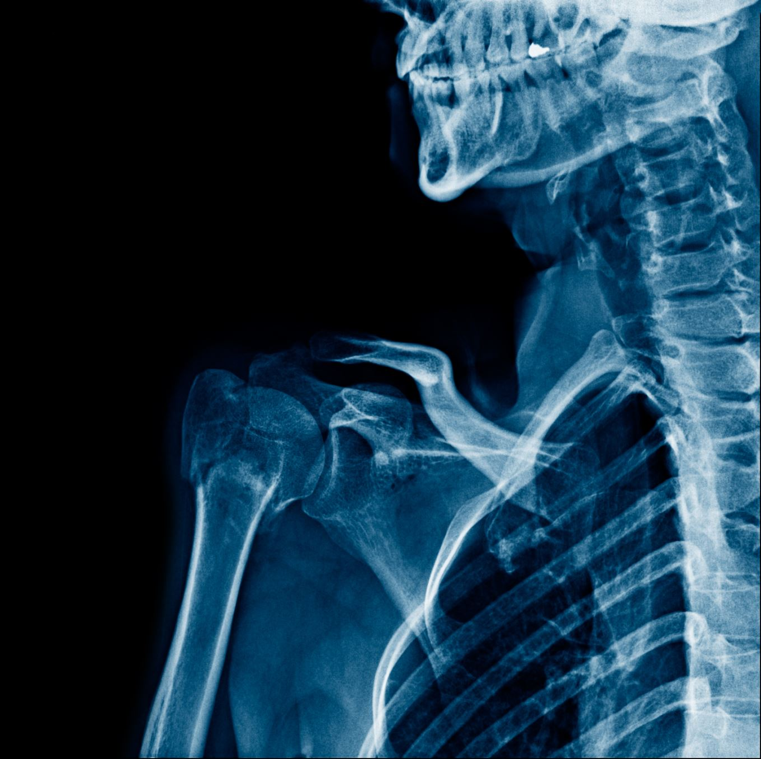
Clarification of Pain Points?

Slide 22
For Next Week
Create
Create your “About” section. Here is an example.
Complete
Complete your vision board.
Install
Install the Google Analytics plugin.
Create
Mini Assignment #1: Create a meme that reflects you or your blog. Post it; tag it @sfupublishing, @learnpublishing #posiel; tweet it, #posiel.

