Slide 1
Editing & Genre + Accessible Websites PUB 101 February 6, 2024

Slide 2
On the menu
Check in
Social media this week
Editors and Genres
Break
Accessibility

Slide 3
First, some fun
Infinite Craft
Calendar

Slide 4
Notes:
https://twitter.com/elmo/status/1751995117366296904?s=43&t=cwsXBsxRzZdYUXUZhMDdxQ

Slide 5
Notes:
https://twitter.com/elmo/status/1751995117366296904?s=43&t=cwsXBsxRzZdYUXUZhMDdxQ

Slide 6
Notes:
https://twitter.com/i/status/1754382171463434421

Slide 7
Tracy Chapman ft. Luke Combs
Notes:
https://twitter.com/yashar/status/1754382171463434421

Slide 9
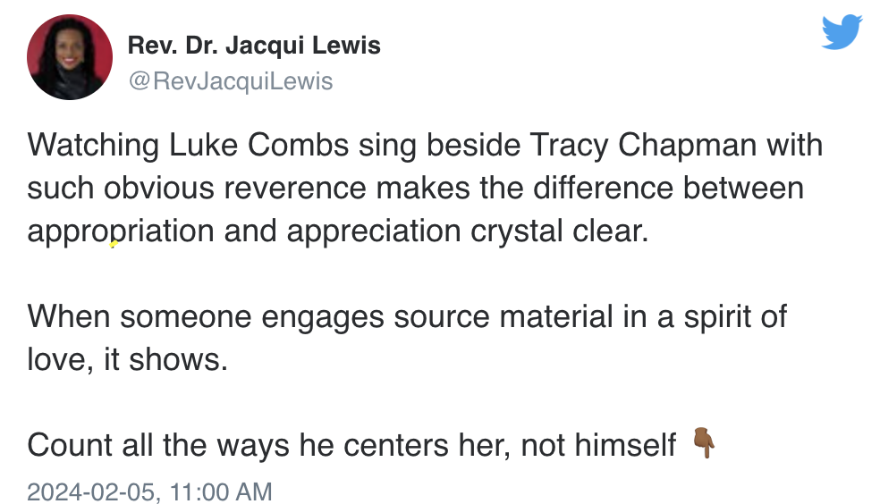
Appropriation or Appreciation?
Notes:
1988 song hits number 1 24 hours after release

Slide 12
“An editor does not add to a book. At best he serves as a handmaiden to an author. Don’t ever get to feeling important about yourself, because an editor at most releases energy. He creates nothing.”
~ Maxwell Perkins

Slide 13
The Editor
In a sense, everyone edits. A writer revises a manuscript. A speaker pauses in mid-sentence to find a better word. A student clarifies her lecture notes. They are all editing.
Professional editors carry out those sorts of tasks for a living. No matter what project an editor is tackling, the goal is always the same: to improve the quality of communication.

Slide 14
Editorial
Beyond working within a text, we also think of editors as the people who make curatorial and audience choices about various communications: a process of assembly, filtering and matching.
Notes:
In a publishing house, an acquisitions editor will select manuscripts
A magazine editor chooses articles
As the admin of your domains, you will choose what is published.

Slide 15
Levels
Acquisitions Editing
Structural or Substantive Editing
Stylistic Editing
Copyediting
Proofreading
Indigenous Editing Protocols

Slide 16
Substantive Editing
Shapes the text
Balance
Chronology
Beginnings and endings
Linkages
Chapters
Mechanical components
Tone

Slide 17
Stylistic
The stylistic editor is also known as a line editor, a content editor, or a manuscript editor. This type of editing is for voice, tone, sense, and flow.
The stylistic editor ensures the material is consistent and accessible to the intended audience.

Slide 18
Copyediting
The copyeditor is responsible for correcting the “mechanics” of the text. They will develop a style sheet specific to the title, which will guide the proofreading process.
Notes:
This style sheet will include special spellings, unique characters, or items that differ from the house style.

Slide 19
Proofreading
The proofreader will check for any typographical errors, deviations from house style (unless indicated in the style sheet), design and composition errors, and flag any errors from previous levels of editing.
Notes:
The proofreader will work on the master set of proofs and will use standard proofreading marks.

Slide 20
Indigenous Editing Protocols
Existing editing practices in western countries were built at the exclusion of Indigenous peoples.
Current copyright laws do not protect.
Editing protocols vary from nation to nation and even within the same community.
Indigenous stories and knowledge systems must be approached with Indigenous community-focused editing practices, employed with care by Indigenous editors.
(source: IEA, 2023)

Slide 21
Other Editorial Responsibilities
Marking and Coding: Setting the text up for digital readiness. Meta data, alt text
Fact checking: In the publishing contract the author will warrant that all the material in the manuscript is correct. However, the publisher also has to do due diligence and ensure any flagged “facts” are verified.
Photo research: Photos used in a publication, unless taken by the author, need to cleared for copyright purposes.
Catalogue copy: Often the information contained in the TI sheet can be used to create copy for the house catalogue. The catalogue is distributed to buyers to give them quick, clear information on a complete seasonal list of titles.
Notes:
And all these roles will vary again with the form and genre

Slide 22
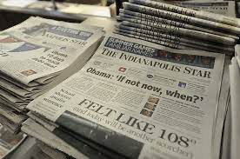
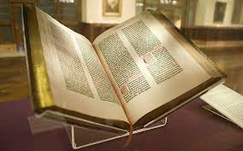
Editors work with Form and Genre
Form – the published format of the story
A Tweet is different from an Instagram post.
A book is different from a magazine article
A letter is different from a newspaper article
Genre – the category of the work
Fiction
sub-genres
Non-fiction
News
Entertainment
Lectures
Notes:
I used to call this lecture editors, form and genre.
Forms have really come to have less significance today.

Slide 23
Form and Genre
Overlap and work together: Graphic novels, mashups (Limetown)
Clash: Think of an accident report typically run in a newspaper, could not be placed in a book?
Create new content containers: Narratives in games (Device Six); choose your own adventure Black Mirror: Bandersnatch

Slide 24
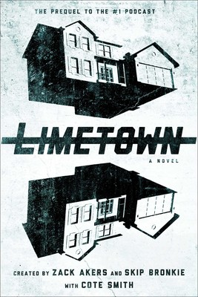
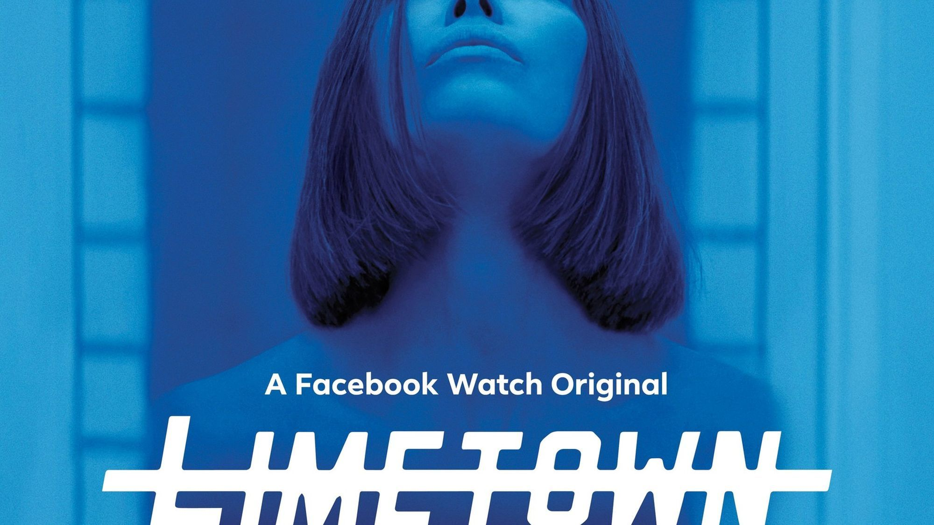
Limetown
Notes:
https://youtu.be/Fxbw7vwCKYw
Started as a podcast, deal with S&S for a book – which got you a free second season of the podcast, then the series which premiered on Facebook watch

Slide 25
The form is crumbling
The problems that an all-in-one, packaged publication used to solve just don’t exist anymore.
Literature has escaped its traditional containers.
We like to create, recreate, rework, mash up, remix.
Notes:
The form as we know it is continually crumbling
Genre used to be heavily influenced by form.
Books meant one thing. Newspapers meant another. Magazines another. Radio shows another.

Slide 26
But we still have genres
Genres used to be heavily constrained and influenced by form
Genre is a sort of game we play--with texts, and with other kinds of communication
Notes:
Genre used to be heavily influenced by form. newspaper article, magazine feature, short story, novel.
A newspaper would contain breaking news. Longer features. Too short for magazines. Even newspaper comics were of a certain look and size.
Romance was a book a novel.
News stories were in newspapers and news magazines
Literary magazines published short fiction.
We recognize things as members of a genre, we write to genres, with expectations of a certain kind of people recognizing it in a certain genre. We're also continually messing with genres: we gradually invent and recognize sub-genres; we mash up genres.

Slide 27
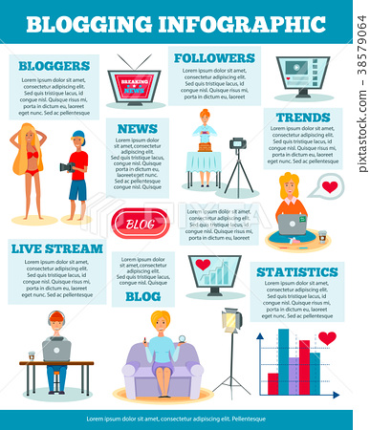
The Blog as form then…
Can also be seen as a supergenre, with many forms within it.
News bits, long-form journalism, critical essays, food photos, microblogging, vlogs, podcasts, streaming, memes…

Slide 28
And genres transform and morph
Perhaps a genre is a thing that publics respond to? That develop from our counterpublics?
Are genres created?
Fanfic
Interactive fic
Mythology fic (mythopoeia)
Cli Fic or Cli –Fi
Minimalism
Bizarro
Notes:
Is genre a "social action" rather than being about identifiable characteristics of literary works?
Fanfic: 50 shades;
Interactive fic: reemerging with ebooks and better narratives in gaming. Women and Bad Decisions by Shawn Harris
Myth fic: game of thrones, percy Jackson (mysths are created by the authors)
Cli fi- climate based – Solar by Ian McEwan;
Minimalism – striped down text and sentences, assumes the audience is intelligent. More like a conversation. Championed by Chuck Palahniuk (of fight club). A good example is Yje Monds Eye by Oliver Sacks or 31 songs by nick Hornby. Also gran lit and
bizzario good weird fiction – Shatnerquake for example

Slide 29
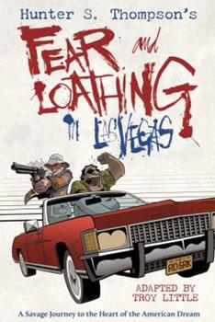
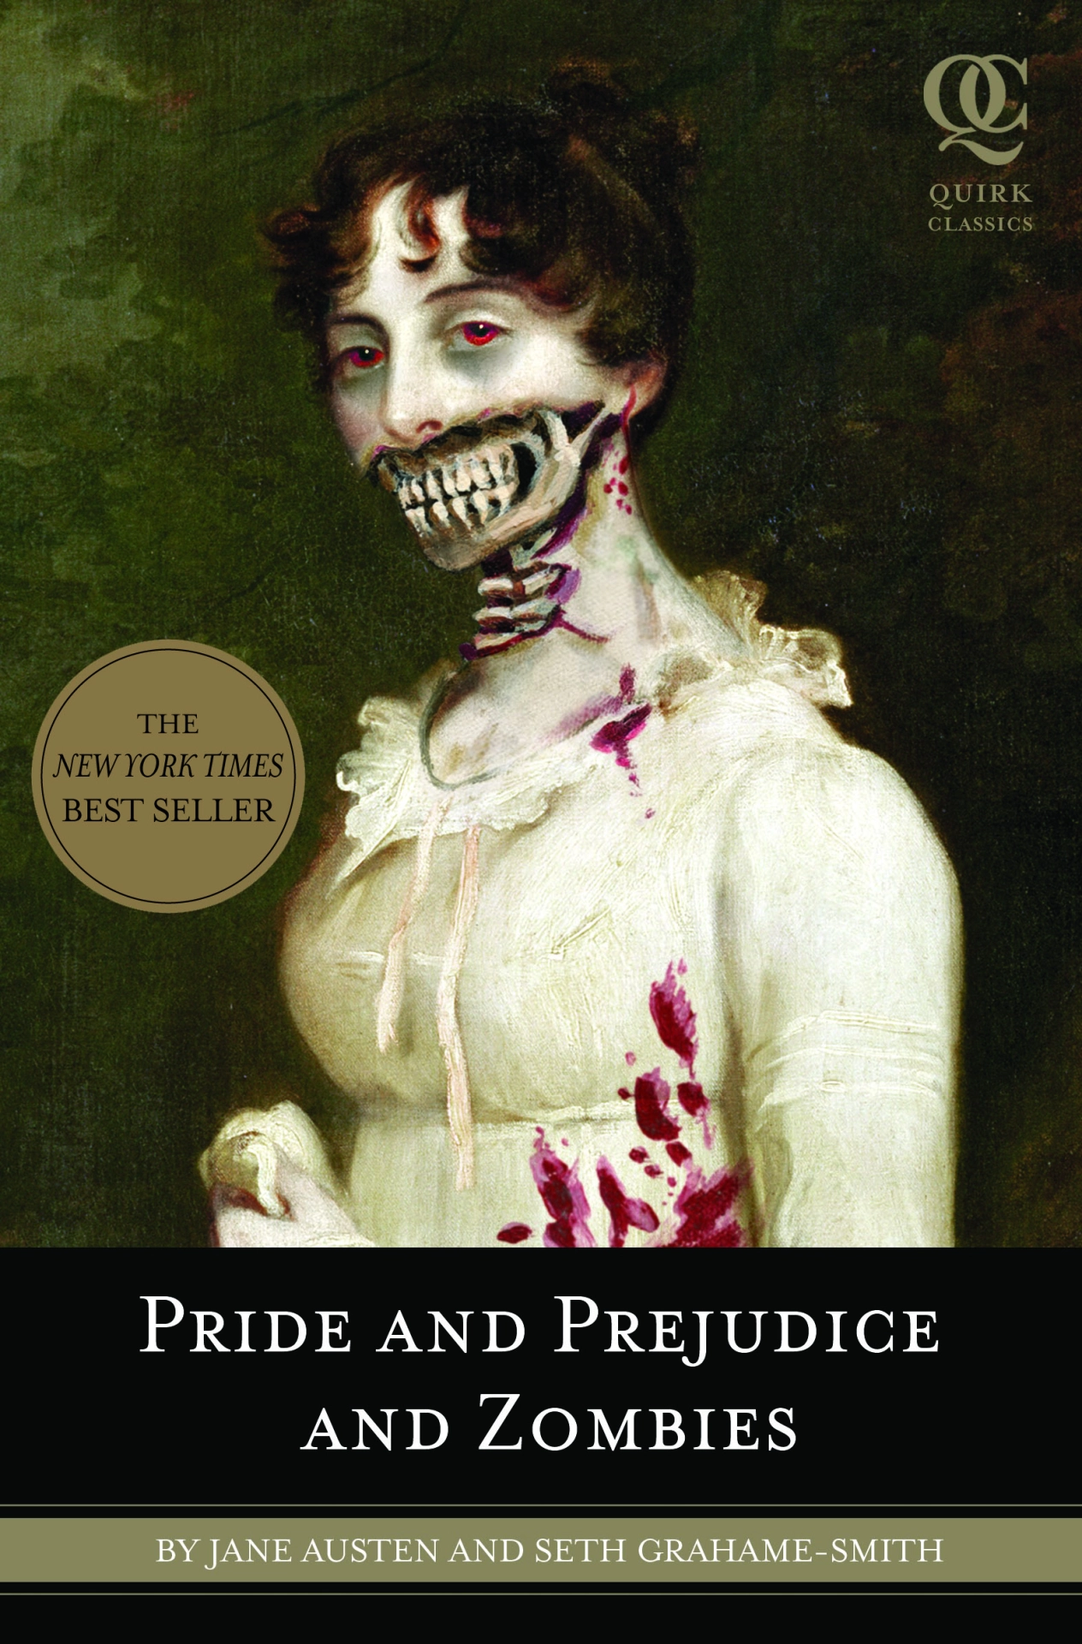
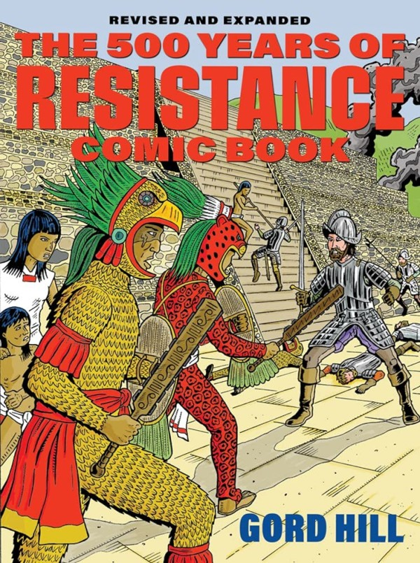
Notes:
Comics in hard cover book format
Classic literature marketed as literature? Horror? Romance? Comedy Horror? Dramatic comedy? Then a movie?
https://www.nytimes.com/projects/2012/snow-fall/index.html#/?part=tunnel-creek Pulitzer Prize winning Project – 2012. Is there another word to describe what it is?
https://www.generatormix.com/random-genre-generator
https://perchance.org/genre-aesthetic-mashup

Slide 30
Genre?
Notes:
Fan Fic

Slide 31
Genre?
Adopt the life of a somewhat average, late twenty-something who has broken up with his girlfriend and is ready to hit the night looking for love... Will your night end with a wild rumpus in the sack with some filly? Can you bed the cougar? Or will horrible tragedy leave you dead in some back alley? YOU MAKE THE DECISIONS THAT DETERMINE THE STORY.
Notes:
Interactive Fic / Black Mirror Bandersnatch

Slide 32
Genre?
As Warden of the north, Lord Eddard Stark counts it a curse when King Robert bestows on him the office of the Hand. His honour weighs him down at court where a true man does what he will, not what he must … and a dead enemy is a thing of beauty. The old gods have no power in the south, Stark’s family is split and there is treachery at court. Worse, the vengeance-mad heir of the deposed Dragon King has grown to maturity in exile in the Free Cities. He claims the Iron Throne.
Notes:
Myth Fic

Slide 33
Genre?
With a global scope, Solar is a comedy dealing directly with the crises of today. A story of one man's ambitions and self-deceptions, it is a startling and stylish new departure in the work of one of the world's great writers.
Notes:
Cli-Fic or Cli SCI

Slide 34
Genre?
After a reality bomb goes off at the first ever ShatnerCon, all of the characters ever played by William Shatner are suddenly sucked into our world. Their mission: hunt down and destroy the real William Shatner. Featuring: Captain Kirk, TJ Hooker, Denny Crane, Priceline Shatner, Cartoon Kirk, Rescue 9-1-1 Shatner, singer Shatner, and many more.
Notes:
Bizzaro

Slide 35
Genre?
Through thirty-one songs that he either loves or has loved, Nick Hornby tells us what music means to his life. These personal and passionate pieces – refreshingly free of pretension – are a celebration of the joy that certain songs have given him. Together with additional writings on music from his column in the new Yorker – seen in the UK for the first time – 31 Songs is for Hornby what many of us have always wanted: a soundtrack to accompany life.
Notes:
Minimalism

