Slide 1
Multiple Channels, Multiple Media
PUB 101, Week Eleven
November 24, 2020

Slide 2
Creating Digital Content
Start with your home base - your website
o Create content that reflects:
§ How people consume content online
§ How people find content online
o Leverage additional platforms and channels:
§ Adapt content for different channels
§ Capitalize on sharing behaviour

Slide 3
Optimize for Web Readers
o Create content that reflects how people read online

Slide 4
How People Read Online
Scan a page in under 10 seconds looking for specific information via bold subheads and heads
Browse link anchor text for calls to action or to navigate
Don’t go below the fold unless motivated
Spend more time scanning the left
Scan only the first few words of a headline, blurb or sentence
o Click around a lot. Read about 20% of what is on a page
Notes:
most page visits are only seconds long; most site visits only include one or two pages

Slide 5
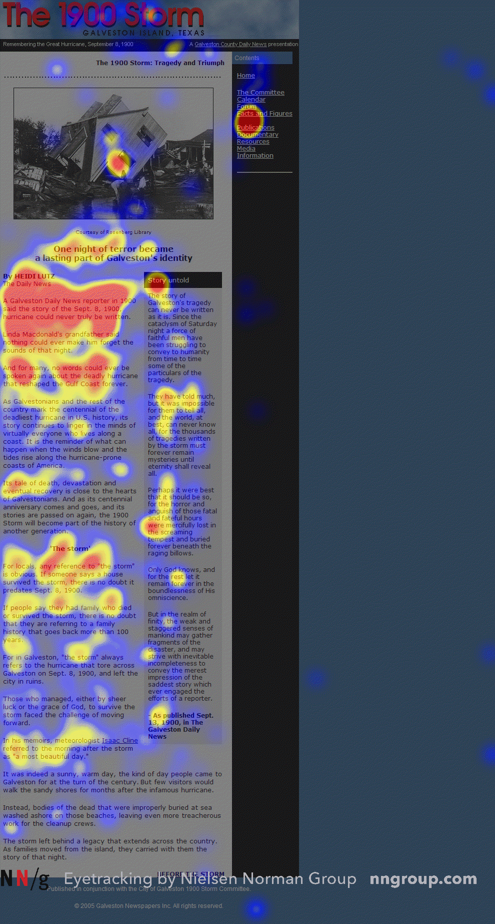
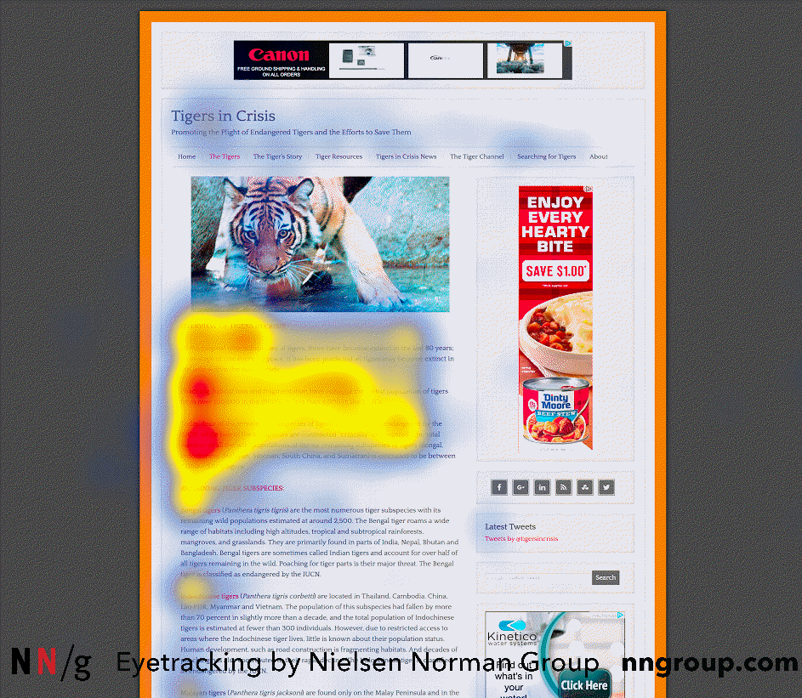
How People Read Online
Eyetracking studies identified an online reading pattern: the F pattern
People also tend to scan just the first two words of a sentence, link or list item, deciding whether to continue

Slide 6
The “F” Reading pattern
Heat/gaze studies showed readers “fixated” most on:
a top horizontal line
A second horizontal line
A vertical line along the left side
Once thought to be a way to customize content for common reading patterns
Only really works well with intentionally formatted content
Bullet points, bolded content, short phrasing, keywords
Notes:
The original thinking was that if content creators and designers ensured the fixated areas contained key words and the most important content, then the reader would be given the content we want them to read. However, if the reader is looking for information they will engage differently on the navigation pages. Do your navigation bars appear on your content pages? How many navigation areas do you have? How do you design your content differently to account for reading patterns?

Slide 7
Beyond the F
Layer-cake pattern occurs when the eyes scan headings and subheadings and skip the normal text below
Spotted pattern consists of skipping big chunks of text and scanning as if looking for something specific
Marking pattern involves keeping the eyes focused in one place as the mouse scrolls or finger swipes the page
Bypassing pattern occurs when people deliberately skip the first words of the line when multiple lines of text in a list start all with the same word(s).
Commitment pattern consists of fixating on almost everything on the page.
Notes:
Layer: A gaze plot or heat map of this behavior will show horizontal lines, reminiscent of a cake with alternating layers of cake and frosting.
Spotted: such as a link, digits, a particular word or a set of words with a distinctive shape (such as an address or signature).
Marking: like a dancer fixates on an object to keep balance as she twirls. Marking happens more on mobile than on desktop.
Commitment: If people are highly motivated and interested in content, they will read all the text in a paragraph or even an entire page. (Don’t count on this to happen frequently, though. Assume that most users will be scanning.)

Slide 8
weaknesses of the F pattern
It’s not indicative of reader process when navigation areas are visible
Responsive websites mean fixations in F patterns may be on different words
Important words and phrases can be missed
Can be mitigated by good design
Notes:
Think of the different words that are present in the F pattern on mobile or different size screens.

Slide 9
Do the work for your readers
Include the most important points in the first two paragraphs on the page.
Use headings and Subheadings. Ensure they look more important, and are more visible.
Start headings and subheadings with the words carrying most information: COVID19 positive users might only see the first 2 words, they should still get the gist of the following section
Bold important words and phrases
Take advantage of the different formatting of links, and ensure that links include information-bearing words. This also improves accessibility for users who hear links read aloud
Use
bullets and
numbers to call out items in a list or process.
Cut unneces.
Adapted from
Visually group small amounts of related content
Like lists
Or cake
Or beer
Notes:
Include the most important points in the first two paragraphs on the page.
Use headings and subheadings. Ensure they look more important, and are more visible, than normal text so users may distinguish them quickly.
Start headings and subheadings with the words carrying most information: if users see only the first 2 words, they should still get the gist of the following section.
Visually group small amounts of related content — for instance, by surrounding them with a border or using a different background.
Bold important words and phrases.
Take advantage of the different formatting of links, and ensure that links include information-bearing words (instead of generic “go”, “click here” or “more”). This technique also improves accessibility for users who hear links read aloud instead of scanning the content visually.
Use bullets and numbers to call out items in a list or process.
Cut unnecessary content.

Slide 10
Images and Video

Slide 11
READING VS. WATCHING
WHILE READING IS ALL ABOUT THINKING, VIDEO IS BETTER AT GETTING US TO FEEL

Slide 12
An Online State of Mind
USER STATE OF MIND
THE USER STATE OF MIND IS DIFFERENT ON THE WEB THAN IN PRINT MEDIA
THE WEB IS ALL ABOUT INFORMATION ON DEMAND VS. BROWSING

Slide 13
An Online State of Mind
SCREEN DISPLAY MAKES READING SLOWER
LOWER RESOLUTION MAKES ONLINE COPY HARDER TO READ, DUE TO FACTORS LIKE SCREEN GLARE
STUDIES HAVE SHOWN READING ONLINE IS ABOUT 25% SLOWER THAN READING A PRINTED DOCUMENT

Slide 14
An Online State of Mind
THE WEB IS INTERACTIVE
THE WEB IS A LINKED MEDIUM. THE USER MOVES WHERE HE OR SHE WANT TO GO, AND CAN EASILY START IN THE MIDDLE
Notes:
Non Linear
Hyperlinked
Remind them to come back

Slide 15
Your Copy Must…
KNOWING WHAT WE KNOW ABOUT HOW PEOPLE USE THE WEB, YOUR COPY MUST:
FOCUS ON WHAT THE READER IS LOOKING FOR, AND OFFER IT UP QUICKLY
MAKE IT EASY FOR THE READER TO SPOT WHAT THEY’RE LOOKING FOR ON A PAGE O EMPLOY SCANNABLE TEXT, USING:
BOLD SUBHEADINGS
LISTS
ANCHOR LINKS
HAVE MEANINGFUL HEADINGS AND SUB-HEADINGS (NOT “CLEVER ONES”)
USE BULLETED OR NUMBERED LISTS WHERE POSSIBLE
STICK TO ONE IDEA PER PARAGRAPH (USERS WILL SKIP OVER ANY ADDITIONAL IDEAS IF THEY ARE NOT CAUGHT BY THE FIRST FEW WORDS IN THE PARAGRAPH)
INCLUDE CALLS TO ACTION
HAVE HALF THE WORD COUNT OF CONVENTIONAL WRITING

Slide 16
Content Must-Haves

Slide 17
Content Must-Haves - Title

Slide 18
Content Must-Haves - Microcontent

Slide 19
Content Must-Haves - Keywords

Slide 20
Content Must-Haves - Visuals

Slide 21
Content Must-Haves - Call to Action

Slide 22
Optimize for Search
CREATE CONTENT THAT WILL BE FOUND AND RANKED WELL BY SEARCH ENGINES
Notes:
Review the SEO strategies from week ten

Slide 23
How People Find Content
CONSIDER HOW YOUR READERS DISCOVER CONTENT AND OPTIMIZE FOR DISCOVERY
SEARCH
SOCIAL MEDIA
E-NEWSLETTER
INFLUENCERS

Slide 24
What is SEO? (redux)
• SEARCH ENGINE OPTIMIZATION IS THE PRACTICE OF IMPROVING AND PROMOTING A WEBSITE IN ORDER TO INCREASE THE NUMBER OF VISITORS THE SITE RECEIVES FROM SEARCH ENGINES
• SEO ALLOWS SEARCH ENGINES TO FIND YOUR CONTENT AND DELIVER IT TO READERS WHEN THEY SEARCH FOR SOMETHING YOUR SITE OFFERS
• WHEN SOMEONE TYPES A SEARCH TERM INTO A SEARCH ENGINE, A COMPLEX SET OF ALGORITHMS IS UNDERTAKEN TO COME UP WITH THE SEARCH RESULTS

Slide 25
Why do SEO?
THINK ABOUT YOUR OWN WEB SEARCHES. HOW FAR DOWN THE LIST OF RESULTS DO YOU SCAN?
ON AVERAGE, 71% OF SEARCHERS WILL CLICK ON A RESULT ON PAGE ONE OF THE SEARCH RESULTS
PAGES TWO AND THREE GET ONLY 5.59% OF THE CLICKS
ON THE FIRST PAGE ALONE, THE FIRST 5 RESULTS ACCOUNT FOR 67.60% OF ALL THE CLICKS AND THE RESULTS FROM 6 TO 10 ACCOUNT FOR ONLY 3.73%

Slide 26
PAGE SEO
ONE OF THE EASIEST WAYS TO IMPLEMENT SEO IS BY ENSURING YOUR COPY CONTAINS KEYWORDS
A KEYWORD IS:
A WORD OR PHRASE THAT DESCRIBES WHAT YOUR CONTENT IS ABOUT
KEYWORDS SHOULD BE DRIVEN BY PHRASES A POTENTIAL READER WOULD USE TO FIND THE CONTENT VIA A SEARCH ENGINE
TRY TO IMAGINE WHAT SOMEONE WHO DOESN'T KNOW YOUR SITE YET WOULD TYPE INTO A SEARCH ENGINE TO FIND SOURCES OF INFORMATION ON YOUR TOPIC

Slide 27
KEYWORD CHARACTERISTICS
THE BEST KEYWORDS ARE:
SPECIFIC 2-3 WORD PHRASES
NAMES OF PEOPLE, PLACES, COMPANIES, PUBLICATIONS, ETC.
COMMON MISTAKES IN SELECTION OF KEYWORDS INCLUDE TARGETING:
SINGLE-WORD TERMS
TERMS THAT ARE TOO BROAD, AND NOT FOCUSED TO WHAT YOU OFFER O TERMS THAT ARE TOO SPECIALIZED
TERMS THAT ARE UNPOPULAR
HIGHLY-COMPETITIVE TERMS WHICH YOU CAN'T HOPE TO RANK WELL FOR

Slide 28
Keywords
HAVE A PRIMARY KEYWORD AND SOME SECONDARY KEYWORDS (FIGURE OUT ALTERNATE WAYS OF SAYING WHAT YOUR CONTENT IS ABOUT)

Slide 29
Placing Keywords
PUT YOUR KEYWORDS IN YOUR:
BROWSER TITLE/META TITLE
PAGE/ARTICLE TITLE – THIS WILL GET PICKED UP IN YOUR URL
SUBTITLE/DECK – IF APPLICABLE
PAGE INTRODUCTION
SUBHEADINGS
LINKS
PHOTO/VIDEO CAPTIONS
META DESCRIPTION

Slide 30
IMPORTANCE OF TITLES
SEARCH ENGINES VIEW ANYTHING YOU PUT IN TITLE AND HEADING TAGS TO BE OF UTMOST IMPORTANCE FOR YOUR SEO – WEIGHTED HEAVILY IN RANKING
YOUR PAGE TITLE/ARTICLE TITLE TELLS BOTH THE SEARCH ENGINE – AND THE READER – WHAT THEY CAN EXPECT TO FIND ON THAT PAGE
PRINT TITLES DON’T TYPICALLY TRANSLATE WELL TO WEB
IDEAL SCENARIO IS TO ADJUST YOUR TITLE ONLINE TO ENSURE IT CONTAINS KEYWORDS
A SIMPLE SOLUTION WOULD BE TO APPEND A COLON, FOLLOWED BY A KEYPHRASE, TO THE ORIGINAL TITLE

Slide 31
Optimize for Social Engagement
READERS WANT TO ENGAGE WITH AND SHARE YOUR CONTENT IN A VARIETY OF WAYS. MAKE IT EASY FOR THEM TO DO SO
FORUMS/COMMENT BOARDS HTTP://THETYEE.CA
AGGREGATION HTTP://THETYEE.CA
BLOGS HTTP://BLOG.CHIMP.NET
SHARING TOOLS HTTP://WWW.BCLIVING.CA
MOST POPULAR HTTPS://WWW.NYTIMES.COM/TRENDING/

Slide 32
Optimize for Social Engagement
INTEGRATE CONTENT FROM OTHER CHANNELS
FLICKR
HTTP://WWW.FLICKR.COM/GROUPS/BCLIVING/ HTTP://WWW.BCLIVING.CA/TRAVEL/THROUGH-YOUR-LENS-A-FOGGY-DAY-IN-BC
OTHER USER-GENERATED CONTENT
WWW.GREENYOURCAMPBELLCASH.COM

Slide 33
Leverage Multiple Platforms
FIRST, DECIDE ON YOUR FORMAT:
BLOG POST
PHOTO GALLERY
VIDEO
INFOGRAPHIC
VIDEO STORY

Slide 34
NEXT, PICK YOUR CHANNEL
YOUR PUBLICATION
BREAK ORIGINAL STORY INTO CHUNKS AND DISTRIBUTE ACROSS MULTIPLE CHANNELS

Slide 35
Understanding Social Sharing
SOCIAL MEDIA USAGE IS NEARLY UBIQUITOUS
94% OF CANADA’S ONLINE POPULATION USES SOCIAL MEDIA
NEARLY 1 IN EVERY 5 MINUTES ONLINE IS SPENT IN SOCIAL MEDIA
comScore: The State of Social Media

Slide 36
Understanding Social Sharing
GREAT CONTENT IS THE LIFEBLOOD OF SOCIAL MEDIA – PEOPLE DEFINE THEMSELVES BY WHAT THEY SHARE, WHETHER IT’S FUNNY, ENLIGHTENING, SERVICE-ORIENTED OR FOR PROFESSIONAL DEVELOPMENT
A SOCIAL STRATEGY MUST START WITH CONTENT THAT IS DESIGNED FOR EACH PLATFORM AND IS INHERENTLY SHAREABLE
IF YOU USE A DASHBOARD BE SURE IT IS COMPATIBLE WITH ALL THE SOCIAL PLATFORMS YOU USE
Notes:
Hootsuite or social sprout are both good dashboards

Slide 37
Understanding Social Sharing
Notes:
Determine who may be in your social platforms and how they might be encouraged to share your content. Try a quiz or survey to get better insight into your audience.

Slide 38
Understanding Social Sharing
WHAT IS SHAREABLE CONTENT?
IT HELPS PEOPLE CONNECT:
IT’S USEFUL:
IT STARTS A CONVERSATION:
IT STRIKES AN EMOTIONAL CORD IT HELPS DEFINE US:
IT’S FUNNY
IT MAKES US LOOK SMART
IT MAKES US FEEL PART OF SOMETHING BIGGER
IT’S JUICY
http://marketingland.com/9-real-life-rules-for-creating-shareable-content-10072
Notes:
WE SHARE CONTENT WE KNOW OUR FRIENDS WILL LIKE (HTTP://WWW.BCLIVING.CA/HEALTH/COFFEE-HEALTH-BENEFITS)
DON’T JUST CREATE HELPFUL CONTENT. CREATE THE MOST HELPFUL CONTENT. DO THE RESEARCH NO ONE ELSE WANTS TO DO AND IT WILL BE SHARED (HTTP://WWW.BCLIVING.CA/HEALTH/BEST-VANCOUVER-BOOT-CAMPS)
MANY PEOPLE WILL SHARE THINGS JUST TO GET A REACTION OR TO START A DEBATE (HTTP://WWW.BCLIVING.CA/ENTERTAINMENT/VANCOUVERITES-SAY-HI-MAKE-CITY-FRIENDLIER)
(HTTP://WWW.BCLIVING.CA/ENTERTAINMENT/ARE-YOU-A-TYPICAL-VANCOUVERITE)
PEOPLE CREATE THEIR ONLINE PERSONAS BASED ON WHAT THEY SHARE’
(HTTP://WWW.BCLIVING.CA/HEALTH/SHOULD-I-EAT-THIS-TREAT)
( HTTP://WWW.BCLIVING.CA/TRAVEL/VANCOUVER-POP-UP-SHOPS-THAT-WENT-PERMANENT)
YOU CAN NEVER GO WRONG WITH GOSSIP, IF IT’S SOMEONE PEOPLE ARE INTERESTED IN (HTTP://WWW.BCLIVING.CA/ENTERTAINMENT/THE-BEAT-945-TO-LOSE-KID-CARSON)

Slide 39
Examples of Multi-platform Publishing

Slide 40
Christian Science Monitor
THIS INTERNATIONAL NEWS ORGANIZATION WAS ONE OF THE FIRST MAGAZINES TO TAKE A DIGITAL-FIRST APPROACH TO PUBLISHING, DELIVERING GLOBAL COVERAGE VIA ITS WEBSITE AND MOBILE SITE, WEEKLY DIGITAL EDITION, DIGITAL APP, WEEKLY PRINT MAGAZINE, DAILY NEWS BRIEFING AND EMAIL NEWSLETTERS.
HTTP://WWW.CSMONITOR.COM/

Slide 41
Christian Science Monitor
CSM LEVERAGES CONTENT ACROSS MULTIPLE PLATFORMS IN ORDER TO GENERATE ADDITIONAL REVENUE
PRINT PUBLISHING: CONTENT IN THE PRINT MAGAZINE IS ALSO DRIVEN BY THE WEBSITE CONTENT VIA THE CMS
CONTENT SYNDICATION: THIS ALLOWS EDITORS TO PUBLISH STORIES ONCE TO THE CMS AND AUTOMATICALLY PUSH THEM OUT TO EXTERNAL PLATFORMS LIKE YAHOO! NEWS, ASSOCIATED PRESS, ETC.

Slide 42
American Museum of Natural History
BASED IN NEW YORK CITY, THE AMERICAN MUSEUM OF NATURAL HISTORY (AMNH) IS ONE OF THE WORLD’S PREEMINENT SCIENTIFIC AND CULTURAL INSTITUTIONS, RENOWNED FOR ITS EXHIBITIONS AND SCIENTIFIC COLLECTIONS
HTTP://WWW.AMNH.ORG/

Slide 43
American Museum of Natural History
AMNH needed a CMS that could handle content input from multiple subject matter experts in a variety of formats, with tags and SEO features and the ability to populate kiosk displays in the museum
Interactive timeline kiosk: A Theodore Roosevelt exhibit in the museum allows visitors to swipe through a timeline on a kiosk and select items of interest to access audio clips, videos and a photo gallery. All of the content accessible via the kiosk is powered by the CMS
Customer account and ticketing system: Visitors can create a personalized account to purchase tickets online or via on-site kiosks. Through their account they can also subscribe to topics of interest and read suggested website content based on their areas of interest

