Slide 1
Digital Literacy
Week Six PUB 101 – Feb 20, 2018

Slide 3
Confirmation Bias
Publics –and Counter publics
Heuristics
Hidden agendas
Conspiracy theories
Reassurance
Fear
Status Quo
MySide Bias
  Is there a disinterest?
  Do you see in yourself what you so easily see in others?
  Is criticism of your view readily listened to?
  When a truth unsettles you, do you attempt to understand why?
Notes:
We assume our wisdom is inherently less flawed
We find items that confirm our opinions and skim or dismiss those that do not
We’re particularly tempted by delusions if they constitute bricks in the walls we have chosen to build and to live behind. We’re also learning that there is a physiological appeal to confirmation bias (processing information that supports our belief system triggers a dopamine rush) and that our brains are hard-wired to embrace or reject information that confirms or challenges our pre-existing attitudes. Our beliefs are also often tied up with our ideas about who we are individually and our group identity. The result is that changing our beliefs in light of new evidence can cause us to be rejected by our political community. No one likes being accused of disloyalty.
Social Media = Echo Chambers
Human nature
Acceptance
Validation

Slide 4
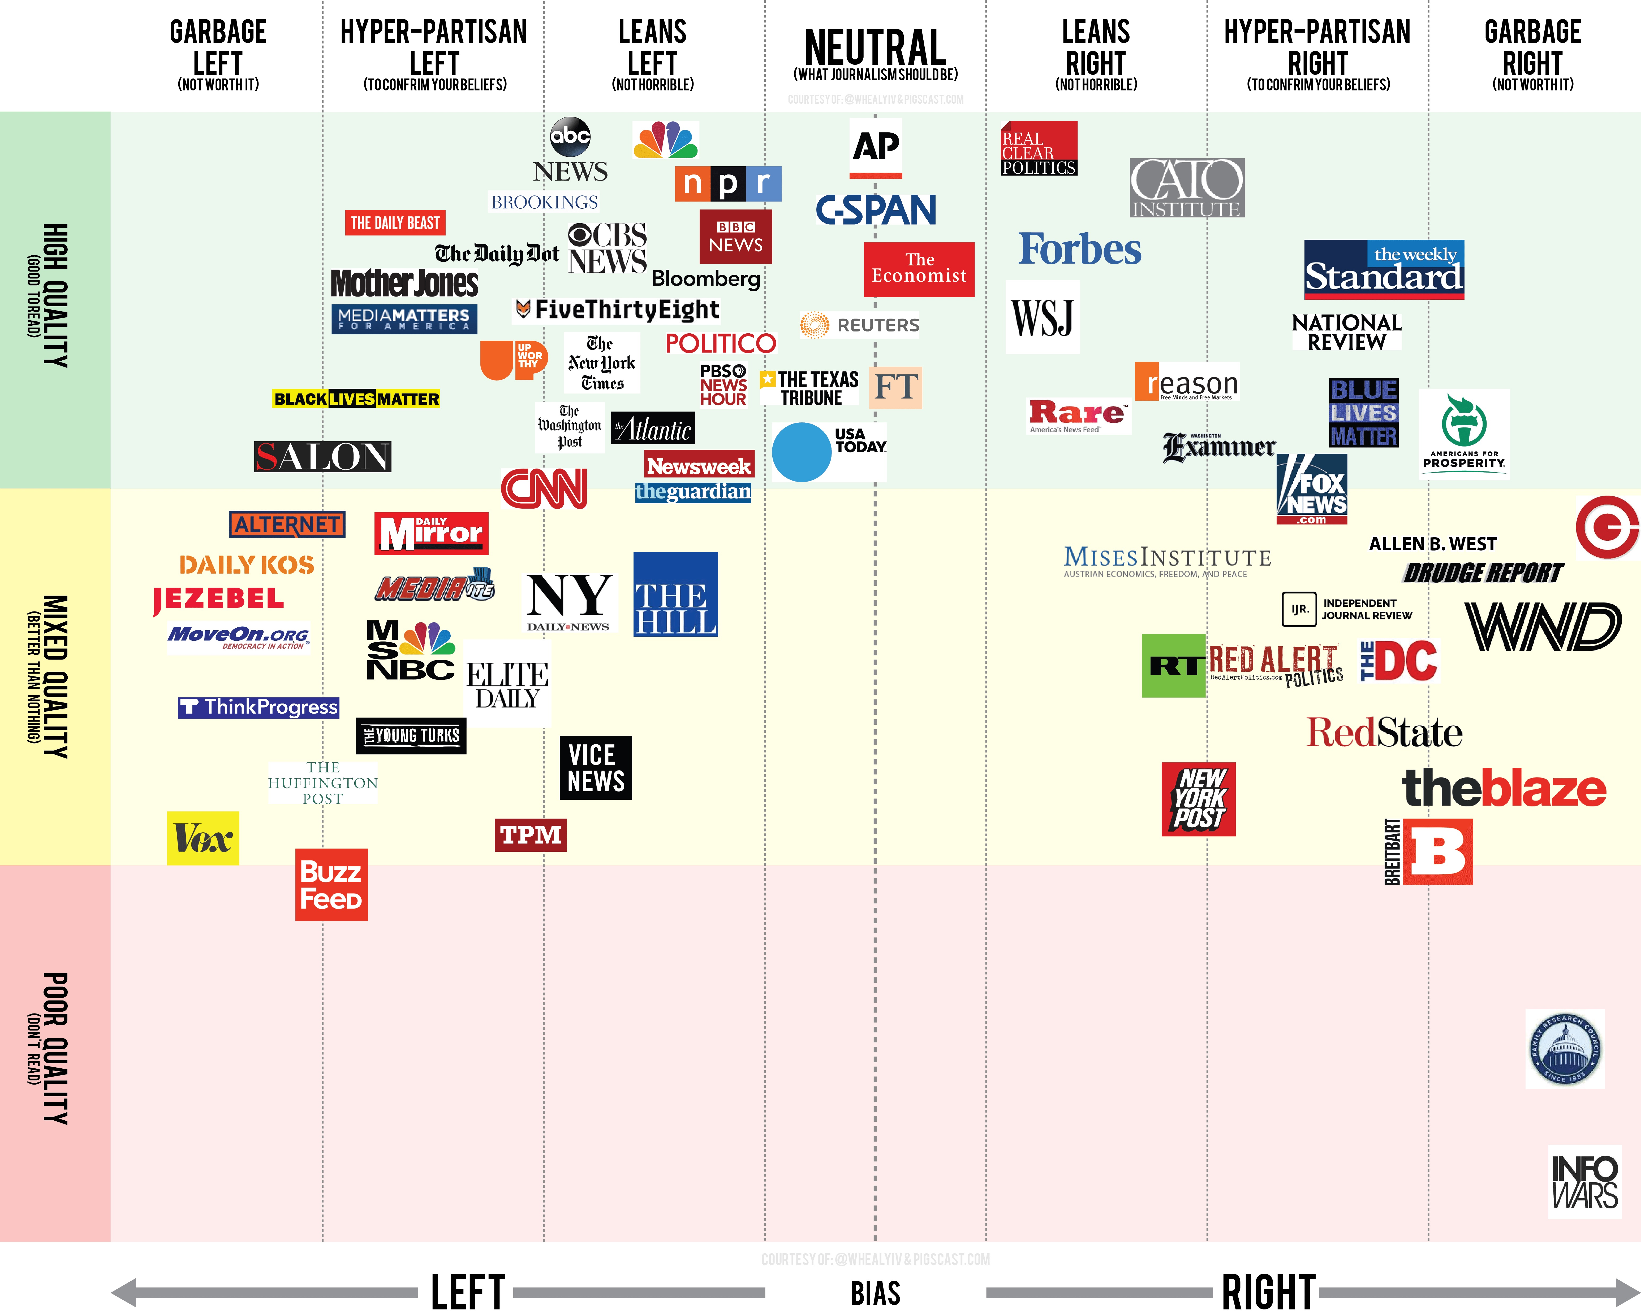

Slide 5
Notes:
In 2017 67% of Americans say they get at least some of their news from social media.
More than half (55%) of Americans over 50 get news from social media sites
78%under 50 get news from social

Slide 6
Digital Literacy
What is it?
  Soft skills?
  Tech skills?
  Information literacy – determining facts vs alternative facts?
  The New Media Consortium recently tackled this:
    Sense of productivity
    Multiple technologies
    Multiple soft skills (beyond technology)
Notes:
The New Media Consortium was founded October 17, 1993 by a group of hardware manufacturers, software developers, and publishers who realized that the ultimate success of their multimedia-capable products depended upon their widespread acceptance by the higher education community in a way that had never been achieved before.

Slide 7
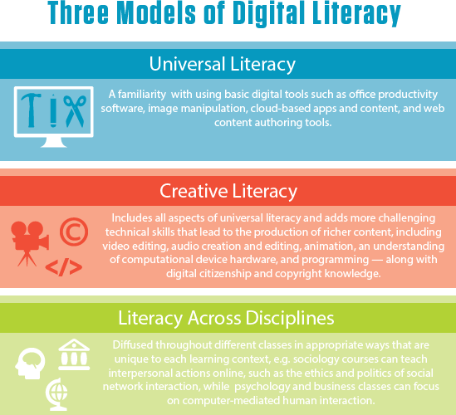
Notes:
From the New Media Consortium

Slide 8
Digital literacy is…
“Domain dependent based not on skills, but on a body of knowledge that comes from mindful immersion in a context.” ~Mike Caufield

Slide 9
But
Will skills suffice?
Do you have the knowledge?
Do you have the context?
Are the indicators evident?
Do we need a common cultural knowledge (Pondiscio)?
Does project based learning (deep diving) give us the knowledge (Caufield)?
Notes:
Part of the ED Hirch’s Cultural Literacy movement, Robert Pondiscio – unable to have rational dicussions becaue of a lack of common touchpoints.
Cultural literacy says we need breadth of knowledge not deep dives into projects. Caufield says skills in deep dives are scalabel and transferable cross disciplines

Slide 10
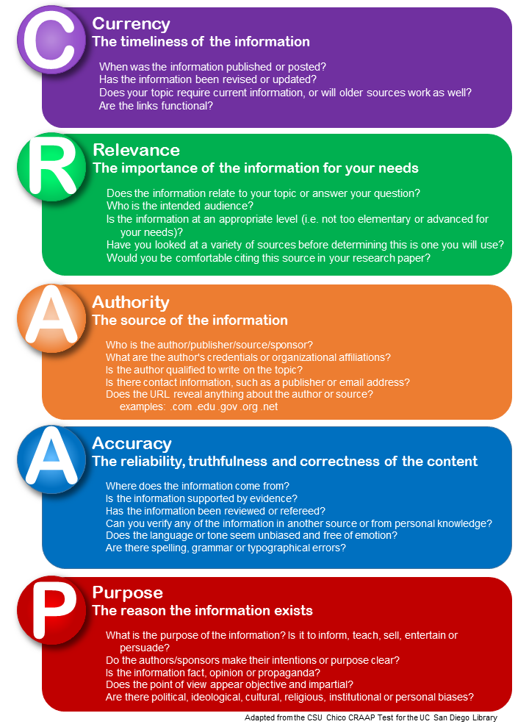

Slide 11
Knowledge and Skills
  Question and act
  Snopes
  Polifacts
  Globe and Mail
  CBC
  Wikipedia
  Reverse image look up
  Time stamps
  Fact check
Notes:
Historical recod

Slide 12
“Above all, I just want something that gets to a level of specificity that I seldom see digital literacy programs get to. Not just “this is what you should value”, but rather, “these are the tools and specific facts that are going to help you act on those values”. Not just “this is what the web is”, but “let’s pull apart the guts of the web and see how we get a reliable publication date”.
“It’s by learning this stuff on a granular level that we form the larger understandings — when you know the difference between a fake news site and an advocacy blog, or understand how to use the Wayback Machine to pull up a deleted web page — these tools and process raise the questions that larger theories can answer.”
Mike Caufield

Slide 13
Minimizing Authority
Difference in personal status is not as evident online vs F2F
  Those with authority can see themselves as less authoritative
  Those with less authority can see themselves as more influential (see Suler)
  A person’s level of authority or power offline is generally irrelevant online and users tend to start interactions as equal
  Solipsistic introjections’ and the sense that one’s mind has become merged with the mind of person they are communicating with, makes the user feel merged with the writer of the text: disinhibiting them as they feel they are talking to themselves
  Dissociative imagination is the creation of online characters in one’s imagination and leads to creating a fictional dimension separating offline ‘fact’ from online fantasy

Slide 14
Critique
Redheads

Slide 15
Group One:
Tim Horton’s Employees Have Illegally Claimed Thousands of Dollars in Winning Cups
Group Two
Refugees in Canada get Better Health Coverage Than its Citizens Do
Group Three
Amid Russian Chaos, Special Counsel Mueller Alleges Melania Trump’s Parents are Illegal Aliens in USA; Calls for Deportation Grow
Group Four
Alleged Shooter in the Parkdale School Killings was a Member of a Florida White Supremist Group

Slide 16
Group Five
Within the Next 13 Years, Scientists Estimate that 25% of Flowering Plants will be Extinct
Group Six
Condoleeza Rice Named in Libyan Sex Scandal: Sexually Explicit Photos Found in Leader’s Bunker
Group Seven
Evidence Emerges in “Vaxxed” Filmmakers Sentencing – Autopsy Hacked by Russian-Affiliated Association
Group Eight
Egg Yokes Successfully Used to Extend Sperm Life.

