Slide 1
Social Media: Digital Literacy and Critical Thinking
Week Seven February 28, 2023

Slide 2
Today’s menu
Check-in
What’s Up in Socials
Roald Dahl
Lecture – digital literacy & Critical Thinking
Survey Monkey
Notes:
https://www.washingtonpost.com/books/2023/02/24/roald-dahl-book-changes/
https://www.surveymonkey.ca/r/QZ9XR9Q

Slide 3
PUBLISHING PROGRAM GRADE SCALE
Publishing Grading Scale
Marks awarded are expected to correspond to established university-wide practices
in both their levels and their distribution.
Direct questions pertaining to grading to the program administrator at:
ccsp-info@sfu.ca
GRADE | PERCENT | DESCRIPTION
a+ | 95–100 | Excellent
a | 90–94
a– | 85–89
b+ | 80–84 | Very good
b | 75–79 | Good
b– | 70–74
c+ | 65–69 | Satisfactory
c | 60–64
c– | 55–59 | Barely satisfactory
d | 50–54 | Marginal performance/ Barely passing
f | <50 | Fail / Unsatisfactory
n | n/a | Incomplete
de | n/a | Defferred
gn * | n/a | Grade no available
ae * | n/a | Compassionate pass
* Requires memo from instructor

Slide 4
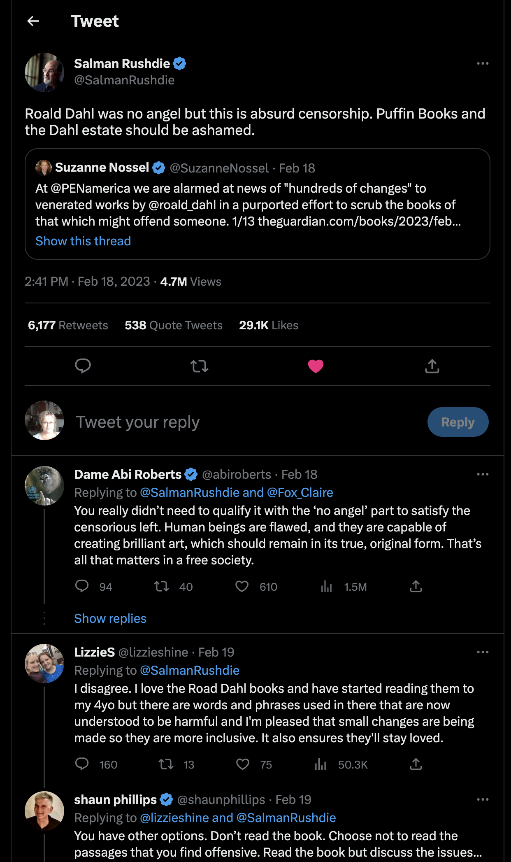
“I disagree. I love the Road Dahl books and have started reading them to my 4yo but there are words and phrases used in there that are now understood to be harmful and I'm pleased that small changes are being made so they are more inclusive. It also ensures they'll stay loved.”
“Those who might cheer specific edits to Dahl's work should consider how the power to rewrite books might be used in the hands of those who do not share their values and sensibilities.”
“Human beings are flawed, and they are capable of creating brilliant art, which should remain in its true, original form. That’s all that matters in a free society.”
“I would love any proof that large swaths of people were not buying his books because he offended wig wearers.”
“The problem with taking license to re-edit classic works is that there is no limiting principle. You start out wanting to replace a word here and a word there, and end up inserting entirely new ideas (as has been done to Dahl's work).”

Slide 5
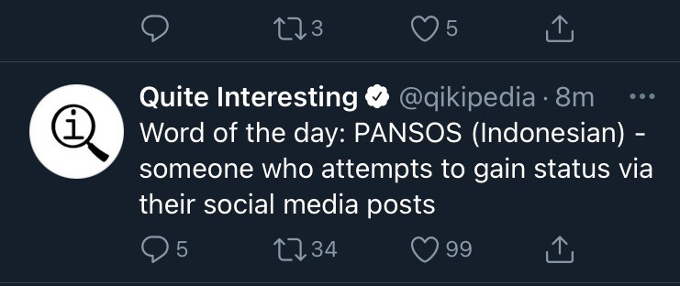

Slide 6
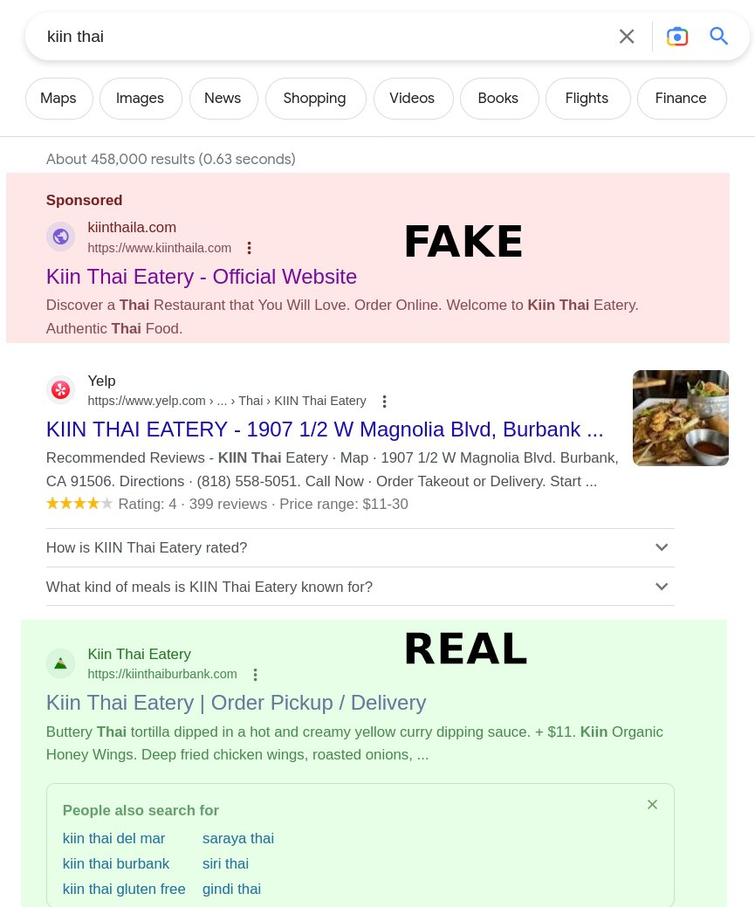
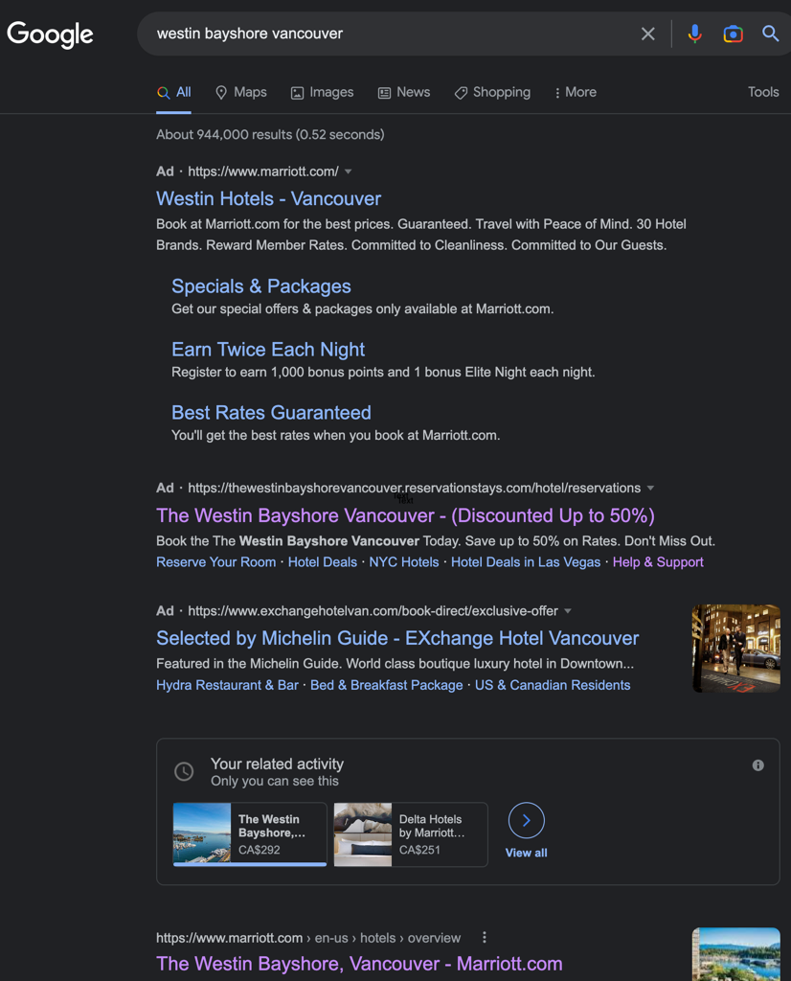
Deceptive Sites
LINK

Slide 7
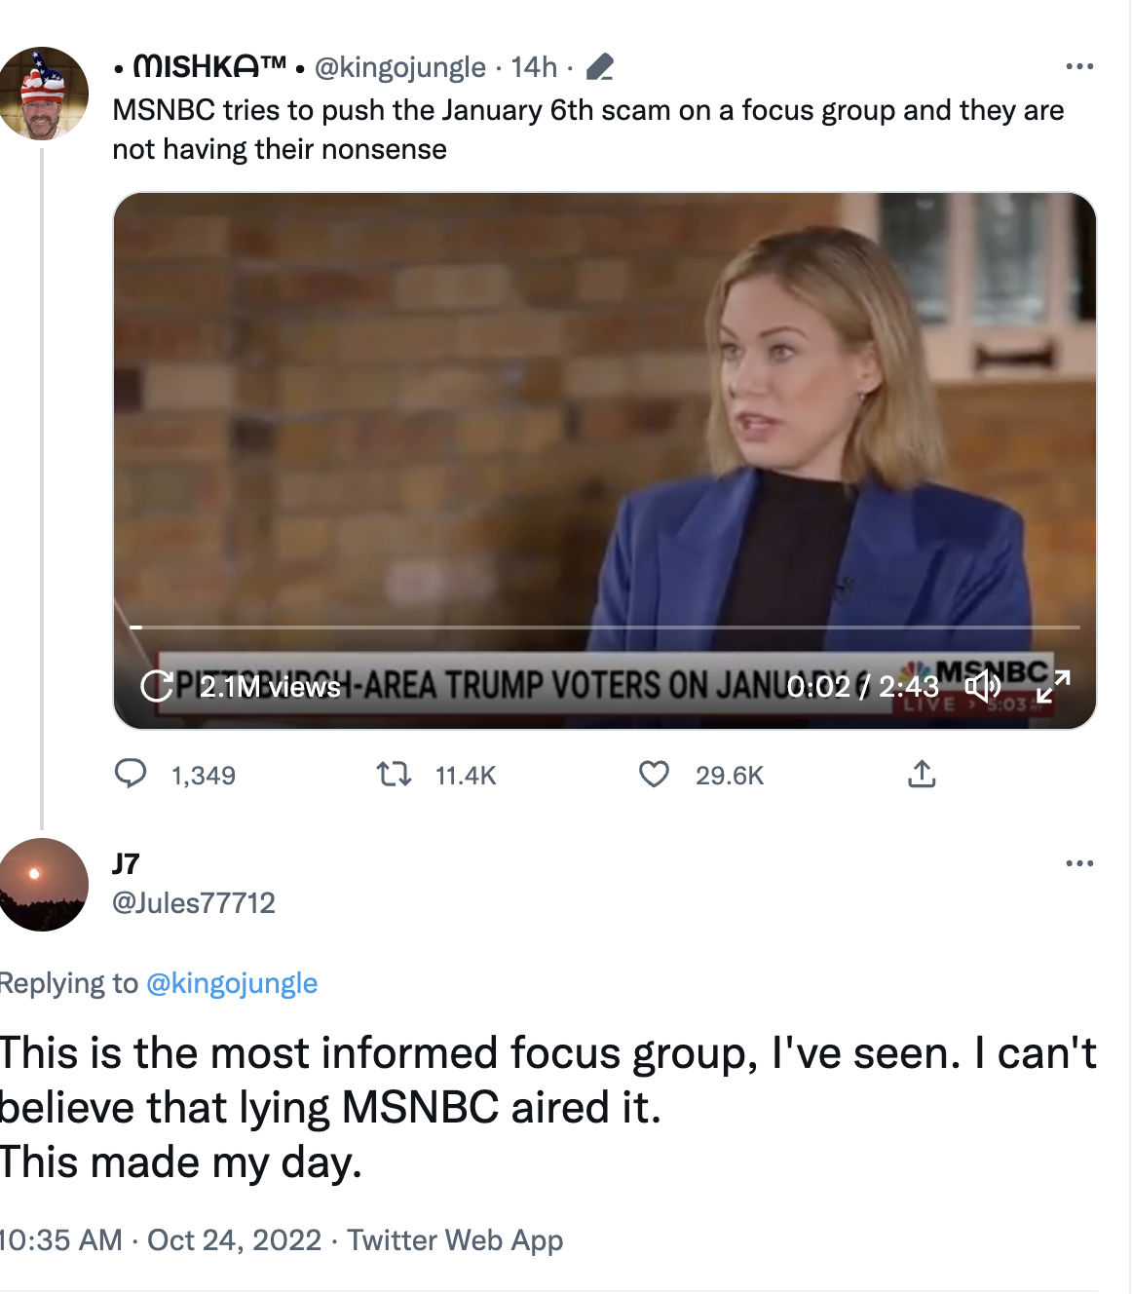

Slide 8
Discussion – 5 mins
Notes:
Trump Voters In Focus Group Say He Couldn't Have Stopped Jan. 6 Violence
271,789 views Oct 24, 2022
In a focus group led by Elise Jordan, Pittsburgh-area Trump voters weigh in on the events of January 6, why they say Trump could not have stopped the violence on January 6 and House Speaker Pelosi on January 6.
https://www.youtube.com/watch?v=6jbaUt-lla4

Slide 9
What stood out first? Who appeared to be the most informed? Why? Did anyone seem to rethink their statements? What is a takeaway for you?
Notes:
"The Democrats are using Jan 6 as their Reichstag fire." That pretty well defines the whole thing.
the Reichstag Fire Decree was a key step to creating the permanent security state of the Nazi regime. It bears strong similarities to our January 6 event here in the US.

Slide 10
“Falsehood flies, and the truth comes limping after it.”
~Jonathan Swift

Slide 11
Misinformation
False information shared by someone who believes it to be true.
Bill Gates is implanting chips
Fake News?
Disinformation
False information intentionally shared by someone who knows it to be false.
Lies spread during elections by interested actors
Malinformation
Information that is likely true but used to harm.
Publicizing that someone’s relative broke a law and therefore the someone is also a criminal

Slide 12
“Domain-dependent based not on skills, but on a body of knowledge that comes from mindful immersion in a context.”
~Mike Caufield
Digital literacy
is…

Slide 13
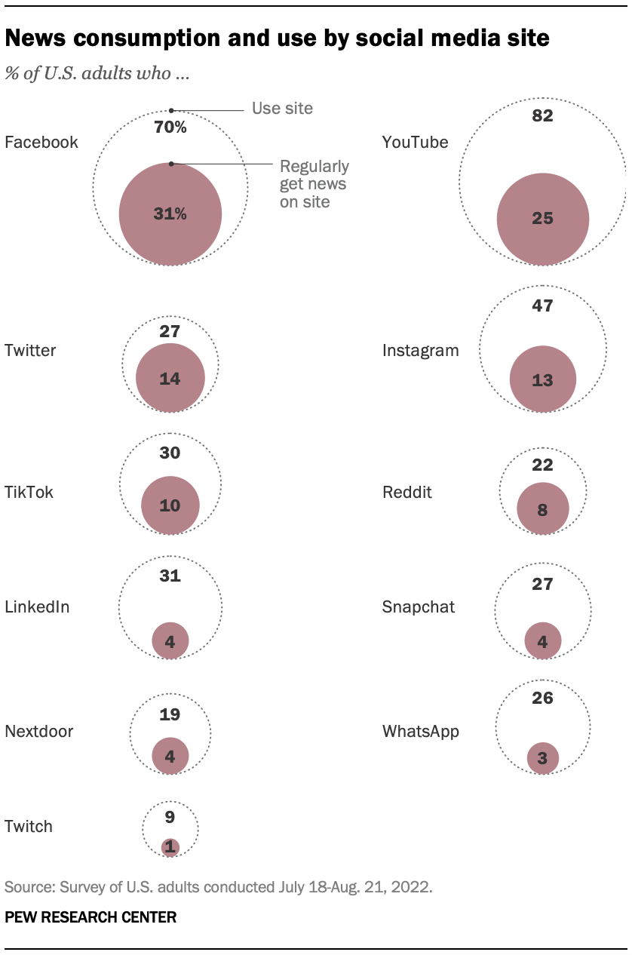
When it comes to where Americans regularly get news on social media, Facebook outpaces all other social media sites. Roughly a third of U.S. adults (31%) say they regularly get news from Facebook.

Slide 14
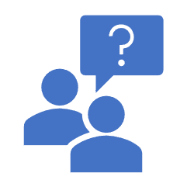
Publics –and Counter publics
Heuristics
Hidden agendas
Conspiracy theories
Reassurance
Fear
Status Quo
MySide Bias
Confirmation Bias
Is there a disinterest?
Do you see in yourself what you so easily see in others?
Is criticism of your view readily listened to?
When a truth unsettles you, do you attempt to understand why?
You’re Not Going to Believe this

Slide 15
Three Particularly Impactful Biases
Digital Amnesia or The Google Effect
We tend to forget information we think we can easily find again – through search engines
The IKEA Effect
Things that we contribute to building or creating, we assign a higher value to.
Algorithms and AI make our decisions for us. How hard is it to look beyond what is offered to us? Where is the curiosity?
Automation Bias

Slide 16
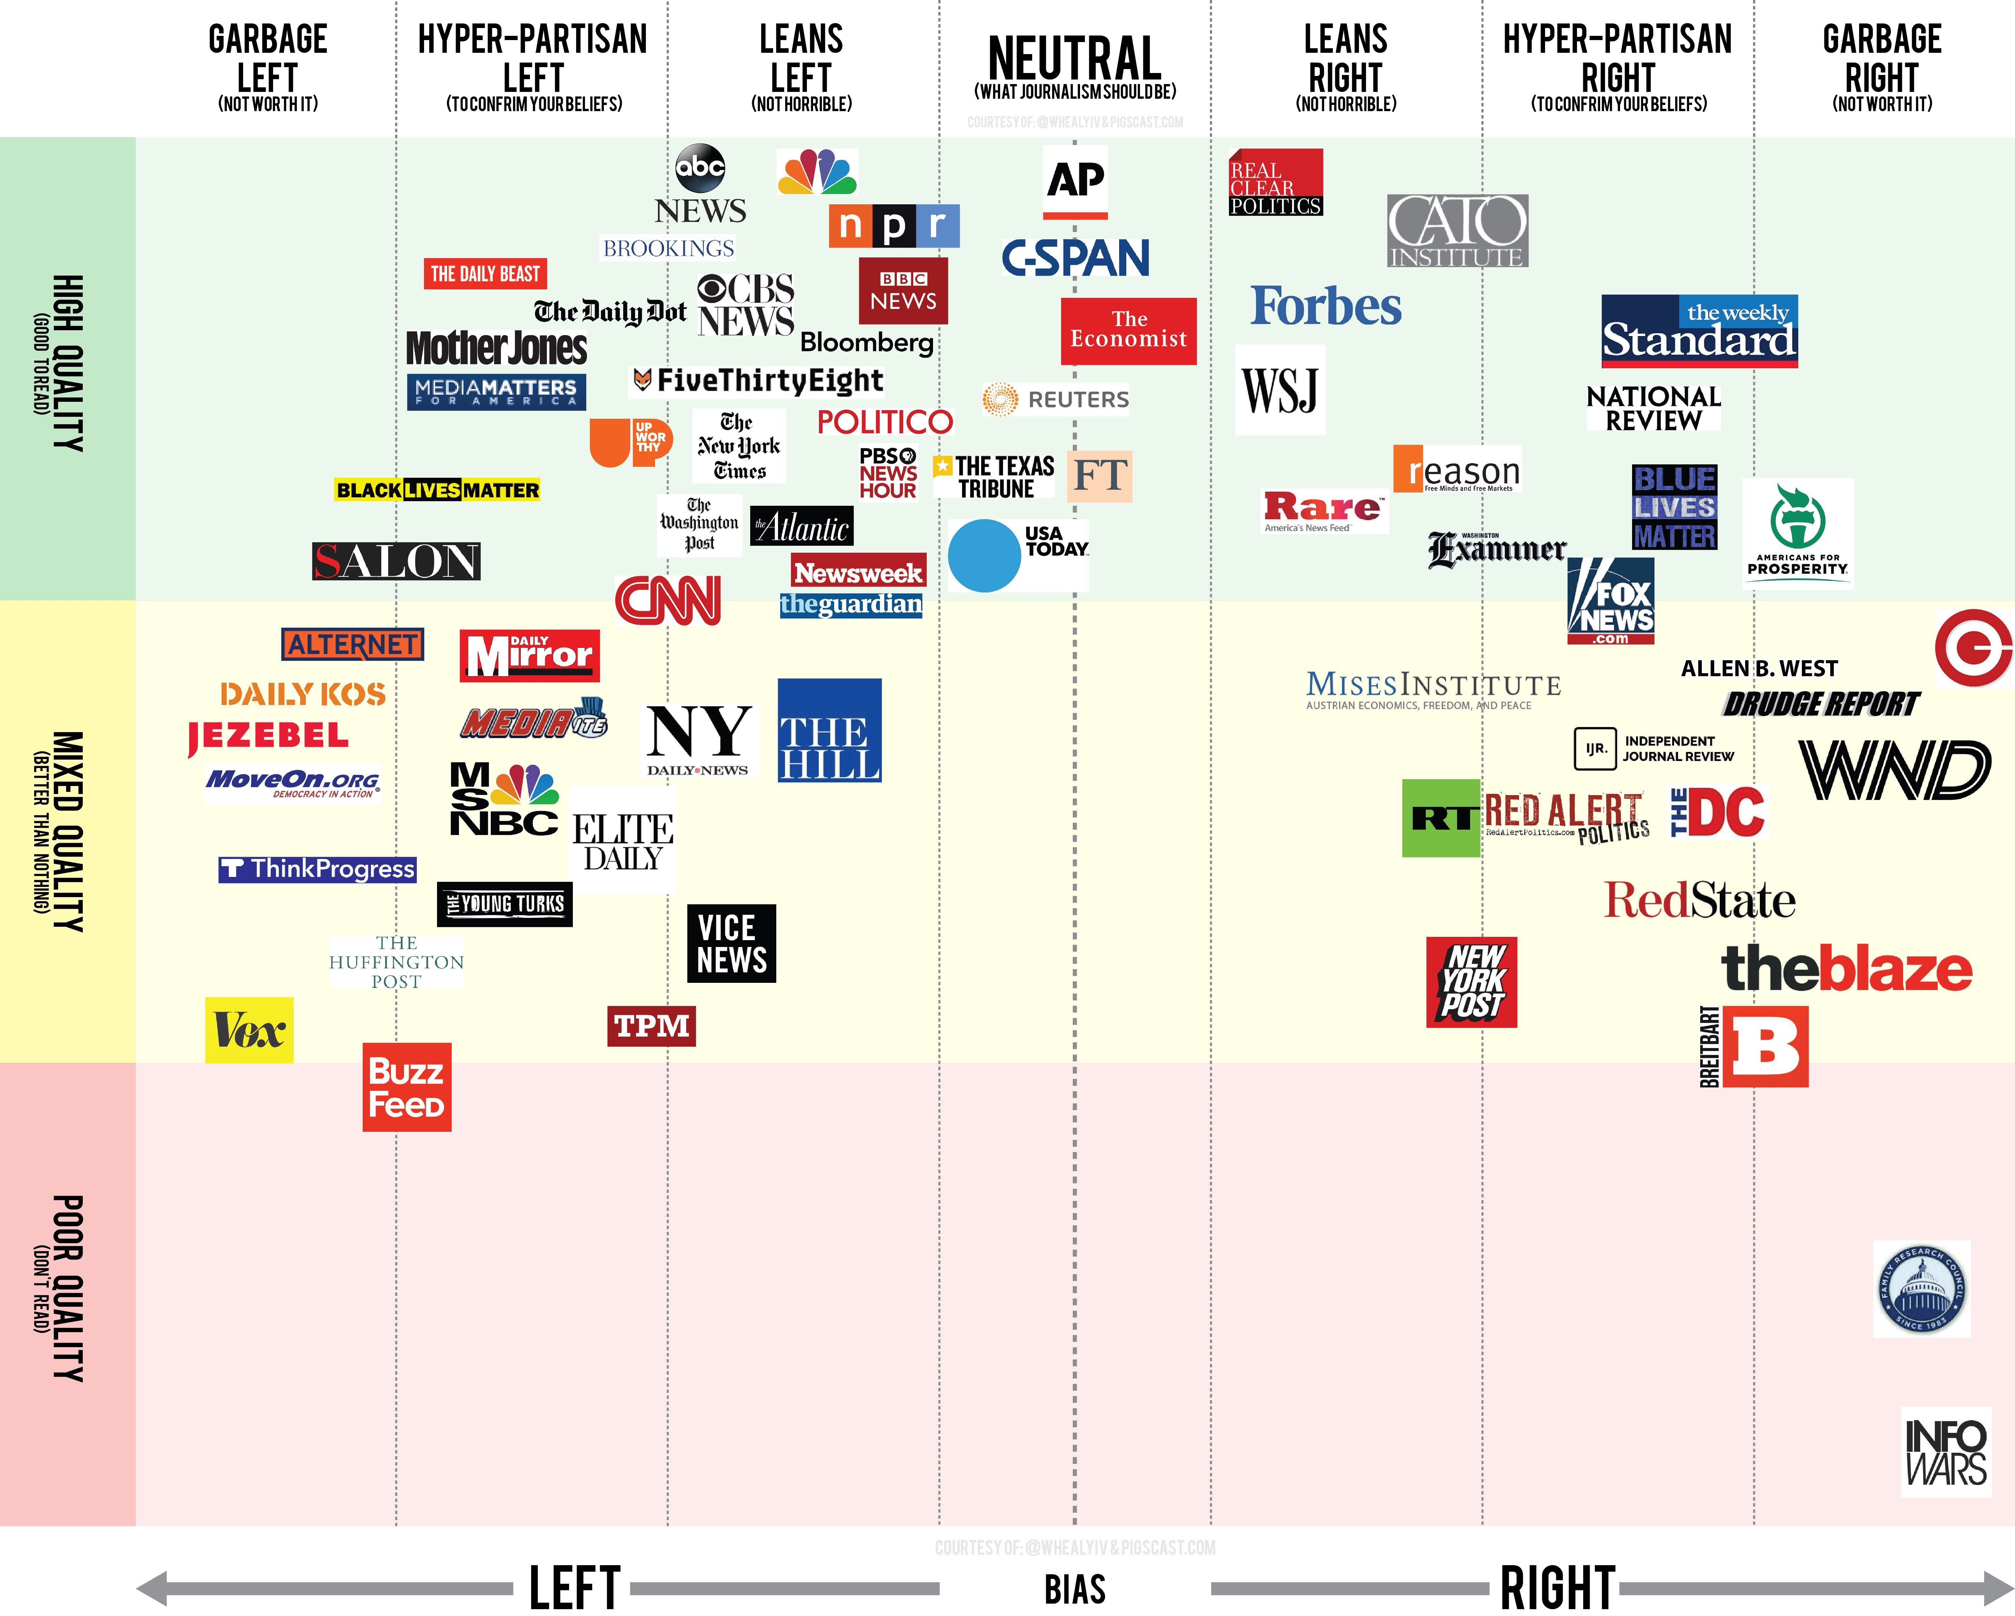

Slide 17
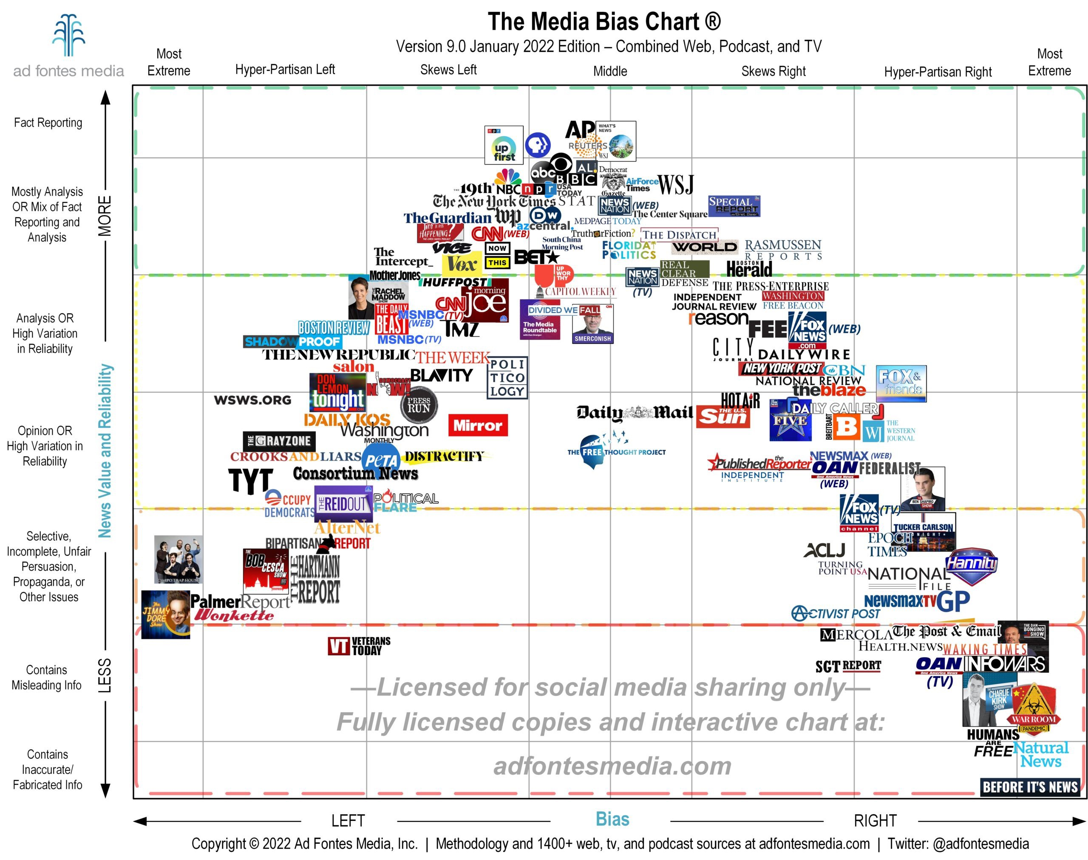
Media Bias Chart Interactive
Notes:
https://adfontesmedia.com/interactive-media-bias-chart/

Slide 18
How active are you in modeling digital literacy?
Have you ever shared a post without reading it?
If you have suspected something being shared via social media was fake, what did you do? Comment? Correct? Nothing?
It is tempting to share the news first. Do you check?
How many sources, if any, do you consult during research? Which ones?
Have you ever shared something that was false?
Did you retract? Apologize? Quietly remove the post?

Slide 19
“Not just “this is what you should value”, but rather, “these are the tools and specific facts that are going to help you act on those values”.
“Not just “this is what the web is”, but “let’s pull apart the guts of the web and see how we get a reliable publication date”.
“It’s by learning this stuff on a granular level that we form the larger understandings — when you know the difference between a fake news site and an advocacy blog or understand how to use the Wayback Machine to pull up a deleted web page — these tools and process raise the questions that larger theories can answer.”
~ Mike Caufield

Slide 20
Question and act
Snopes
Deutsche Welle
Globe and Mail
CBC
Wikipedia
Reverse image look up
Time stamps
Fact check
Wayback machine
Counter social
Knowledge and Skills – what you need to consider

Slide 21
Critique
Redheads
Try the wayback machine
https://www.digitaljournal.com/artic le/220229

Slide 22
Difference in personal status is not as evident online vs F2F
Those with authority can see themselves as less authoritative
Those with less authority can see
Authority?
themselves as more influential (see Suler)
A person’s level of authority or power offline is generally irrelevant online and users tend to start interactions as equal

Slide 23
Thought exercise
What have you done to lay the foundation for your authority?

Slide 24
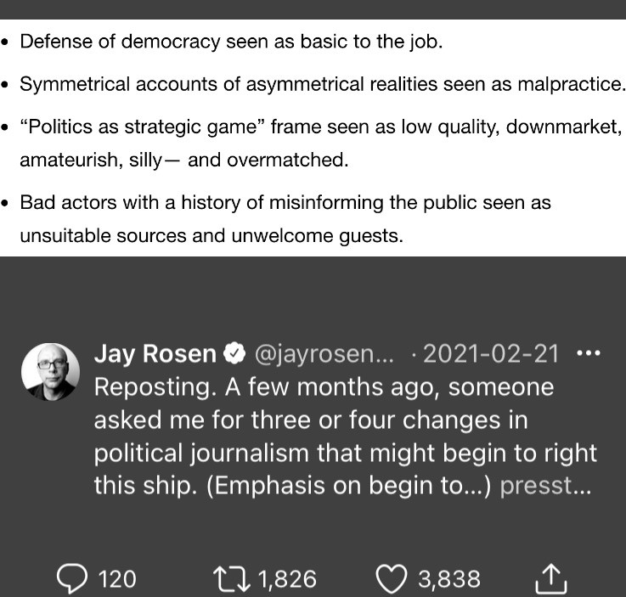
Some tips for content creators

Slide 25
BREAK

Slide 26
“Deepfakes will impact public trust, provide cover & plausible deniability for criminals/abusers caught on video or audio, and will be (and are) used to manipulate, humiliate, & hurt people. If you’re building manipulated/synthetic media detection technology, get it moving.”
Rachel Tobac, CEO SocialProof Security (twitter)

Slide 27
“[J]ust because you feel you can
personally tell the difference between synthetic & authentic media, it doesn’t
Altered Media
mean we’re good to go. It matters what
the general public believes. Altered
media has real world safety, political etc. impact for everyone.”
Rachel Tobac, CEO SocialProof Security (twitter)

Slide 28
Social Media Statistics

Slide 29
World population is 8 b (November 2021)
The internet has 5.3 b users (July 2022)
There are 3.96 b active social media users (June 2022)
Global social media penetration: 58.4% (June 2022)
FB has more than 2.9 b monthly users (Feb 2023)
FB’s family (WA, Mess, Insta) 5.8 b active users (Feb 2023)
Social Media Stats
Source: © Statista 2023
Notes:
https://www.internetlivestats.com/

Slide 30
On average, people have 7.6 social media accounts
The average daily time spent on social is 142 minutes a day
There is a new social media user every 6.4 seconds
In Canada, 13% of SM users spent >10 hs/week; 17 – 6-10 hrs (April 2019)
In US – average daily SM use is 38 mins
Social Media Stats
Source: © Statista 2021

Slide 31
UAE: 99%
South Korea: 89.3
Taiwan 88.1
Netherlands 88
Malaysia 86
Canada 84.9 (7)
Australia 79.9 (15th)
Saudi Arabia 79.3 (17th)
United States 72.3 (31st)
Social penetration
Source Statista Jan 28 2022

Slide 32
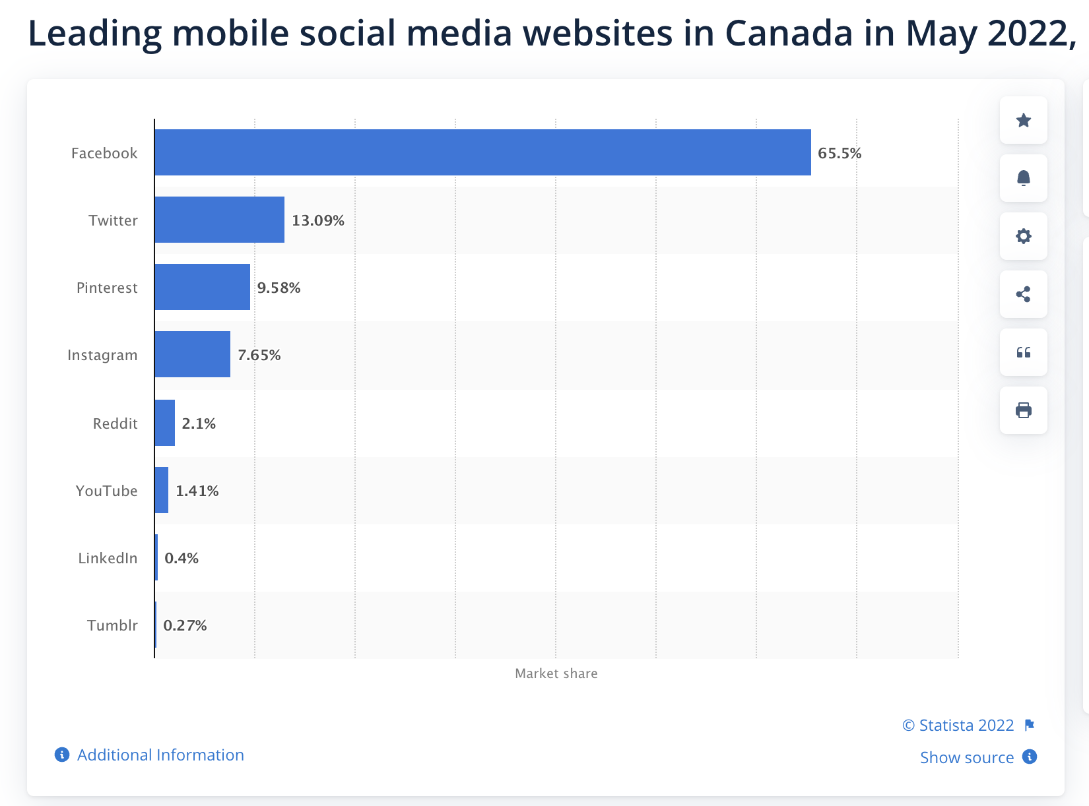
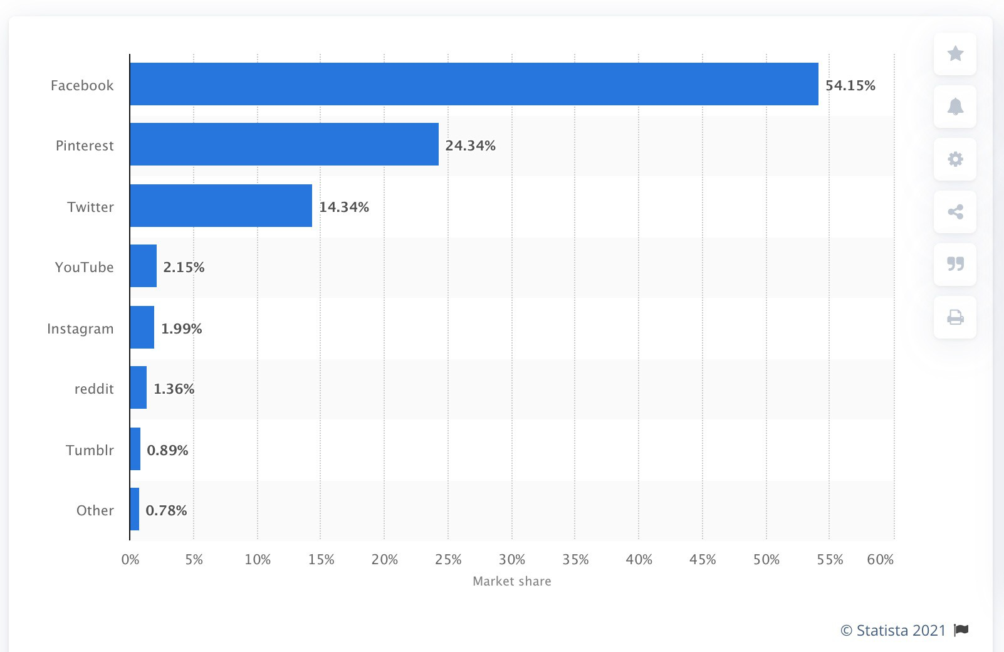
Leading social media sites in Canada

Slide 33
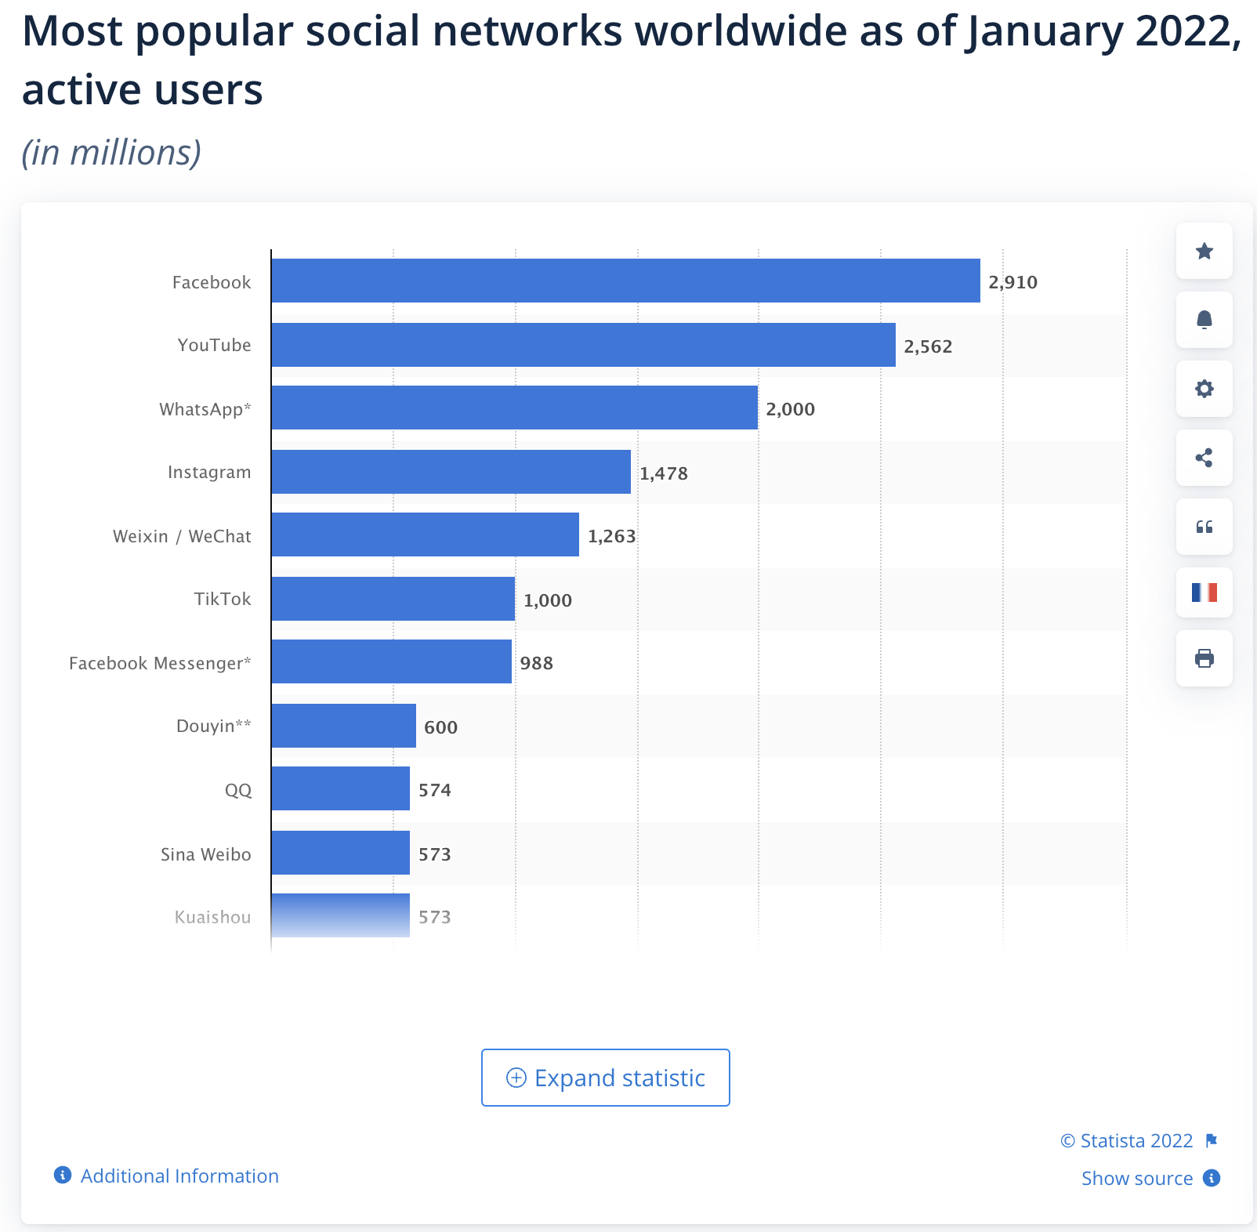
Notes:
In September 2022, BeReal was the most-downloaded social networking app for iPhone in the Apple App Store worldwide, with the photo-sharing social app reporting almost 14 million downloads from iPhone users worldwide. Meta-owned WhatsApp was the second most downloaded iPhone app, with the social app generating approximately seven million downloads from iPhone users. Telegram was the third most popular social media app with roughly four million downloads from global users.

Slide 34
Facebook
1.6 b mobile active users
Adds 500,000 new users every day
6 new profiles every second
7/10 US adults use FB
Ages 25-24 biggest demographic
More than 4 billion video views take place on Facebook every day.
85% watch videos w/o sound;
The average user spends 35 minutes a day
Pros: | Cons:
Billions of people use Facebook | Billions of people use Facebook
It’s an easy process | It has to be consistent
It’s relatively free ($$ wise at least) | Meta is starting to use verification
 | It demands awareness of changes and fixes

Slide 35
Instagram
Pros | Cons
It’s is one of the two top places to be right now | It’s mobile centric
Image-based and easy to post to | It’s mainly a younger age demographic
Hashtags and handles help spread the message | There is not a lot of room for text
Video integration is easy and accessible | It’s audience is very ad cynical
There are 1.2 b Active Users on Instagram (up from 90 m in 2013)
Over 500 m daily story users Jan 2019
The average Instagram user spends 15 minutes a day on the
90 percent of Instagram users are younger than 35 (July 2020)

Slide 36
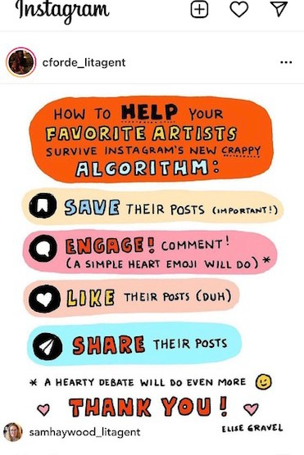
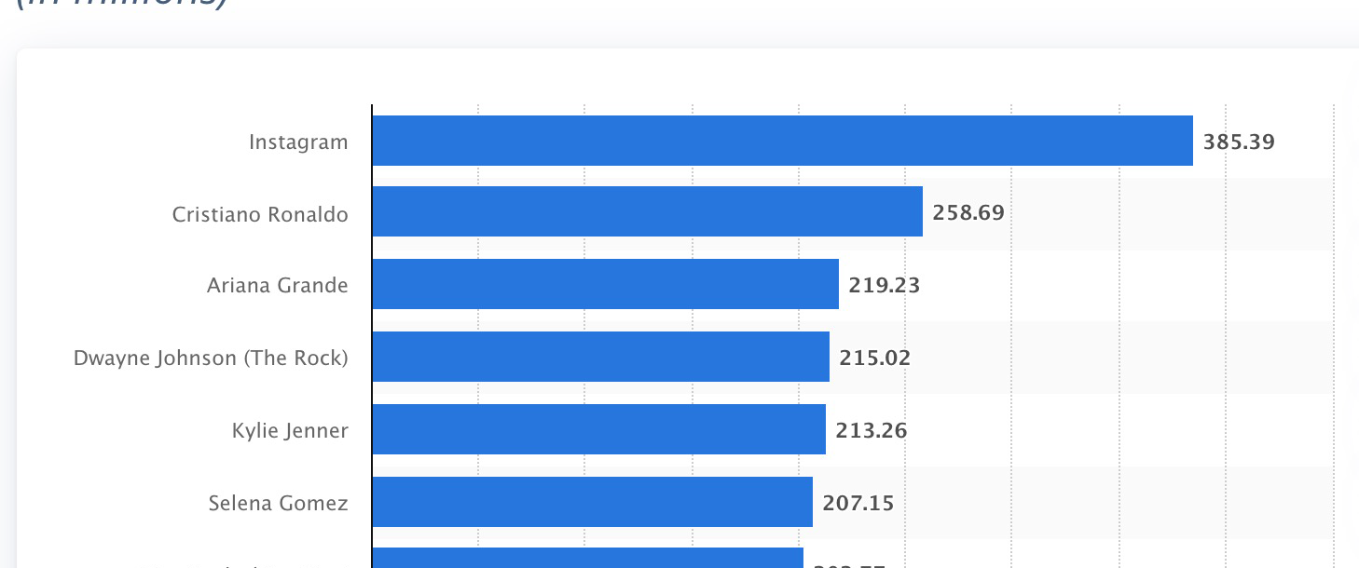
It’s all relative…

Slide 37
TikTok
There are 1 b Active monthly users Jan 2023
672 m downloads in 2022
First-time installs growing by 400% y/y
41 percent of TikTok users are aged between 16 and 24.
TikTok users spend an average of 19. 6 hours per month on the app
Pros
Cons
It’s mobile centric
Fasting growing install rate
Image-based and easy to post to
US TikTok Reach in 2021 50.3%
It’s mainly a younger age demographic
More political; fewer users
Hashtags and handles help spread the message
There is not a lot of room for text
Video integration is easy and accessible Its audience is very ad cynical
Global spend Q4 2021 824 m USD It is being banned

Slide 38
Twitter
There are a total of 1.3 billion accounts, with 556 m active users Jan 2023
Of those, 44% made an account and left before ever sending a Tweet
There are 500 million Tweets sent each day. That’s 6,000 Tweets every second
1 in 5 US adults use Twitter
38% of U.S. Twitter users are between the ages of 18 and 29
Pros | Cons
556 million active users | It takes time to build from scratch
It’s fast | It’s important to build the right community
It’s free | It’s has to be consistent
It’s fairly easy to get up to speed | It’s not stable

Slide 39
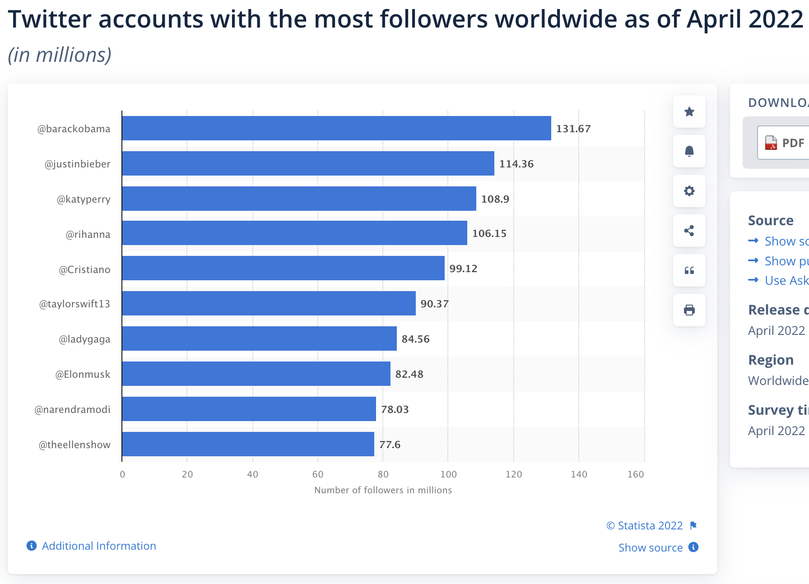
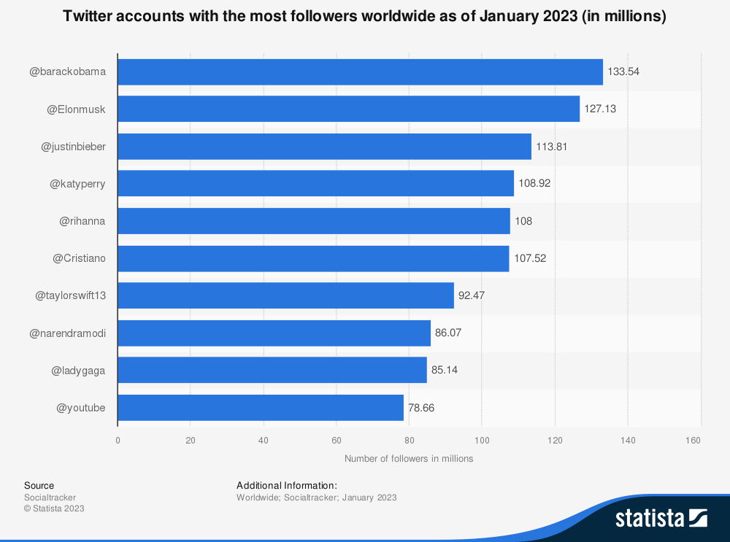

Slide 40
Snapchat
Pros _{Cons}
Fast growing platform Quick and short content
Quick and short content Younger demographic
Doesn’t take up disk space
Snapchat has 363 m active daily users
75% of them are under 35
>175K daily video
Over 5 b snaps created every day

Slide 41
Spot the Troll
A troll is an inauthentic social media account.
The intent is to harass, spread misinformation, instill distrust of everything, and sow division. Fear is a powerful tool.
Tactics include unsolicited messages, hyper- active accounts, accounts with no profile image, accounts with stolen profile images, or computer-generated account names.

Slide 42
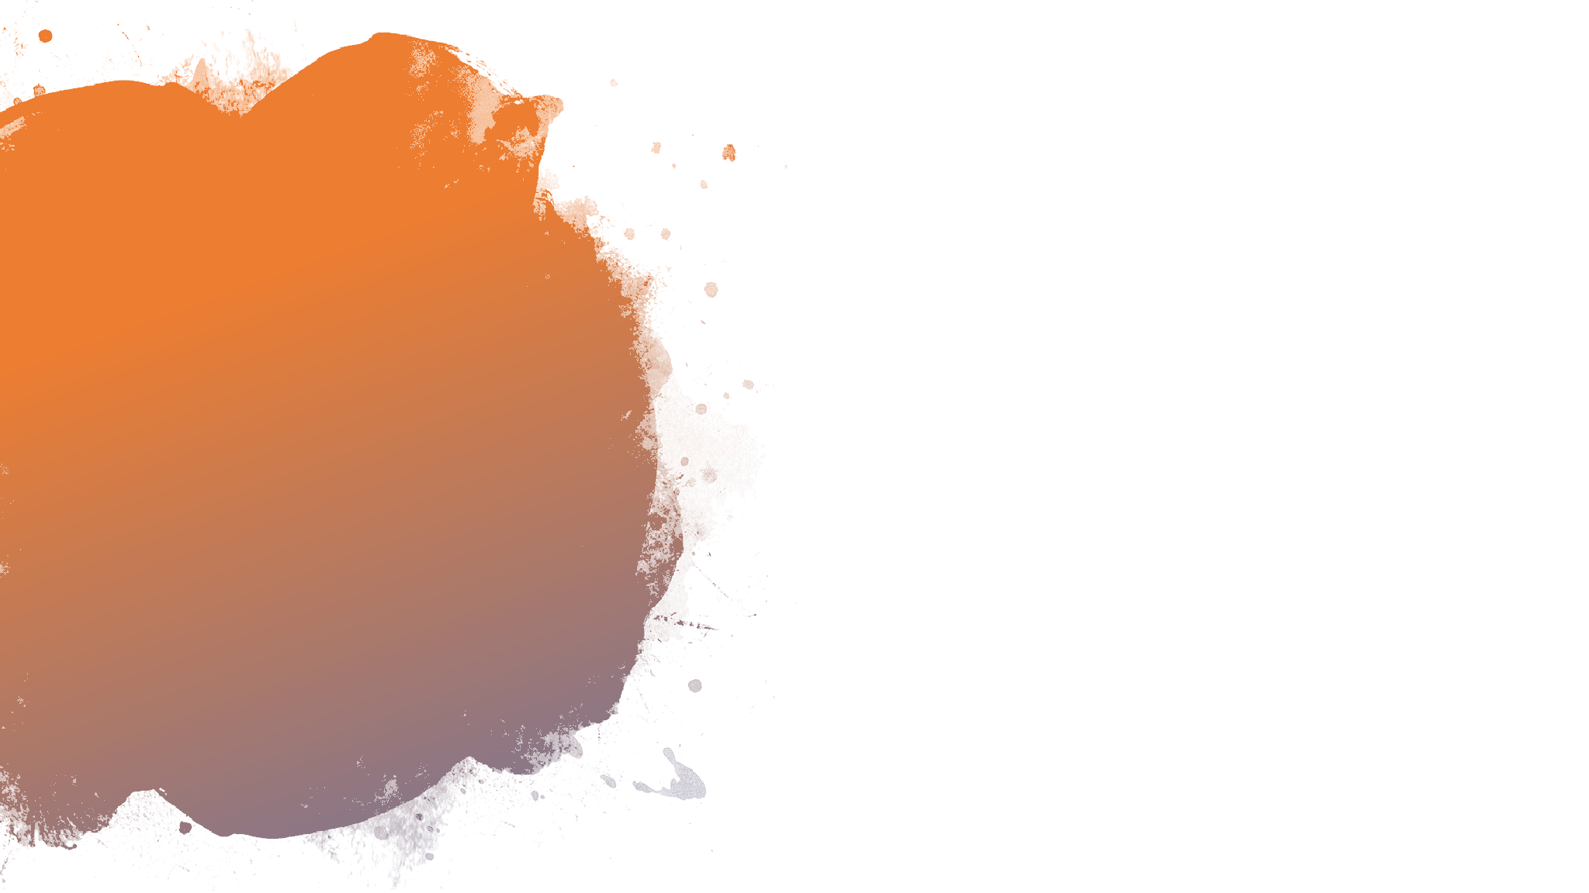
All of the accounts and posts used in this quiz, both the genuine accounts and the trolls, have been taken directly from Facebook, Instagram, and Twitter.
Nothing has been changed.
Spot the Troll Quiz
Spot the Troll

Slide 43
Resources
First Draft Basic Toolkit
Cranky Uncle Code: SFUPUB
How to Spot Fake News
First Draft Training
CTRL-F
Web Literary for Student Fact-Checkers
How to Overthrow the Illuminati
Conspiracy Theories Podcast
The Learning Portal

Slide 44
Links I spoke about in class today
Illia Ponomarenko – defense reporter with The Kyiv Independent
https://twitter.com/IAPonomarenko
The Media Bias Chart- Interactive

