Slide 1
The Commentariat
PUB 101
April 4, 2023
Notes:
Some thoughts about the commentariat
Empowerment of the user trumps everything.
When you’ve gained money, fame, and notice, you are fair game for harassment.
There are people behind every post.
“It’s just the Internet. No one takes it seriously.”
When we think this way, it distances the “person” from the action.

Slide 2
Today’s Menu
Check-in
On socials
Potluck signup (in real-time)
What’s due next week
Primer – online safety best practices
Lecture
Video
End

Slide 3
VPNs
What are they?
Virtual Private Networks
Encrypt data – scrambles and needs a key
Change your IP address
Provide a barrier between your computer and the open internet
Why do we use them?
To encrypt your personal data, browsing, and files
To access your files and services on remote local networks
Censorship workaround
Stop tracking software
Locks our data door to hackers and scrapers
Torrenting, pirating, bypassing copyright
Notes:
When you go to a website, your computer connects to the server where the site is hosted, and that website can see a certain amount of data about you and your computer depending on the site. With a VPN, you connect to a private server first, which scrambles your data and makes it far more difficult for third parties to track what you’re doing online.
With a VPN, you connect to another computer (a server) before heading to the internet, effectively telling other computers that you’re in a different location
You can choose this location yourself.
A VPN changes your digital location, allowing you to access the streaming libraries of other countries.
At the extreme end, a VPN helps bypass censorship. Some government agencies around the world use geo-blocking, which is a technique for region-locking content based on your IP address to block websites and services. VPNs get around the issue by changing your IP address and making it seem like you’re connected to the internet from a different location.
On the flip side, VPNs remove accountability, so some people use them for torrenting (aka peer-to-peer file sharing) copyrighted content and engaging in other illegal activities online.
Torrenting isn’t necessarily illegal, as you can use it to send public domain and personal content. But downloading copyrighted content through torrents is illegal in most countries. It’s still illegal to torrent this type of content with a VPN, but you can use one to hide your identity. Source: Forbes

Slide 4
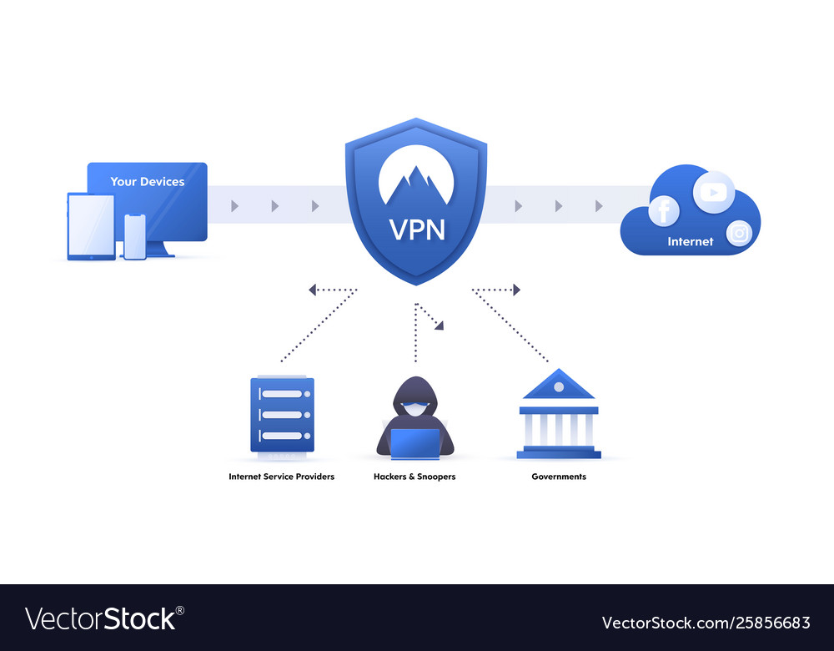
source
Notes:
A VPN protocol is essentially a set of instructions that tells your computer how to communicate with a VPN server. In addition to instructions for establishing and maintaining your connection, the protocol includes standards for encryption.
Think of your internet connection as a tunnel. This tunnel is wrapped in a layer of encryption that keeps others from seeing what you’re doing online. If you’re logging in to your Twitter account, for example, you’re passing your account information from your computer to Twitter through a tunnel that no one else has access to.
The same thing happens with a VPN. The difference is that you pass your data along to a VPN server, where it’s anonymised, before going to the internet.
Most VPN providers use the AES cipher with a 256-bit key. AES is an industry-standard block cipher, which breaks up data into blocks and encrypts them.
Source - Forbes

Slide 5
VPNs
Are they safe?
A reputable and proven VPN is safe to use
Do they work?
Some encrypt your data better than others
Most require a subscription ($100-$150)
Are they legal?
In some countries, they are not or are heavily regulated
Which ones are the best?
Do your research. I like ExpressVPN and Nord
Notes:
Browsers carry a lot of data, including your time zone, content-language, operating system and even your screen resolution. VPNs scramble the data and hide the metadata that is transmitted to a site when you connect to a site.
Once you connect to the site the site will put a cookie on your browser for a period of time ( and that allows the site to track your data and movements)
Even if not scrambled the data will not be specific to you, but it will provide enough unique information to identify a lot about you. Browser Fingerprinting (governments, advertisers, hackers, trolls.
A good VPN A VPN hides all of your browser metadata, as well as your browsing history. While you’re connected, no one, including your internet service provider, can tell what you’re doing online.
It blocks your data but what you do and use on the sites you visit is still on you. And browsers can use their own accounts to still track where you go on the internet through cookies and across devices – which is why you get ads everywhere.
Source Forbes

Slide 6
What to look for in a VPN
No-logging policy – it cannot log your personal info
Wide server selection – and continually updating
Top-notch security - AES-256 encryption at least and OpenVPN protocol on desktop and the IKEv2 protocol
Streaming performance – look for reviews noting streaming performance
Speed – VPNs will slow your connection find one that is least impacting
Read the reviews!
Source
Notes:
VPNs get blacklisted so they need to be up to date

Slide 7
Protecting your information
Login directly and not through apps or google
Use incognito in your browser (Google)
Use a different browser (duckduckgo app, extension, search engine)
Turn on https in your browser
Secure your own site with https
Ask to have the information removed
Take the time to scrub old accounts
Use incognito and look for your name(s), cities, schools etc.
Get rid of or archive old emails and attachments
For new accounts is it necessary to use all your personal info?
Use an extension or app to stop advertisers and other third-parties
Privacy badger
Notes:
https encrypts your communications with many major websites, making your browsing more secure.

Slide 8
Resources
AmIUnique – can help you determine how identifiable on the internet
Ipleak.org and ipleak.net can test whether the VPN is working in the ways it should (covering the correct info/data)
Electronic Frontier Foundation
Cover your Tracks tests your browsers to assess protection
US data brokers – database of companies buying and selling your data

Slide 9
Notes:
This was a screen shot from around a couple of years ago. A year before the pandemic.
Do you remember anything newsworthy from March 2019?
Amazon was still pondering where to set up a new HQ. Brexit was still in flux. Mueller was in the process of submitting his report and US AG Barr was in the process of drafting a version to publicly release.
Sports teams were competing – the NHL playoffs were buzzing.
Trump was being his usual self and online outrage at him or in defense of him were daily events on many news and social sites.
Trudeau had an election coming up in October, but unlike in the US, elections are not a constant source of news, so there was little campaigning yet.
Do you recall anything you did online that was memorable? One year later and everything changed. Three years after that we are in an even more fractured world than ever before.
This week, we are looking at the Commentariat or, those people (and bots) that comprise the narratives of threads on social media, opinion-following news stories, and random “drive-bys” of posted content.
I think if The Warax were to post this today, it would be for an entirely new set of events and would be inferred drastically different by many. Would you agree with that? Why or why not? How would this comment be interpreted right now, a pandemic, a US election, and a war later?

Slide 10
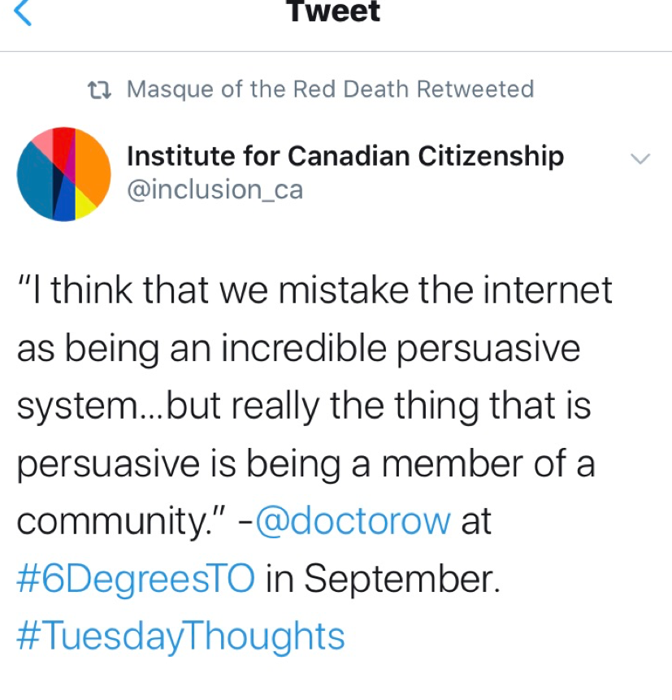
Notes:
What does this mean? Does it mean that we are likely to be persuaded by things we read on the internet?
That we are individuals who are capable of being equally persuasive online? Does it mean that our individual opinions become secondary to the opinions of the many, or at least to the opinion of the ones who have the largest communities, perhaps communities of which we want to be part?
That we take on the opinions of others to be part of the group? Or are we multiple selves depending on the medium?
Erving Goffman (1959) theorized self-presentation as a performance; the need for a multiple, composite self has only increased since public communication moved to an online space.

Slide 11
Notes:
Chris Kluwe has said if he could invent anything in this world it would be an empathy pill that everyone would be required to take. Walk the talk.
Dylan Marron says we need to be clear that empathy is not endorsement. It means we try to see another point of view. To build bridges. We will see his Ted talk in a bit. What is Empathy? Does it matter.

Slide 12
“How I turn negative Comments into positive interactions”
How I turn negative comments into positive interactions
Notes:
Empathy helps us understand.
11 mins
This Ted Talk from Dylan Marron is not a recommendation that we all engage with the commentariat. It is one way and one that works for him. It has to be mentally exhausting. But he sees the successes he has had as worth it. Would you do this?

Slide 13
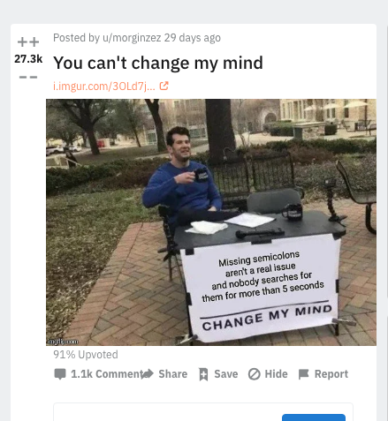
“While anonymous comments were more likely to be contrarian and extreme than non-anonymous ones, they were also far less likely to change a subject’s opinion on an ethical issue.”
Notes:
In a 2012 study of anonymity in computer interactions, researchers found that, while anonymous comments were more likely to be contrarian and extreme than non-anonymous ones, they were also far less likely to change a subject’s opinion on an ethical issue.
Read more on this topic in The New Yorker
Reddit and the Struggle to Detoxify the Internet

Slide 14
HEY, IT’S MY RIGHT TO SAY WHAT I WANT!
In Canada, the Right to Free Expression is enshrined in the Charter of Rights and Freedoms.
Its umbrella covers any expression through speech, text, images, cartoons, etc.
The government can enforce reasonable limits
In the US it’s the first amendment
Freedom of speech is the freedom to express anything written or oral, as long as it can be defended by the speaker as something they truly believe.
Notes:
IT DOESN’T MEAN A PERSON CAN ENGAGE IN HATE SPEECH. WELL THEY CAN – AND THE GOVERNMENT CAN ENFORCE REASONABLE LIMITS.
MOSTLY THOUGH, EMPLOYERS CAN DISMISS OFFENDERS, AND PEERS CAN CALL OUT THE BEHAVIOUR. REMEMBER DON CHERRY?
CAN THAT GO TOO FAR? WHAT IS TOO FAR? IS BEING CANCELLED TOO FAR?

Slide 15
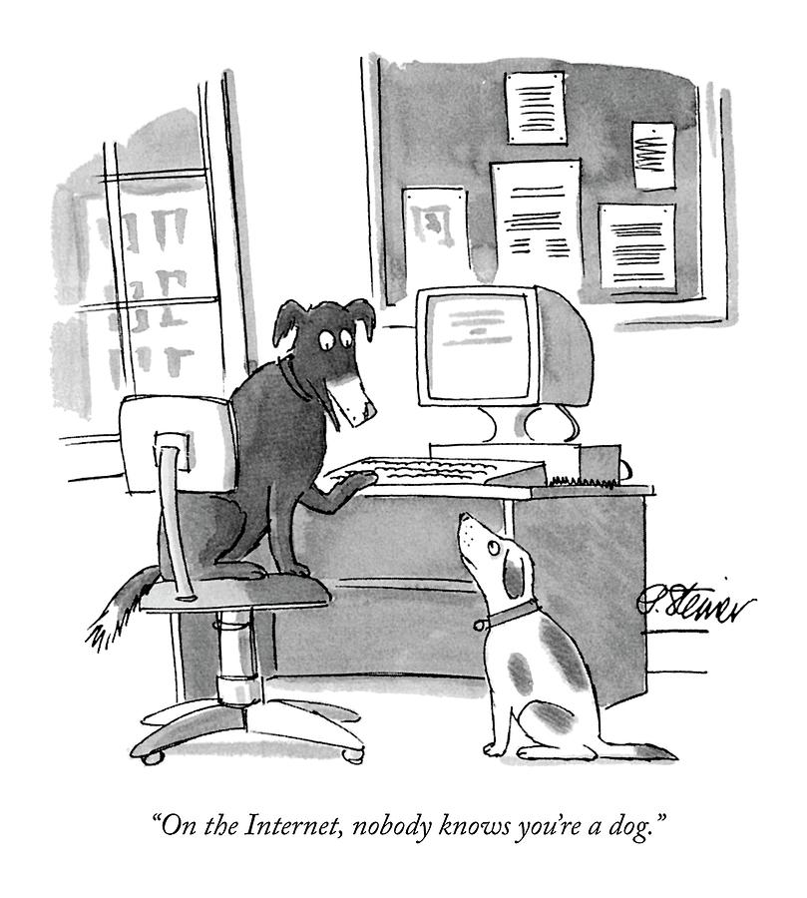
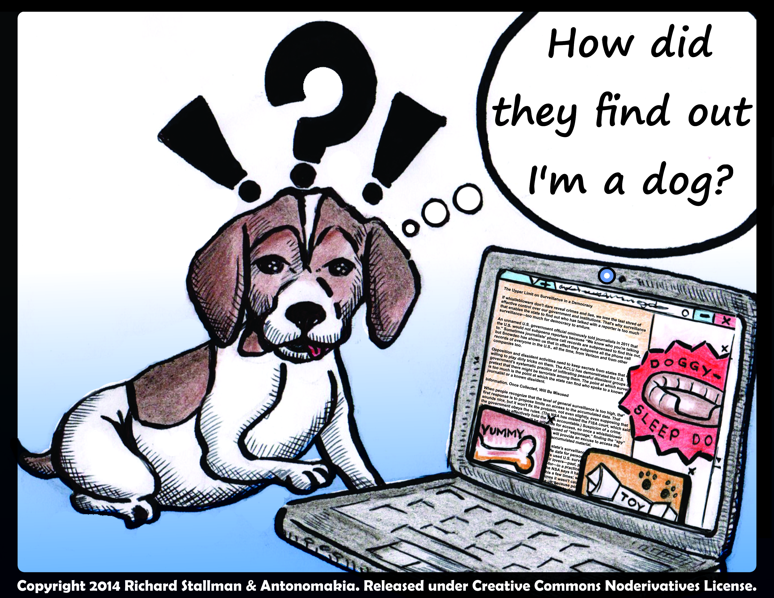
Notes:
Comments can be valuable. They can illuminate, explain, add context, provide counterpoints, and start conversations. They can also extinguish ideas, prevent context, stop conversations, and in the worst cases hurt and destroy.
The medium may change, but people do not. The question instead is whether the outliers, the trolls and the flamers, will hold outsized influence—and the answer seems to be that, even protected by the shade of anonymity, a dog will often make himself known with a stray, accidental bark. Then, hopefully, he will be treated accordingly.
The commentariat can sometimes amplify that bark. We have to weigh that.
When are comments good?
Take away comments entirely, and you take away some of that shared reality, (that important connection and the currency of the internet) which is why we often want to share or comment in the first place. We want to believe that others will read and react to our ideas.
KEEP THE COMMENTS IN, AND THE READERSHIP CAN SPOT THE DOG AT THE OTHER OF THE END OF THE KEYBOARD, AND PUT HIM DOWN.
BUT – AT WHAT COST?

Slide 16
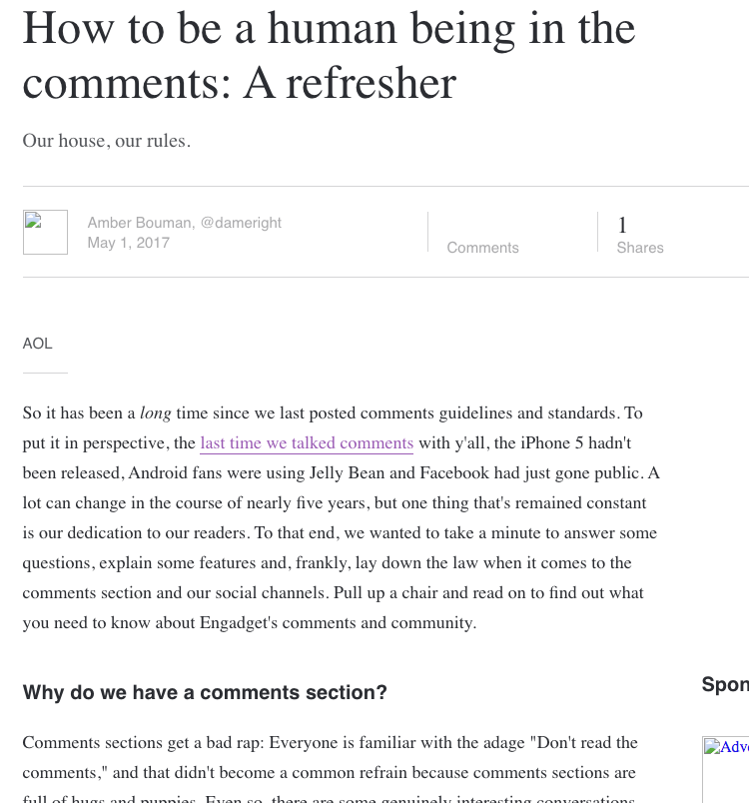
Examples of Comments Guidelines
“…we were seeing an inordinate amount of hate, abuse, misogyny and threats in the comments under our stories. Our story subjects were attacked. Other commenters were attacked. Our journalists were attacked. Misinformation and disinformation were rife.”
CBC turns off FB comments
Engadget
The Guardian.com
The Tyee
CBC (Indigenous Comments)
CBC Content Guidelines
NPR
The Washington post
“In 2015, CBC made the difficult decision to close comment threads on most Indigenous-related stories. We noticed that these stories draw a disproportionate number of comments that cross the line and violate our guidelines.”
Notes:
NPR removed comments in 2016 and pushed listeners to FB, blogs NPR HAS AN ETHICS HANDBOOK THAT NOW INCLUDES A SPECIAL SECTION ON SOCIAL MEDIA.
The Guardian : “… henceforth … would only have comments open if a moderated, positive debate were deemed possible – one without racism, abuse of vulnerable subjects, author abuse or trolling.”
CBC will turn off comments if the topic has a high probability of attracting trolls and/or harmful contributions.
In 2019 the cbc turned off comments on a story about Colten Boushie and the acquittal of Gerard Stanley
CBC editorial staff select when and where our audience members can engage in conversation on all our community spaces. Online, we consider many things before deciding whether to open comments or not, including the type of moderation needed and the resources required to moderate, as well as legal issues (i.e. publication bans), etc.
CBC: We will open comments for call-outs to ask specific questions of the audience in order to help us cover stories and issues more comprehensively, and on a few pages that have small but healthy commenting communities. But otherwise, they will remain closed.

Slide 17
The Argument For Blog Comments
“Without comments, a blog isn’t really a blog. To me, blogging is not just about publishing content, but also the two-way communication and community building aspects behind it.”
Source: Pat Flynn
Provide a form of social proof
Helps you understand what your readers want you to write about
Responding helps you to deepen your relationship with your readers
Commenting increases the likelihood that users will also engage in other ways, such as subscribing to your newsletter, or even making a purchase down the road.
Source: Pat Flynn

Slide 18
The Argument Against Blog Comments
“To say a blog is not a blog when it doesn’t have comments can’t be true, because my blog works just fine without comments. My ideas are definitely not perfect, but at a certain point I had to make a decision about where my focus would lie.
“Did I want hordes of Internet randoms deciding where my ideas needed to go, or did I want to proactively choose the opinions that would influence my ideas?”
Source: Everett Bogue

Slide 19
What does the data say?
Blog comments are not correlated with increased traffic. Hubspot
Comments section brought in 16% of all search traffic Neil Patel
Bottom Line - Comments are Nice to Have, Not a Necessity Opinionmonster
Notes:
Do comments lead to more traffic?
Do comments generate more search traffic (more content = increase in keywords)?

Slide 20
SOME THINGS TO CONSIDER ABOUT YOUR OWN SITE’S GUIDELINES
Are they allowed?
Is there a policy?
Moderated?
Anonymous?
Repercussions?
Suggestions?
Anonymous?

Slide 21
CALL OUT CULTURE: AFTER THE COMMENTS FADE
Jon Ronson When online shaming spirals out of control

