Slide 1

Pub 101 – Week Nine
March 14, 2023
Monetization

Slide 2

On the Menu
Check-in
  Activity
This week in Socials
Feedback
Guest speaker – Trevor Battye

Slide 3

Just for fun…
Kahoot!

Slide 4
Feedback
“Many required readings are skipped over (especially in terms of Indigenous specific content-copyright would have been an interesting discussion topic!)”
The worst thing about the course?
We have to pay for the website domains haha.
I was not expecting such a huge focus on AI. I won't go on a rant but it's pretty disappointing for a publishing class to be so in favour of it.
What is the best thing about the class?
The amazing term long project of creating a website.
The open-minded flowing of ideas
Being able to build a website that represents something about yourself.
What should we continue doing?
Keep the conversational learning model
Continue giving students space to talk and share opinions!
What should we stop doing?
The focus on what celebrities

Slide 5
Content Marketing/Editorial/Advertising
Content Marketing
Can be sponsored (the brand creates the content) or it can be created in-house (staff write profiles or content about the brand).
Editorial
Content that is considered news, information, reportage. Unbiased, uninfluenced by financial or reward incentive.
Advertising
Purchased space (visual, audio, text) to promote a brand

Slide 6
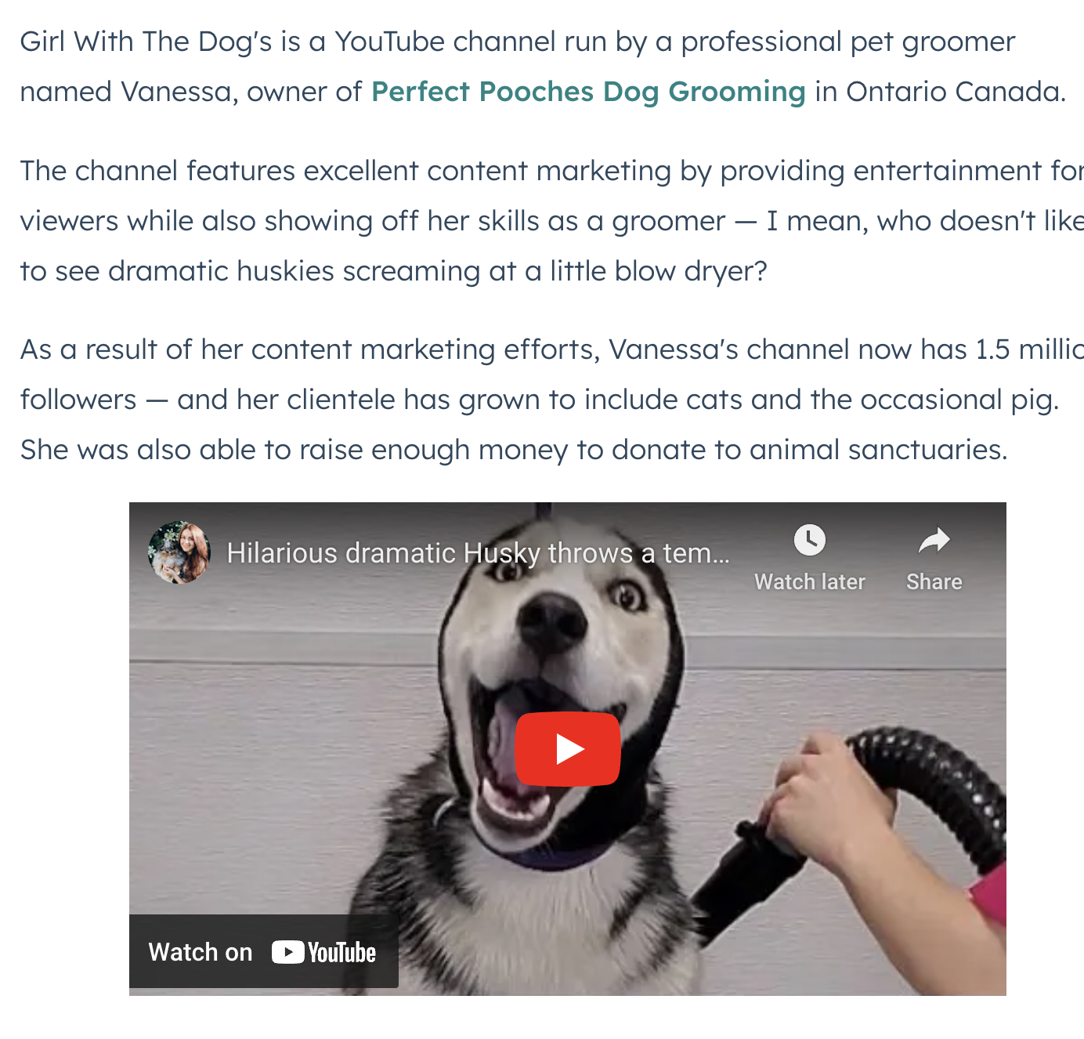
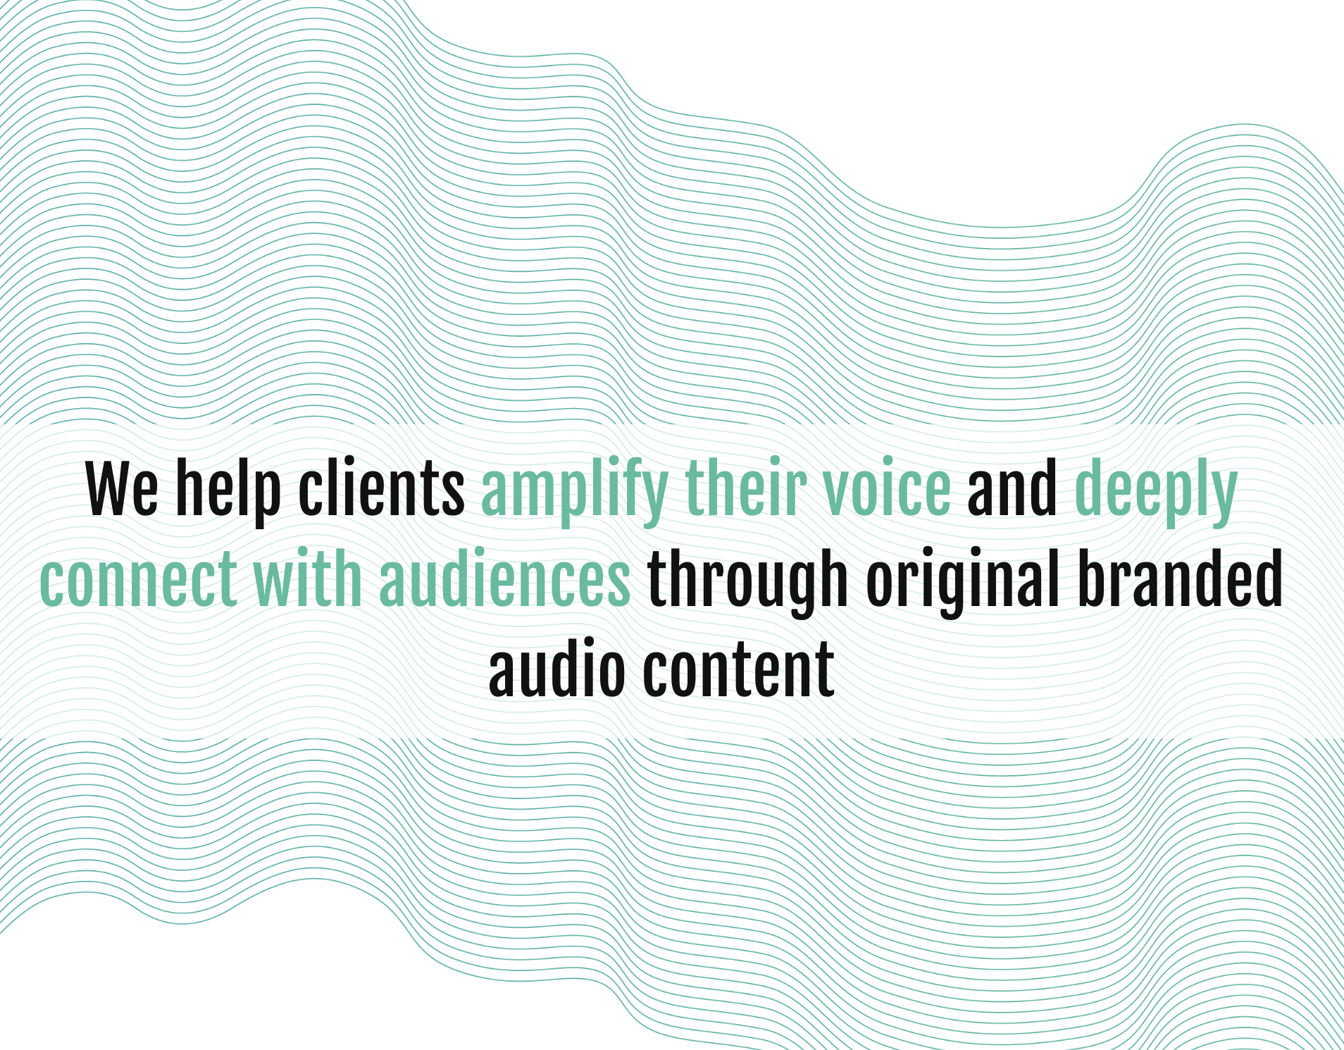
Content Marketing
Also called sponsored content, native advertising, paid editorial
Is storytelling by brands - building community and loyalty
Can be unrelated editorial paid for by a brand (Pacific Content)

Slide 7
Editorial
Is free of strings
  No incentives to write about a topic
  No payment involved
Earns your reputation and trustworthiness
Is clearly separated from other types of content
Withstands scrutiny
Is time-consuming, can be expensive, resource heavy
Is what builds your credibility and contributes to your growth

Slide 8
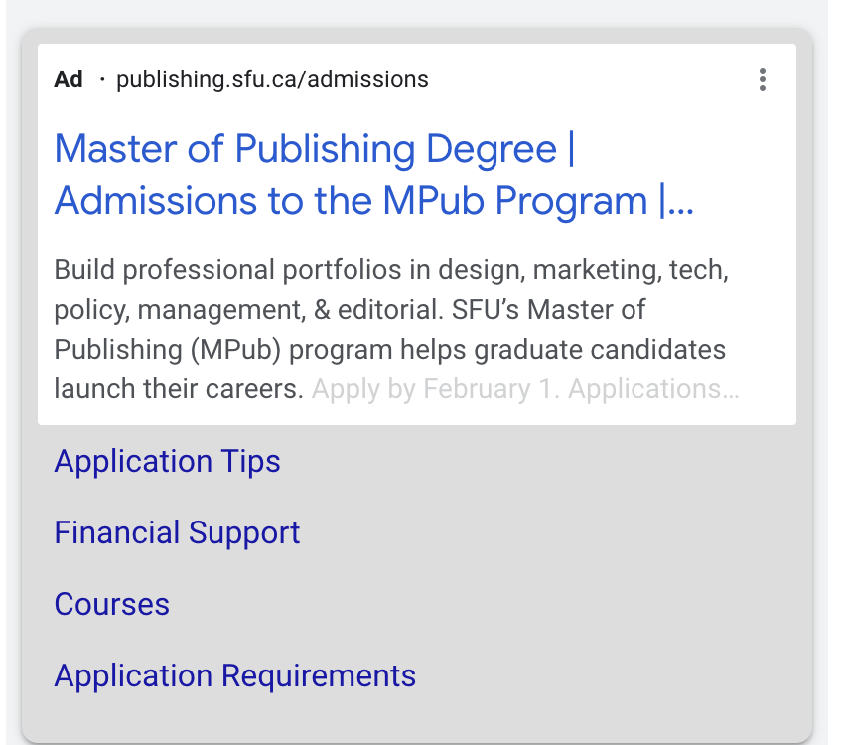
Advertising - typical
Is transactional: an advertiser buys space and the ad is shown.
Can be “display” – appears in set places in a publication.
Can be embedded in content but is clearly defined.
There should be no confusion as to what an advertisement looks like.

Slide 9
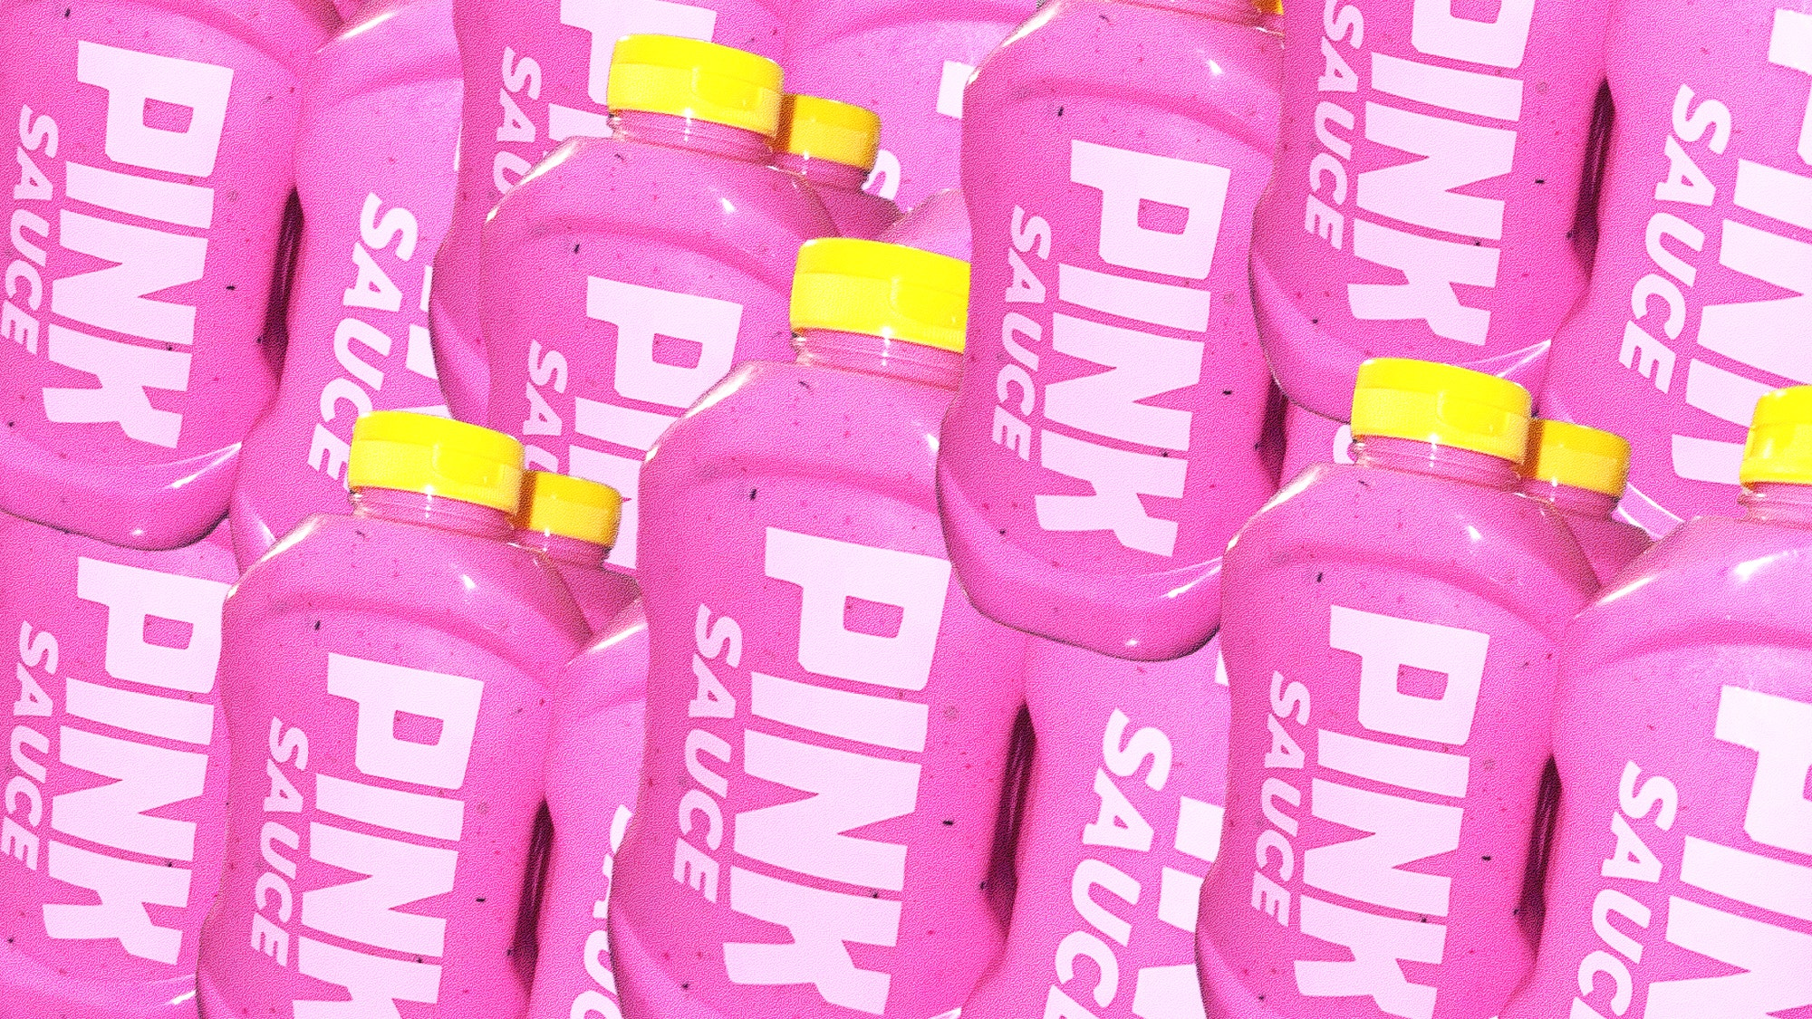
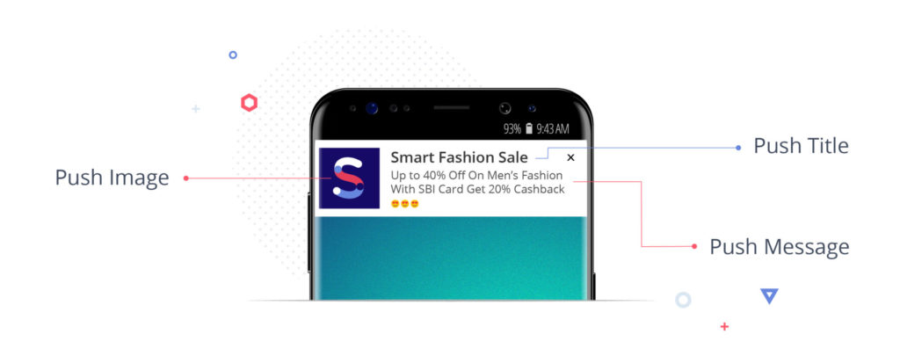
Blurring Lines
Pull
Pull customers to the product - SEO
Dollar Shave Club
Blurred lines
What is editorial and what is advertising?
Ads above the fold
Authority and editorial independence – the fine balance
Demise of traditional media
Push
Push ads are opted in from websites
Resemble ordinary push notifications
Bring you back to websites
Uses content marketing; converts

Slide 10
Important to be aware:
All sponsored content must be labelled clearly as such.
Advertising must be set in a different typeface (maybe font).
Content must be agreed to upfront: how much negativity can there be in the piece, length, images etc.
Be aware of audience response and be prepared to handle it.
How much of your site will you allocate to ads, affiliates, and sponsored content?

Slide 11


Slide 12
Activity…
In groups of three or four
You’ve been given an incredible opportunity to promote your brand. You can use two social platforms to create a guerilla marketing campaign.
Choose a space: sports, service, lifestyle, personal, food, politics…
Decide whether you will use editorial, advertising, or sponsored content
Write a paragraph describing your brand
List three tactics in your marketing strategy

