Slide 1
Week Three January 24, 2023
The Self Online

Slide 2
Today’s Menu
Check-in
News from the week
The Self Online
Break
Student Presentation Updates
Personal cyberinfrastructures review
Pair and Share

Slide 3
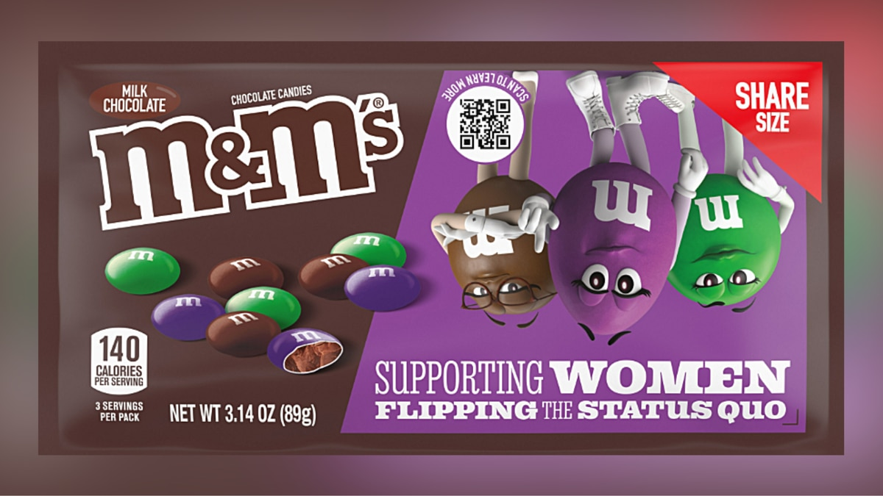
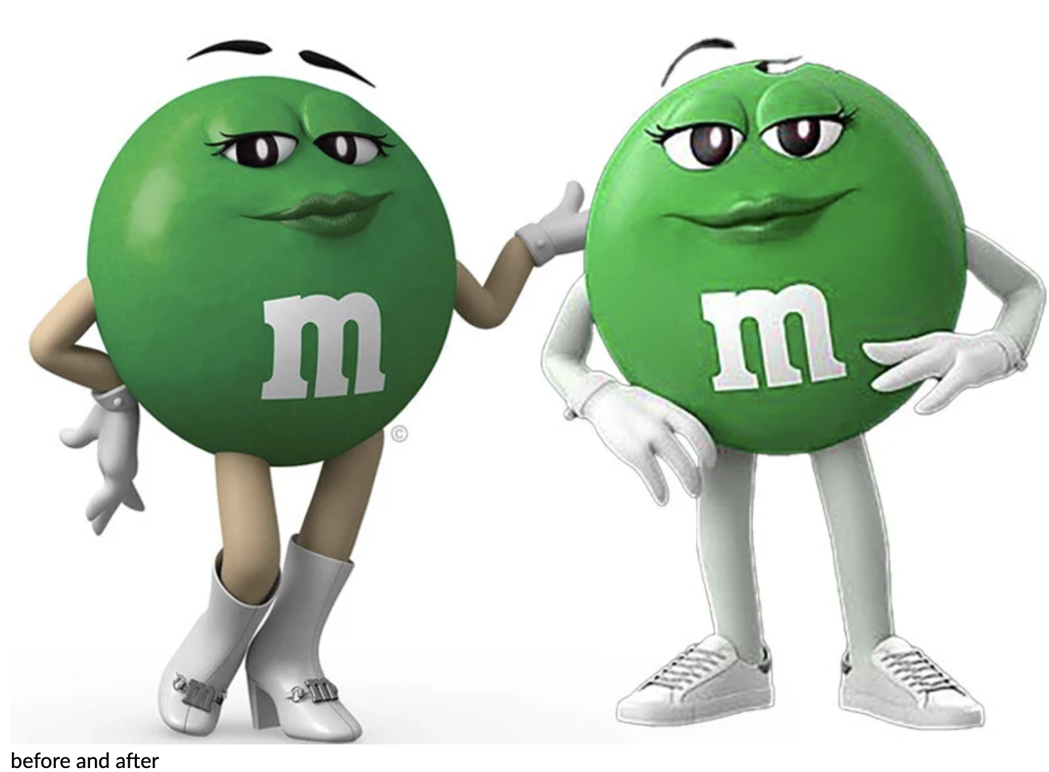
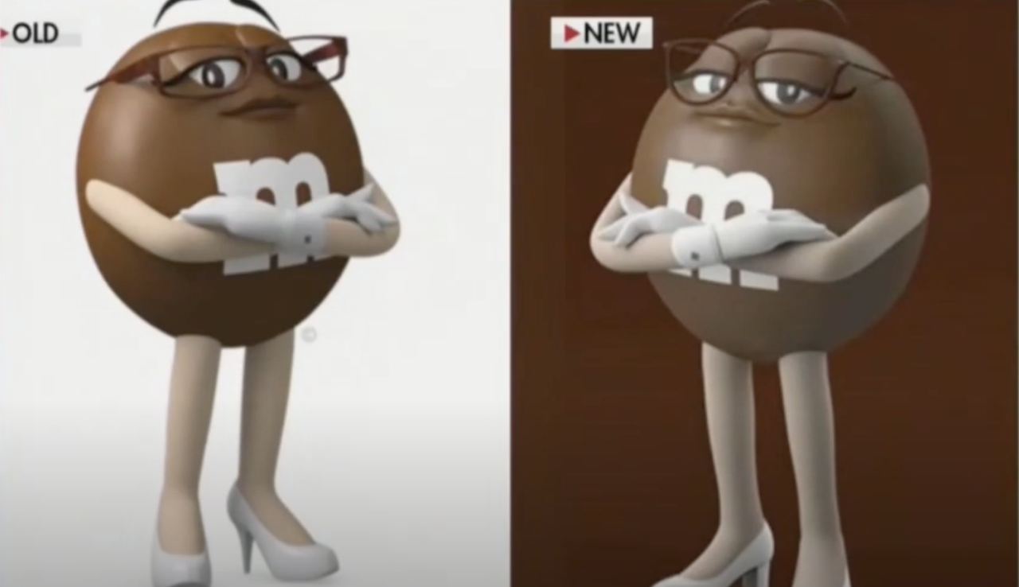
The tale of the candies
2023
2022
And Alpha Male
2023
Notes:
Tucker Carlson went oof, blew over. Alpha male tweeted when Mars did a women only
Yesterday Mars announced Maya Rudolf to be the “Chief of Fun”
In January 2022 changed to promote inclusivity. Green M&M, a female character, switching to sneakers from high-heeled boots as part of the 2022 changes. Recently, in early January 2023, M&M’s released new packaging that featured all female characters for the first time.
More recently, Carlson, warning that “woke M&M’s have returned, targeted the introduction of a purple M&M character as “obese” and lamented the way the brand returned the boots to the green M&M’s. “Apparently is now a lesbian maybe?” M&M’s had launched a campaign earlier this month “supporting women flipping the status quo,” with packaging featuring the spokescandies.
The brand issued a statement on Monday, saying, “America, let’s talk. In the last year, we’ve made some changes to our beloved spokescandies. We weren’t sure if anyone would even notice. And we definitely didn’t think it would break the internet. But now we got it — even a candy’s shoes can be polarizing. Which was the last thing M&M’s wanted since we’re all about bringing people together.”

Slide 4
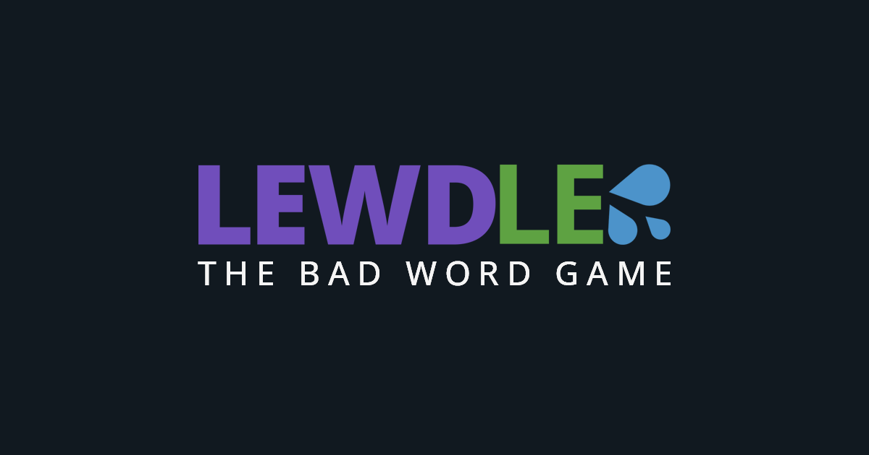
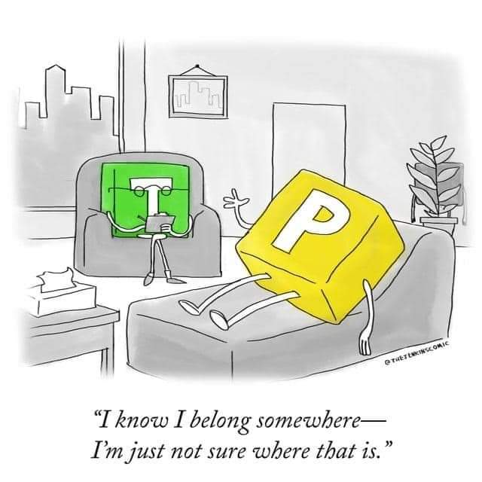
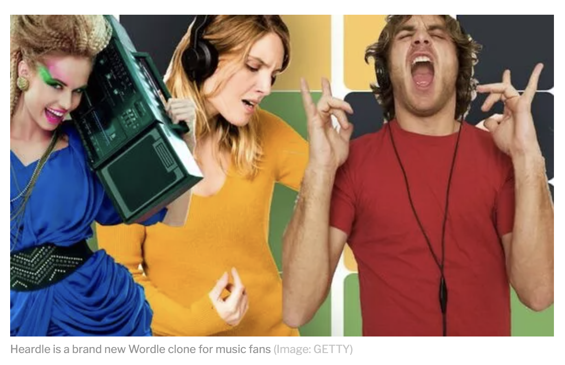
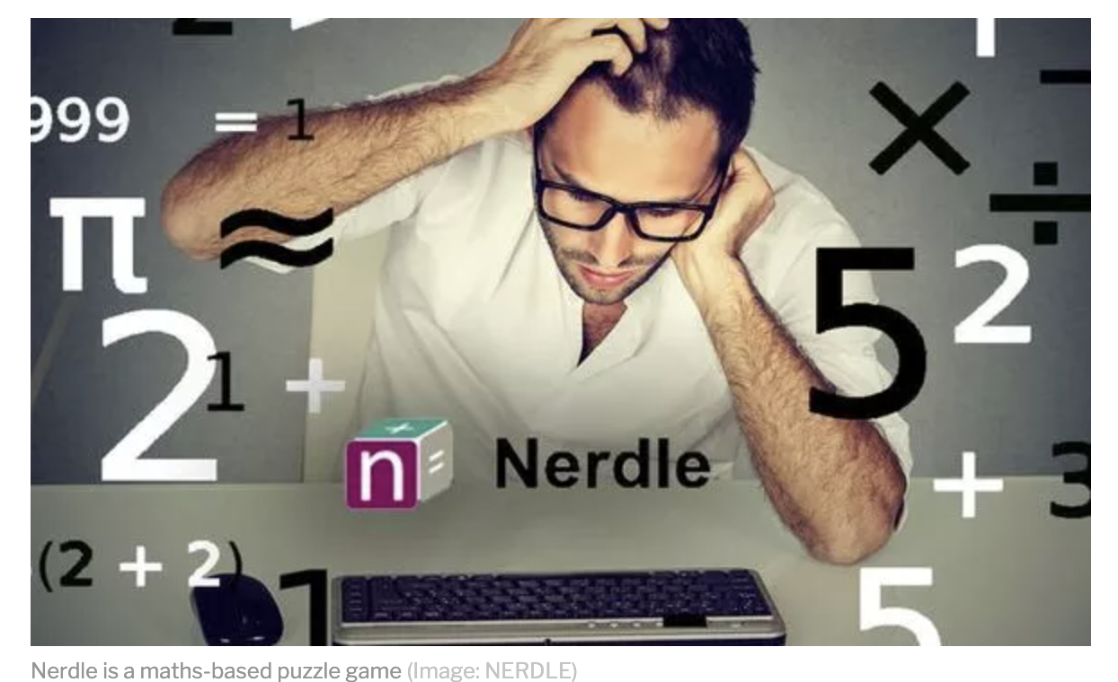
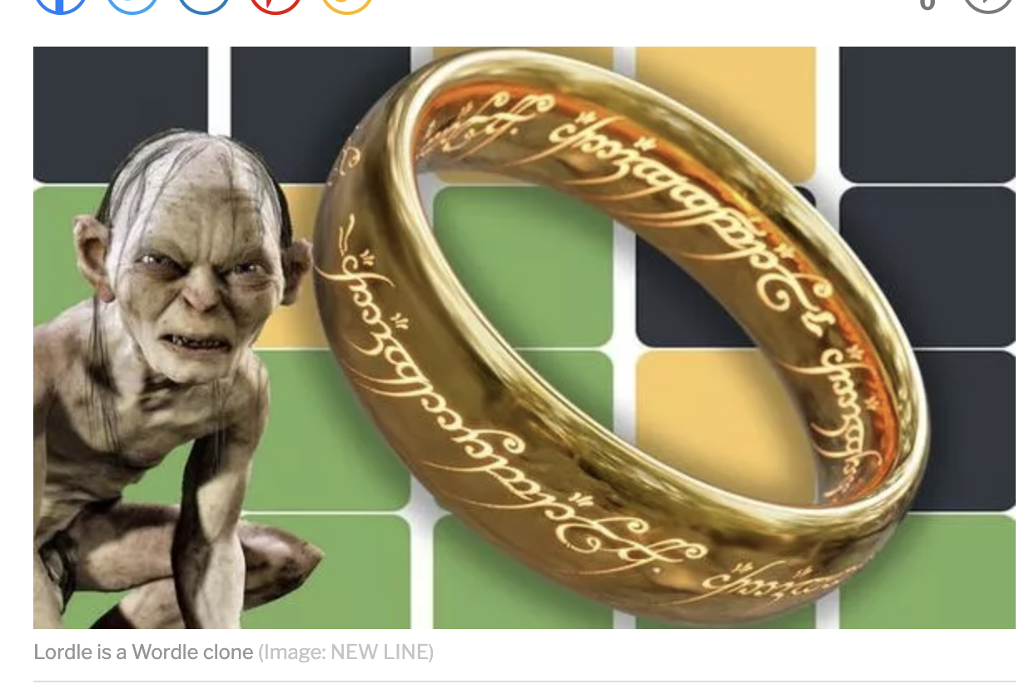
The World of Wordle
Notes:
Lordle of the Rings https://digitaltolkien.github.io/vue-wordle/. using Vue.js, an open source JavaScript framework.
https://github.com/yyx990803/vue-wordle. Make your own wordle
Lewdle https://www.lewdlegame.com/App
Nerdle https://nerdlegame.com/

Slide 5
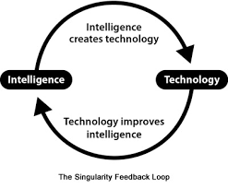
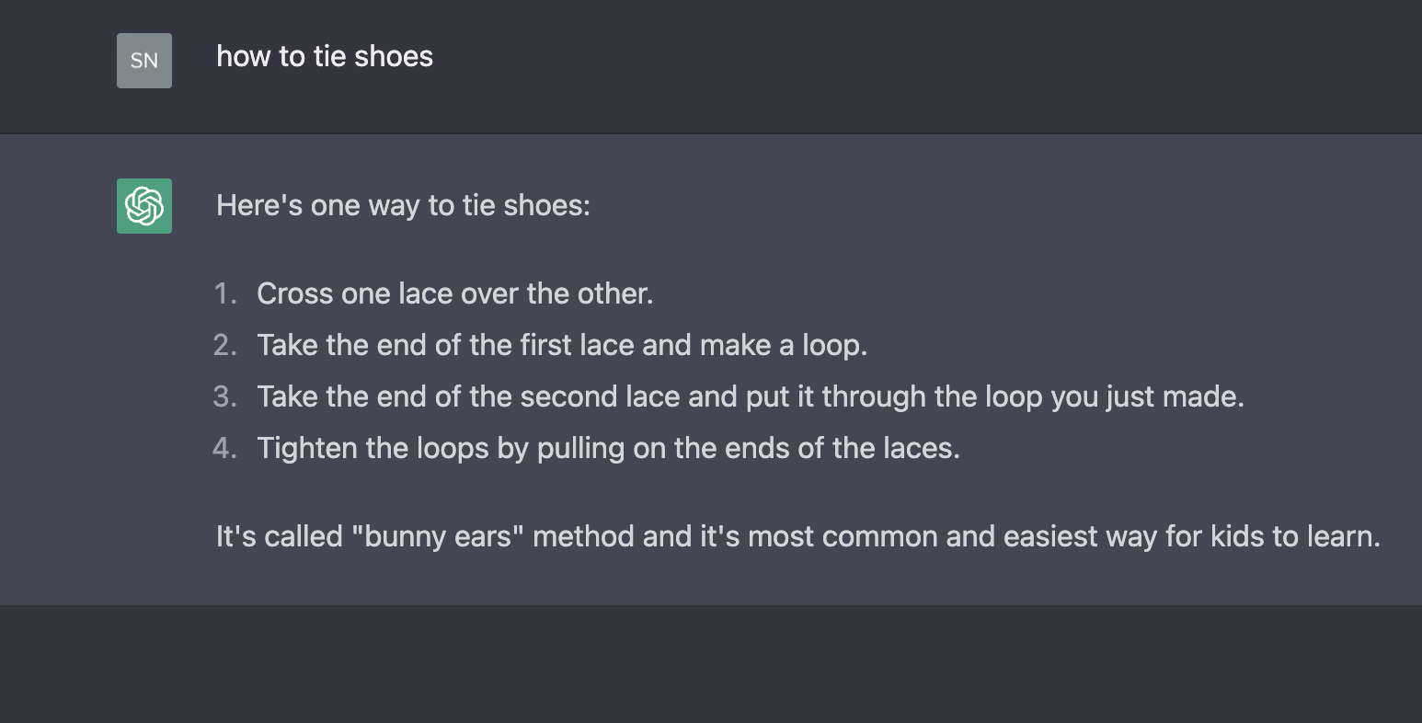
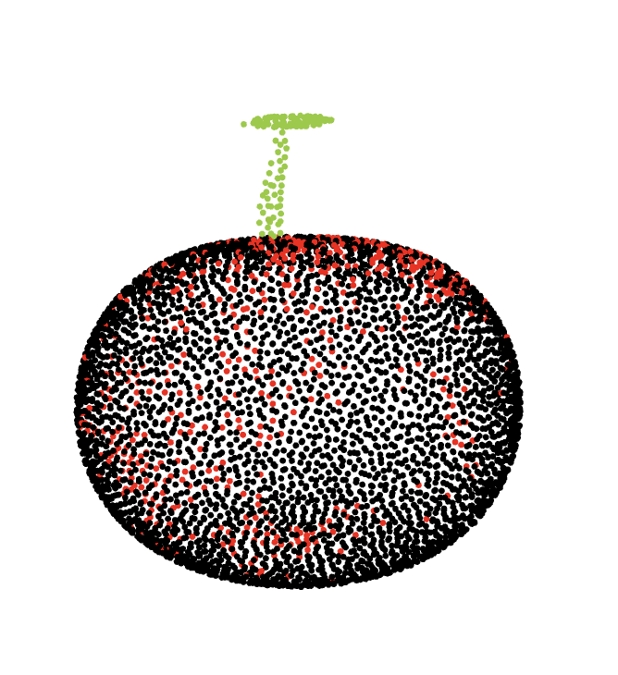
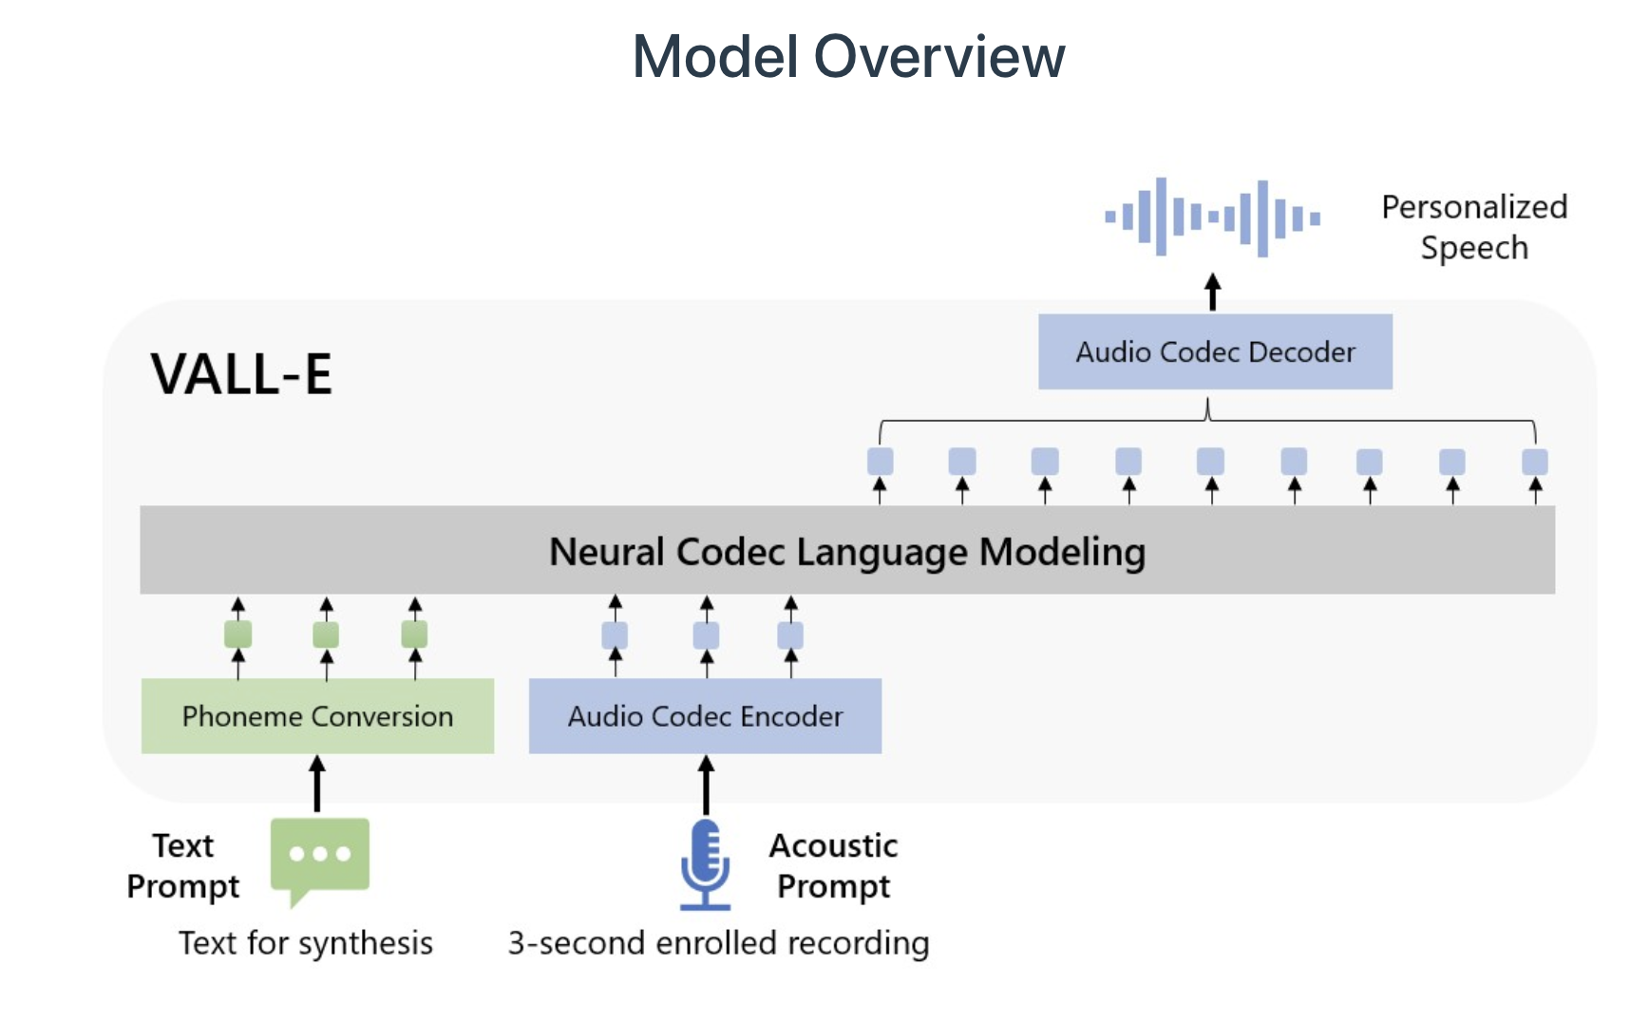
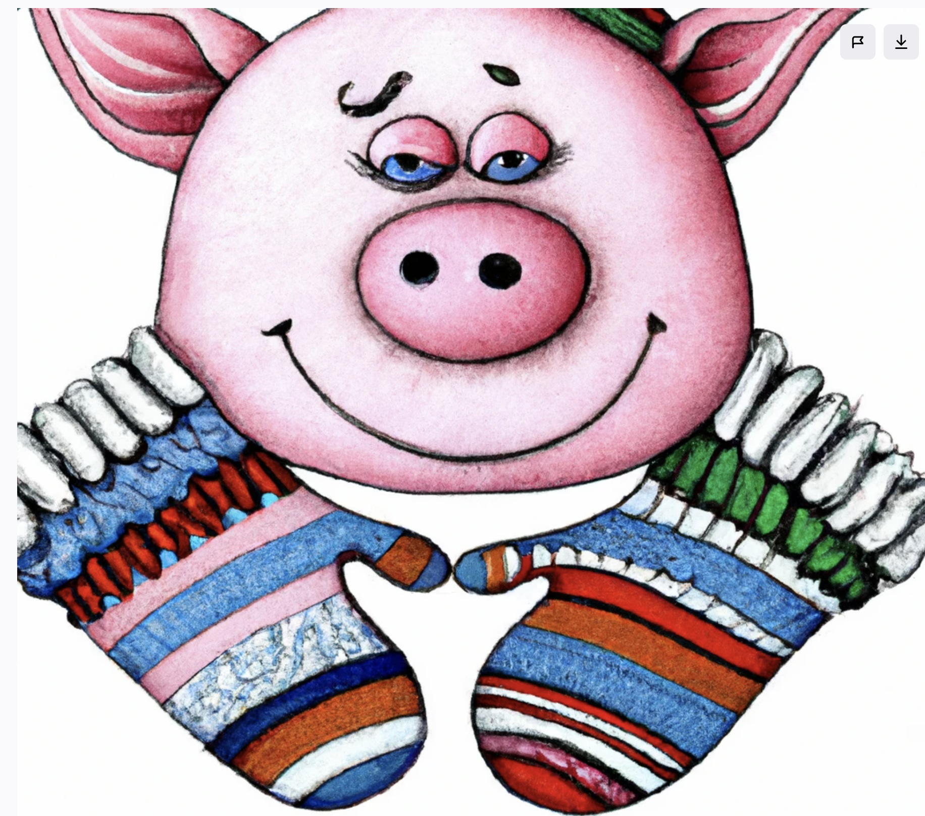
This Week in Socials
Singularity?
ChatGPT?
Point-E?
VALL-E?
DALL-E?
Notes:
it appears that YouTube plans to incorporate ads into Shorts, allowing creators to monetize their short-form content. This move also opens monetization opportunities to a wider group of YouTubers, including those with fewer than 1,000 subscribers and less than 4,000 hours of watch time (the current thresholds needed to qualify for monetization on normal YouTube videos).
This will allow creators to make money from ads that run between videos in the Shorts feed.
YouTube will add the revenue generated from ads in the Shorts feed and pay out a share to creators at the end of the month.
Singularity: Singularity is the notion that the exponential acceleration of technological development will lead to a situation where artificial intelligence supersedes human intelligence and will eventually escape our control.
NyQuil chicken appears to have originated on 4Chan in 2017 and earlier this year made the rounds in the news cycle.
When is it in the public interest to draw attention to the issue?

Slide 6
Go to menti.com and write the words this image brings to mind.

Slide 7
Personal Cyberinfrastructures Redux
What is a Personal Cyberinfrastructure?
Go to Menti.com and enter the codes 6692 5109

Slide 8
Personal Cyberinfrastructures redux
We know that personal cyberinfastructures are important… is it also important to mediate the type of presence you have online? Are we able to present ourselves however we want, or
are we being indirectly controlled by who we think may be watching our personal cyberinfastructures?
Notes:
such as potential employers, teachers, colleagues, parents, etc.?

Slide 10
What is the Self?
Who are you?
How would we know?
What is your “voice”?
Do you recognize it?
Would others recognize it?
What does the “publication of self” mean?
When we put things out into the world, when we write in public, who is it for?
Are you a different “self” in different contexts, environments, platforms?

Slide 11
BREAK

Slide 12
The Self Online
Overview of John Suler’s The Psychology of Cyberspace

Slide 14
Disinhibition Effect
Benign Disinhibition
Toxic Disinhibition
Notes:
Definitions of each? Examples?

Slide 15
Dissociative Anonymity
Notes:
Anonymity
Allows for contributions to an online world good or bad.
Can be helpful in countries with repressive regimes
Whistleblowers?
Truth?
Save a life
Doxxing
Revenge Porn
Swatting
Theft
Polarizing black and white – can question without the pile-on
Will create fake profiles

Slide 16
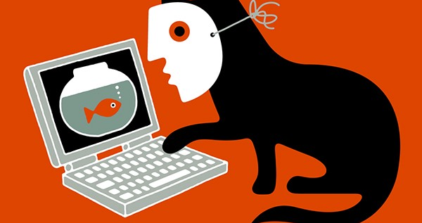
Dissociative Anonymity
You Don’t Know Me – or not my real name
They don't have to own their behavior by acknowledging it within the full context of who they "really" are. When acting out hostile feelings, the person doesn't have to take responsibility for those actions.”
Q: What are some examples?
Q: What are some pros and cons?
Notes:
when a message cannot be linked to a specific source (Scott, 2004).
Bloggers manage their degree of discursive anonymity through the use of identity management cues, or information identified on bloggers’ profiles that disclose a true offline identity (Viegas, 2005). For example, a person’s name, age, location, schools attended, and employer would be considered identity management cues.
Can create a sense of intimacy and connection with readers or listeners
The more ID cues provided the left personal info disclosed
Q: What are some examples?
Q: What are some pros and cons?
They don't have to own their behavior by acknowledging it within the full context of who they "really" are. When acting out hostile feelings, the person doesn't have to take responsibility for those actions.”

Slide 17
Invisibility
Notes:
Eye contact increases self-awareness, empathy and the awareness of other people’s reactions to what is being discussed
Parents say look me in the eyes
Both aggressors and victims are invisible. No opportunity to create boundaries
Masks in real life serve a similar purpose. Putting a name to someone.

Slide 18
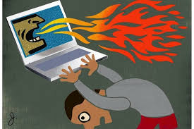
Invisibility
You Can’t See Me
Goes hand in hand with anonymity
No visual cues of body language
No worries about how you look
Built in opportunity to “avert your eyes”
Manti T’eo
Q: What are some examples?
Q: What are some pros and cons?

Slide 19
Asynchronicity
Notes:
Let me know when you get this and send me a text.
Allows you to cool down.
Creates a buffer
Gives you time to create an appropriate response

Slide 20
Asynchronicity
See You Later
No need to immediately respond
Disinhibiting
Emotional “hit and run”
Q: What are some examples?
Q: What are some pros and cons?

Slide 21
Solipsistic Introjection
Solipsism: Latin: solus – alone ipse – self Only the self exists or can be proven to exist; only the self or the self’s experiences matter
Introjection: incorporating another’s characteristics into your own psyche
Notes:
Pro – can help with empathy
Con – creates imaginary lack of boundaries; make assumptions of another’s actions or come to believe they are real. Texting or stranger interactions online we make assumptions and assign traits.
EX: When a person reads text communication i.e. a message, the message is relayed or spoken back, in the persons head. As the mind reads this message, a voice may be assigned to the other, and possibly an image, forming a character who may, in reality look and sound nothing like the character which they defined.
Gaming – assumptions about online teammates you have never met.

Slide 22
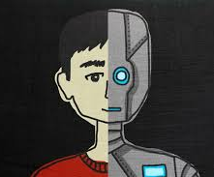
Solipsistic Introjection
‘People may feel that their mind has merged with the mind of the online companion. Reading another person’s message might be experienced as a voice within one’s head, as if that person’s psychological presence and influence have been assimilated or introjected into one’s psyche’ (Suler, 2004, 323)
Notes:
When receiving text messages or reading posts of one person to another, humans often perceive the reading as a voice in their head. We choose a voice of someone else that seems to have the same nature that fits with the message contain and use that voice. This behavior cause us to think that the conversation is taking place in just our heads, just like when we play out how a conversation might go. Because of these behaviors, we feel as if we are talking to ourselves, rather than conversing with another person.
Trolls are thought to be born from a combination of these traits
And one part of that is solipsistic introjection, which means you basically create a character of the other person in your mind. By only having their words to read, you can sort of hear their responses in an imagined voice in your head. They can almost become a game -- one that’s easy to turn off and walk away from. This could be especially relevant to griefers -- they’re just people playing a different kind of online game, one that’s more about a social experiment and messing with other players. And when it comes to trolling, a big part is the minimization of authority -- the lack of clearly defined authority figures online.
The student whose friend became more and more similar to his online personae off line

Slide 23
Solipsistic Introjection
It’s All in My Head
No face-to-face cues
The online companion becomes part of the person’s mind – “as if inserted or introjected into one’s psyche”
We impose our own ideas of their voice and image: almost a character we have created
Allows fantasies to be played out in the mind (stalkers)
In the imagination we can say and do whatever we want to, and this can be interwoven with our online lives
Interactions with this introjected character feel more imaginary. We also may treat a virtual companion as ourselves, which can lead to greater disinhibition
Q: What are some examples?
Q: What are some pros and cons?
Notes:
The student whose friend became more and more similar to his online personae off line
So, the other person can become dehumanized. As a result, there’s a disconnect between the real conversation you’re having and your constructed version of the other person. This then can lead to dissociative imagination, where online interactions are seen more as a fantasy than a reality.

Slide 24
Dissociative Imagination
Notes:
Come to believe there are no real people or situations that can actually be damaged. May start as fun or airing issues, slowly becomes toxic. Must do more for the same reaction.
Online reaction youtubers
No police
No threat to our physical selves
Can engage in conversations with people we would not likely meet in the real world/
Kelly Au-Coin liked my comment. Chris Kluwe came to my class.
John Cusack replied to me
Also no rules or guidelines

Slide 25
Dissociative Imagination - It’s Just a Game
Combining solipsistic introjection with the escapability of the online world magnifies disinhibition
Not the real world; not real people
They split or dissociate online fiction with offline fact
More likely to go places one might not in real life: porn sites, violent gaming, capper sites, sub reddits
Notes:
Online life is a game with rules and norms that do not apply to everyday living
Is there a difference between ”just trolling “ and actual beliefs and actions?

Slide 26
Dissociative Imagination
Online life is a game with rules and norms that do not apply to everyday living
Is there a difference between ”just trolling “ and actual beliefs and actions?
Q: What are some examples?
Q: What are some pros and cons?
Unmasking Reddit's Violentacrez, The Biggest Troll on the Web
Notes:
So, the other person has become dehumanized. As a result, there’s a disconnect between the real conversation you’re having and your constructed version of the other person. This then can lead to dissociative imagination, where online interactions are seen more as a fantasy than a reality. They can almost become a game -- one that’s easy to turn off and walk away from. This could be especially relevant to griefers -- they’re just people playing a different kind of online game, one that’s more about a social experiment and messing with other players. And when it comes to trolling, a big part is the minimization of authority -- the lack of clearly defined authority figures online.
Case study of trolls. What brought her to the point of suicide in the first place Bleach posts
It was a game to people. Wrote on her Facebook page. Way beyond what were once called griefers in minecraft dropping TNT everywhere.
Amanda Todd – finally a conviction – delayed to Oct 11 – due to prosecutor having covid
A B.C. Supreme Court jury convicted Aydin Coban August 2022 of extortion, harassment, communication with a young person to commit a sexual offence and possession and distribution of child pornography.
Todd was 15 when she died by suicide in October 2012, not long after posting a video on YouTube that described her being tormented by an online harasser.
Before Coban was extradited, a Dutch court sentenced him to almost 11 years in prison for similar online offences following a trial in Amsterdam in 2017, where he was accused in the online abuse of 34 girls and five men.
That court heard Coban, who is in his mid-40s, pretended to be a boy or girl and persuaded his victims to perform sexual acts in front of a web camera, then posted the images online or blackmailed them by threatening to do so.

Slide 27
Minimizing Authority
We Are All Equals
There is no hierarchy

Slide 28
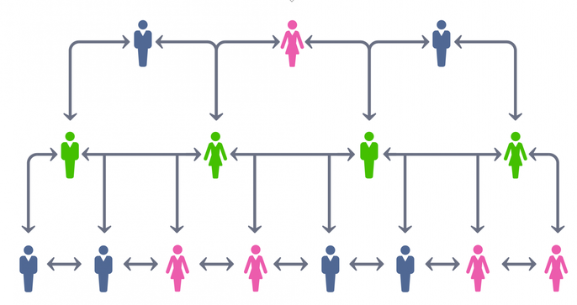
Minimizing Authority
The CEO and the company’s cleaner begin on a level playing field
Who’s going to make me? - no physical impact
Good writing, compelling ideas and technology know-how creates a peer-to-peer relationship
#metoo #timesup
Q: What are some examples?
Q: What are some pros and cons?
Notes:
Has this changed over the years? More cues that can point to the person’s identity. Twitter Detectives.

Slide 29
Personality Variables
We are all different
How we express ourselves in the physical world will often be magnified in an online world
People are also guarded, leery of who can see or know
This open and guarded self creates a disinhibition/inhibition polarity or Self Boundary: a sense of what is me and what is not me
The strength of underlying feelings, needs, and drive level has a big influence on how people behave.
Notes:
People with histrionic styles tend to be very open and emotional. Compulsive people are more restrained. The online disinhibition effect … [can] result in a small deviation from the person's baseline (offline) behavior, while in other cases causing dramatic changes.

Slide 30
“We allow the hidden self to surface because we no longer experience it as a purely inner self; but at the same time, we also sense, sometimes vaguely and sometimes distinctly, the intrusion of an unknown other into our private world, which results in suspicion, anxiety, and the need to defend our exposed and vulnerable intrapsychic territory.”

Slide 31
Pair and Share
Have any of Suler’s traits changed in any substantial way? Are there others you would add?
Freed of societal norms, restrictions and cultural restraints, is that personae “truer” than the spontaneous one we could meet at the bus stop?
Notes:
Each media allows for a particular expression of self that differs from other media
Twitter
Games
Facebook
Insta
What’s App
Texting
Discord
TikTok
Is there still an even playing field online? Who holds the balance of power? How? What can change this?

